Slide 1
Brain Imaging Sharing Initiative
Chao-Gan YAN, Ph.D.
严超赣
ycg.yan@gmail.com
http://rfmri.org
The R-fMRI Lab
International Big-Data Center for Depression Research
Institute of Psychology, Chinese Academy of Sciences

Slide 2
Brain Imaging Sharing Initiative (BISI)
1
Download with BISI
2
Share with BISI
2

Slide 3
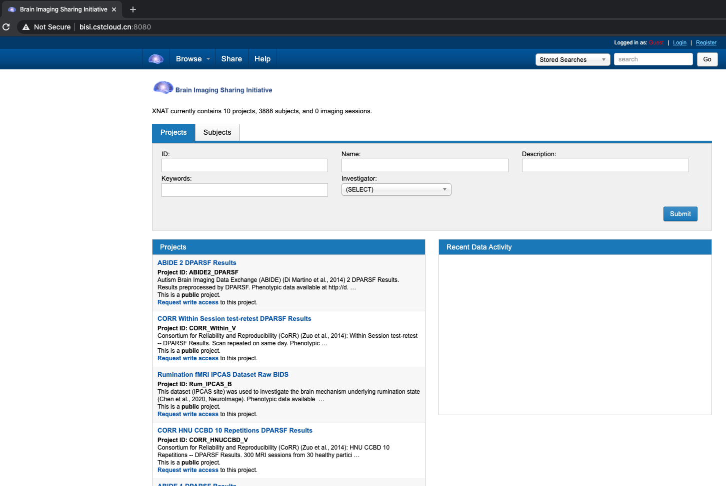
Download with BISI
3

Slide 4
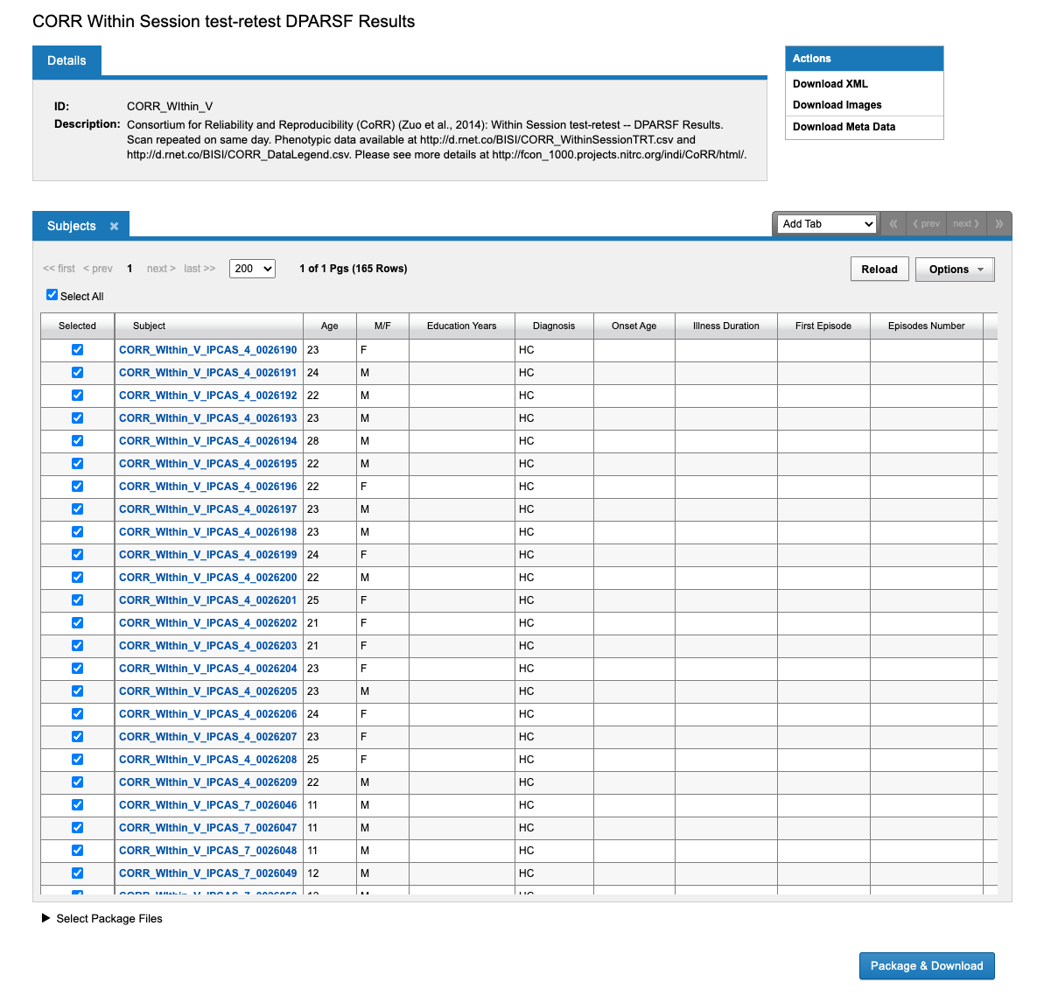
4

Slide 5
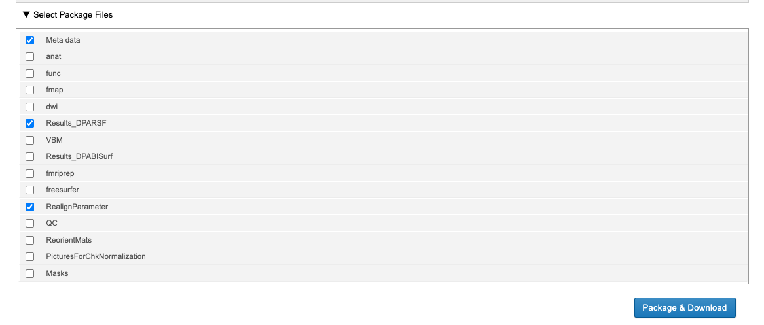
Download with BISI
5

Slide 6
Download with BISI
6

Slide 7
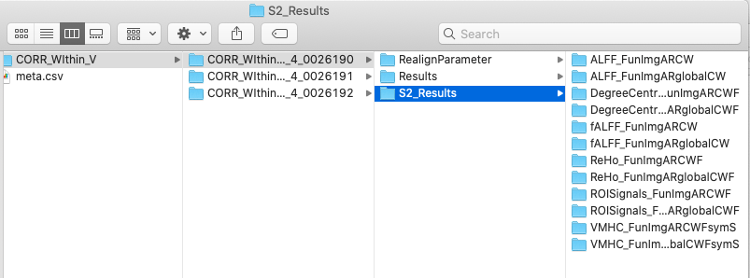
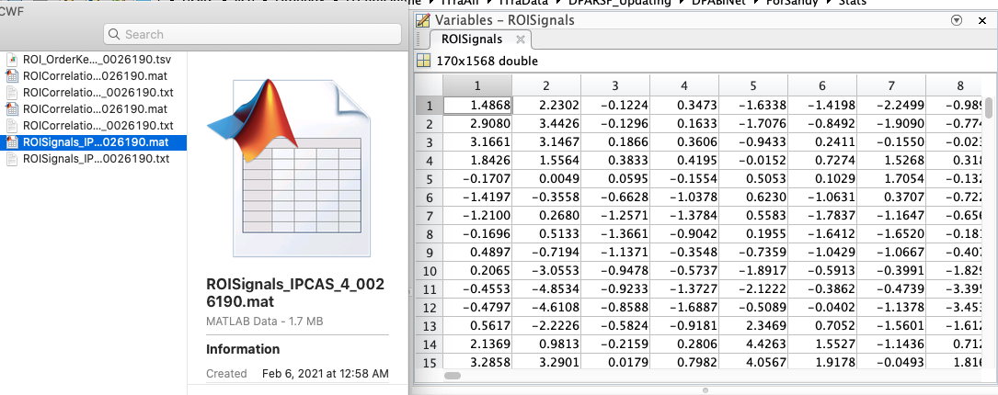
Download with BISI
7

Slide 8
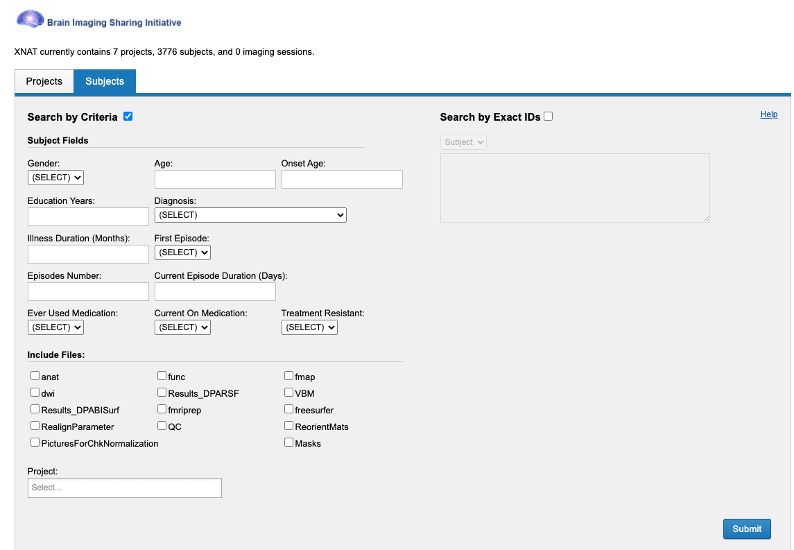
Search with BISI
8

Slide 9
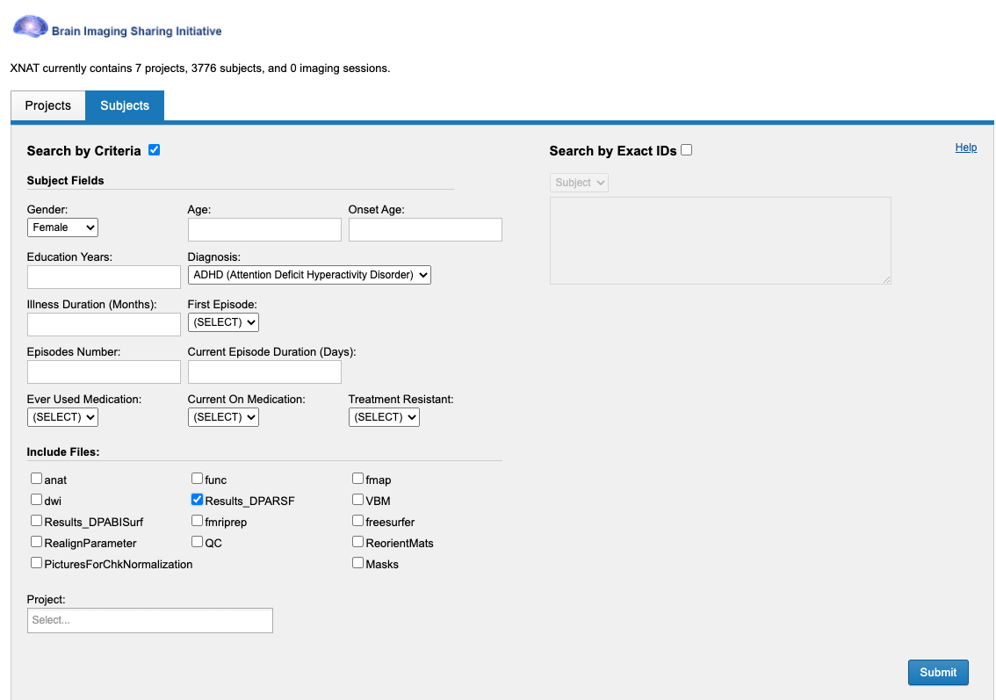
Search with BISI
9

Slide 10
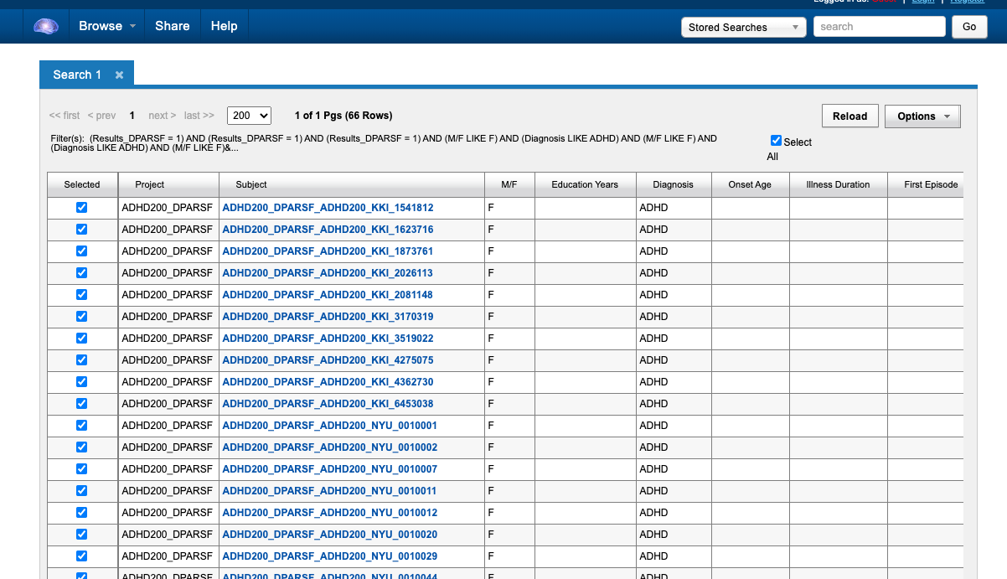
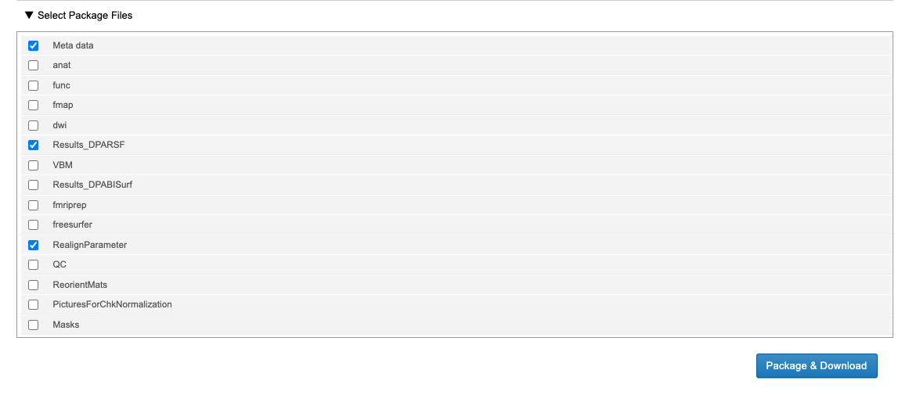
Search with BISI
10

Slide 11
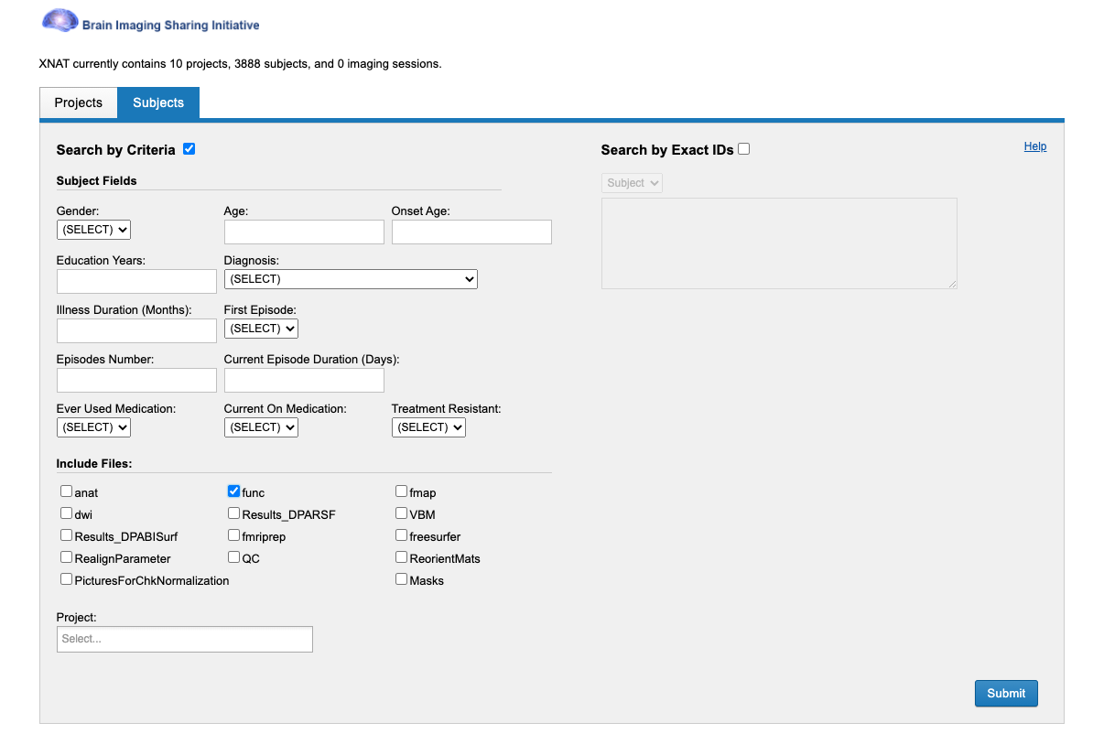
Search with BISI
11

Slide 12
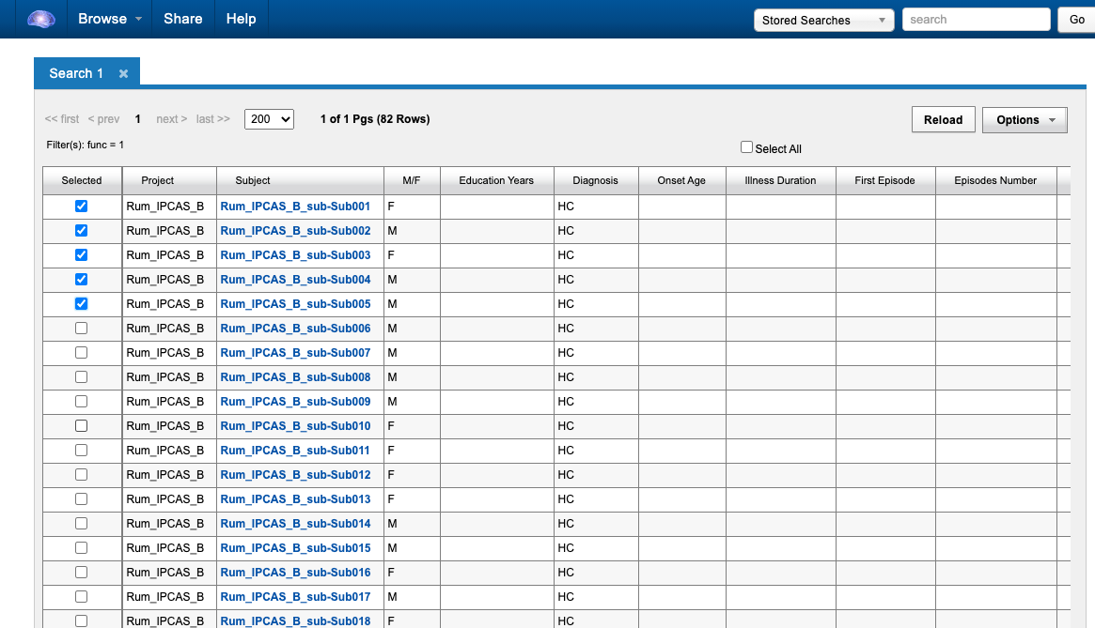
Search with BISI
12

Slide 13
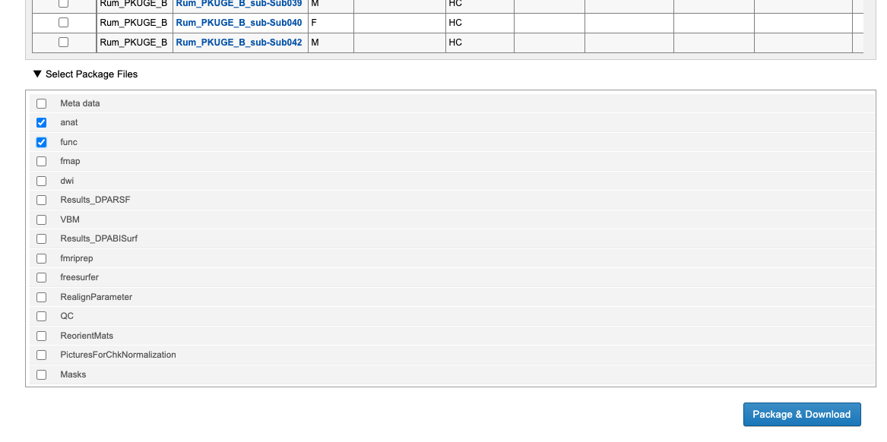
Search with BISI
13

Slide 14
Brain Imaging Sharing Initiative (BISI)
1
Download with BISI
2
Share with BISI
14

Slide 15
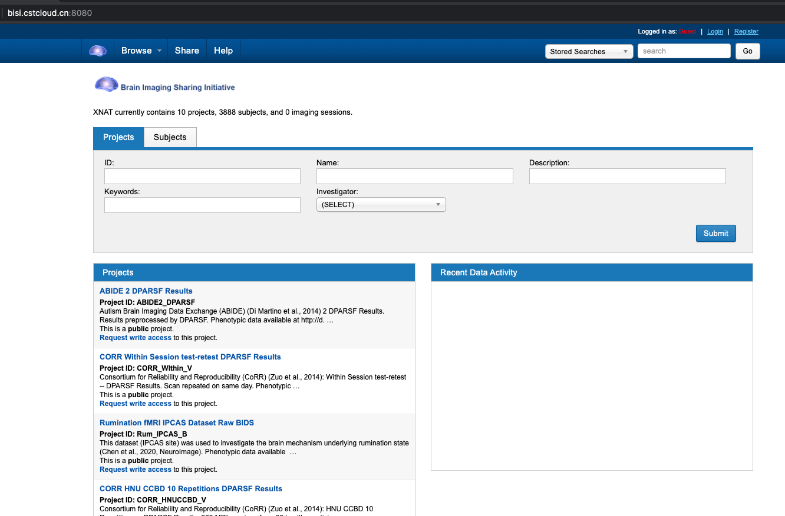
Share with BISI
15

Slide 16
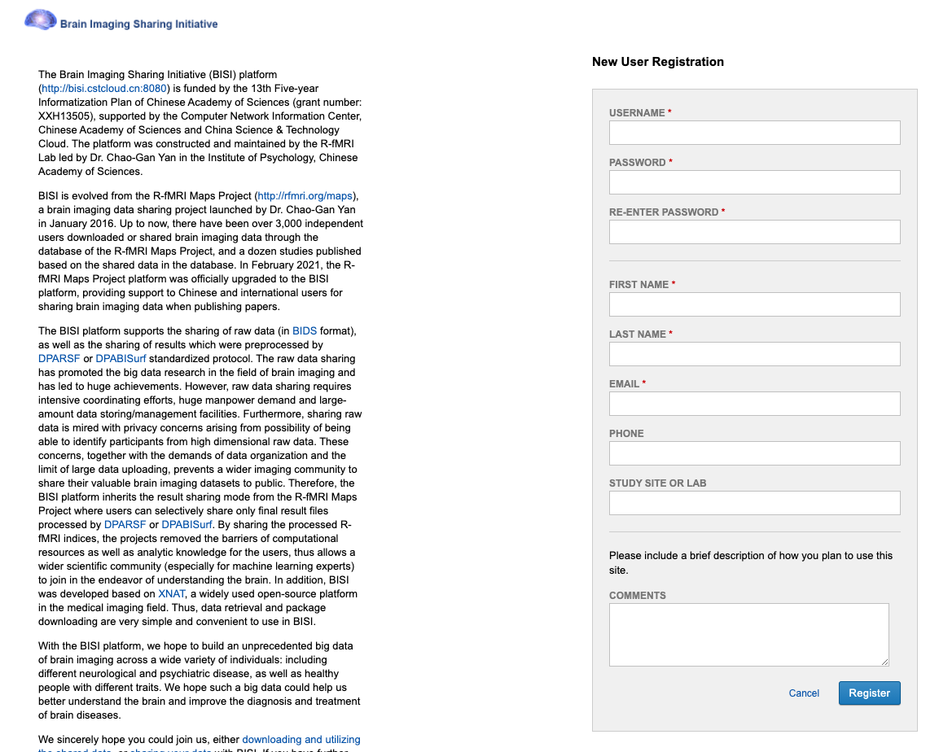
Share with BISI
16

Slide 17
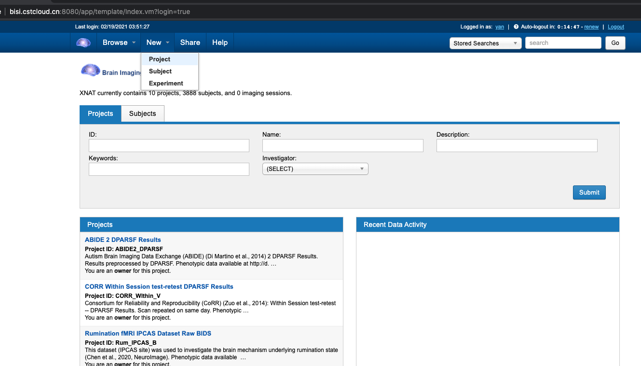
Share with BISI
17

Slide 18
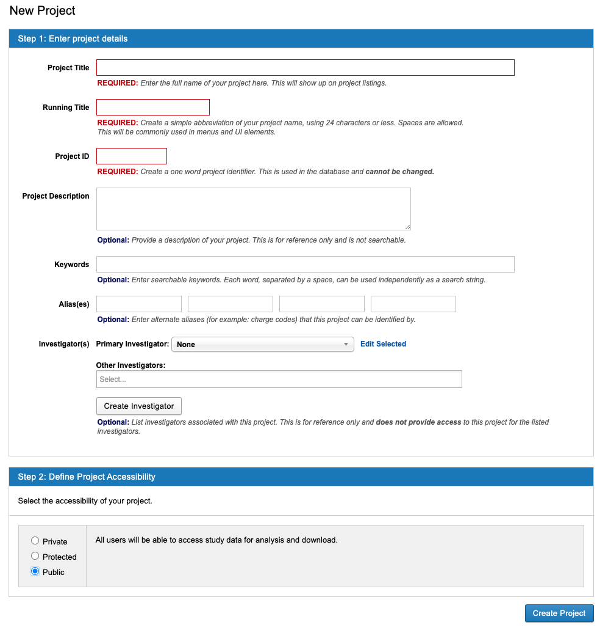
18

Slide 19
Organize Your Data
Raw Data (in BIDS format).
DPARSF Results.
DPABISurf Results.
19

Slide 20
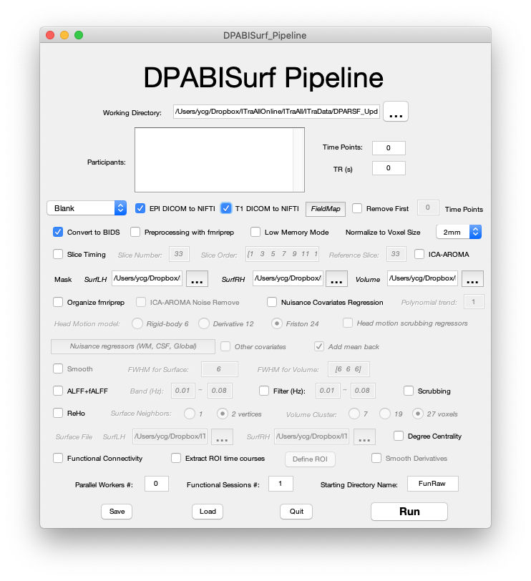
Organize Your Data (Raw Data)
20

Slide 21
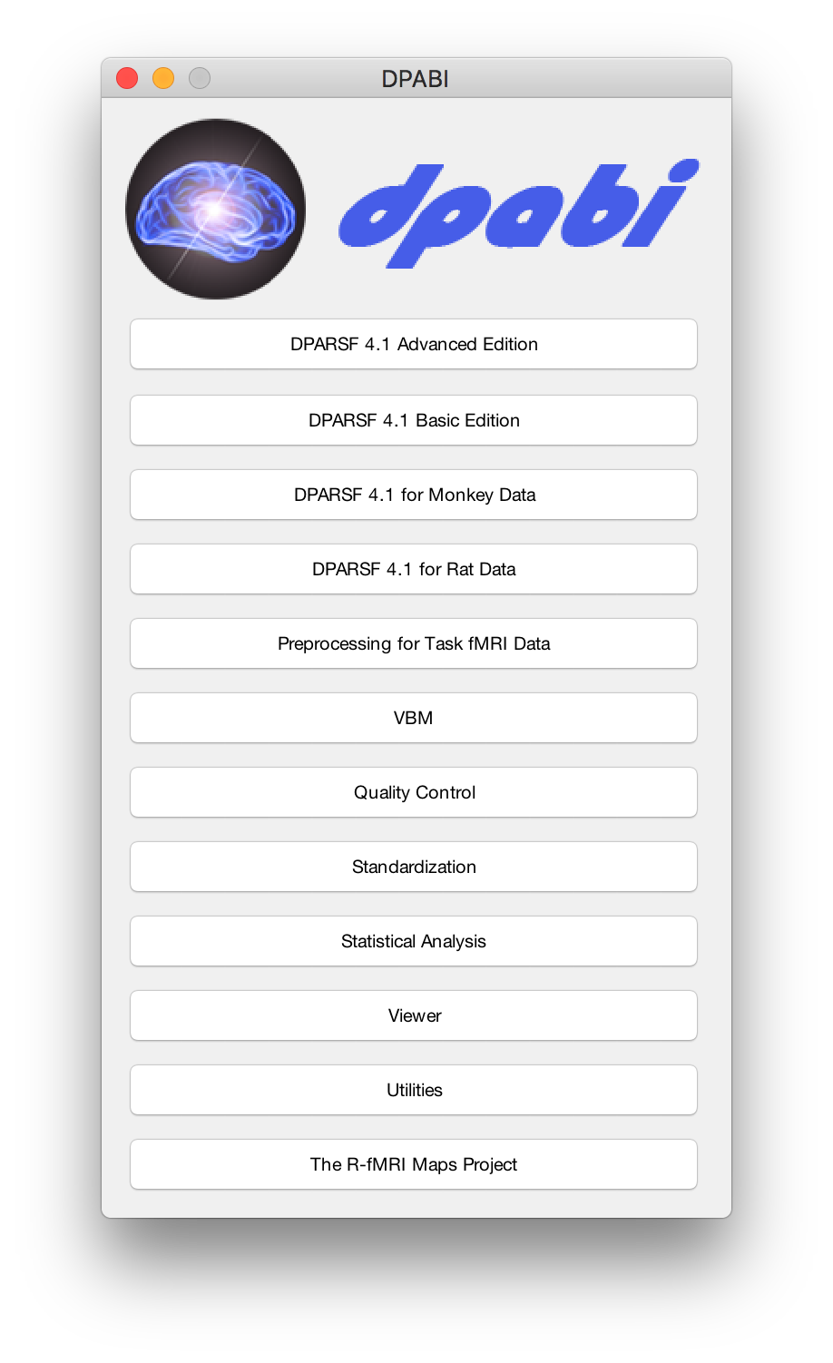
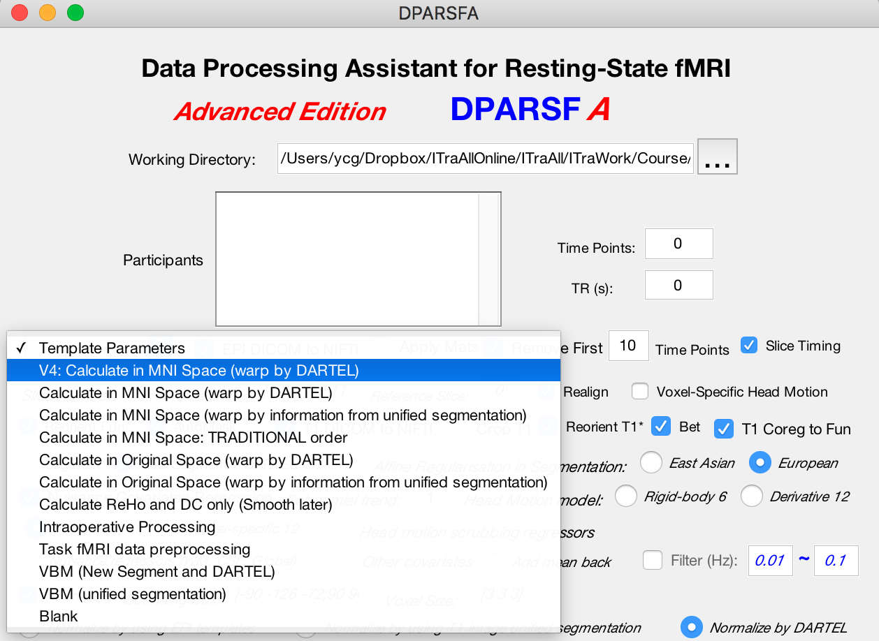
Organize Your Data (DPARSF Results)

Slide 22
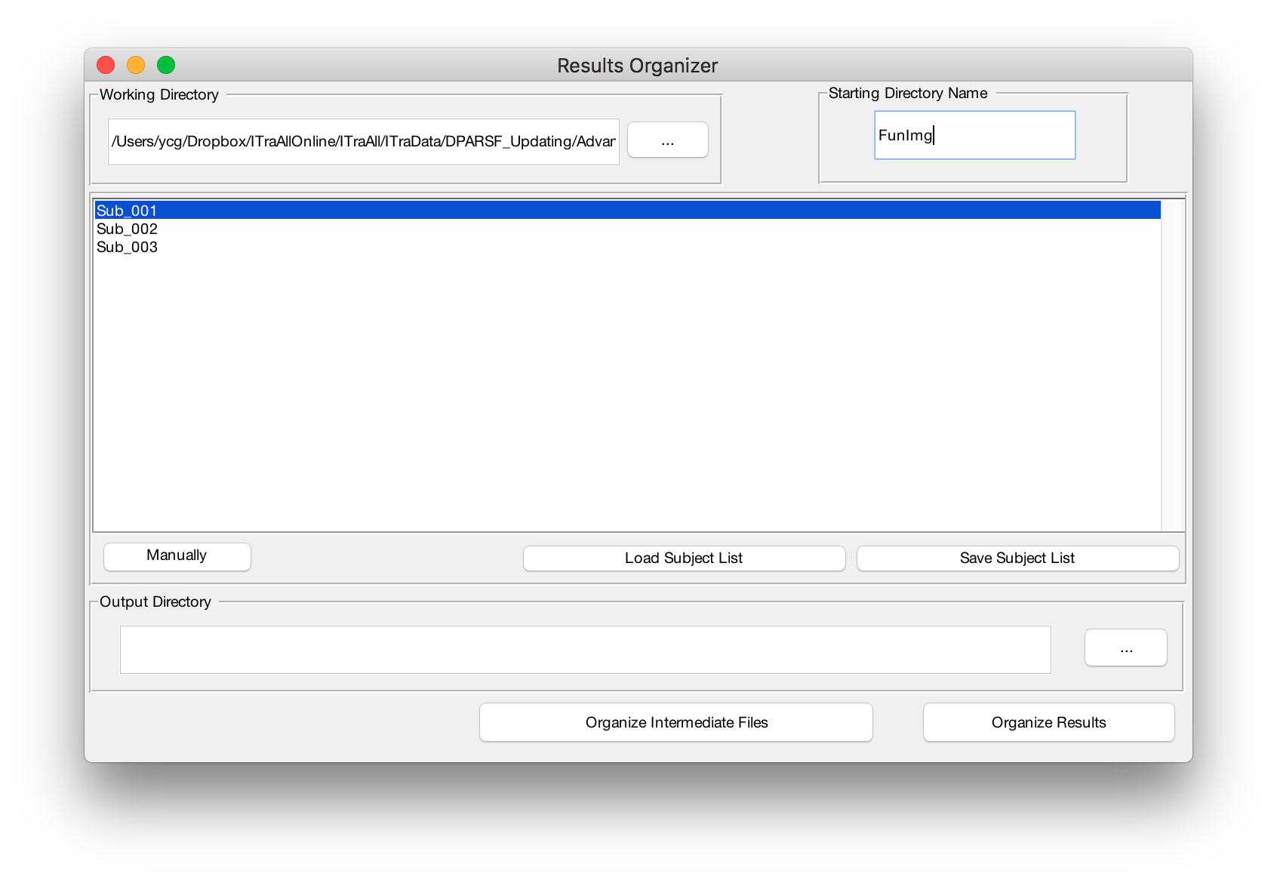
Organize Your Data (DPARSF Results)

Slide 23
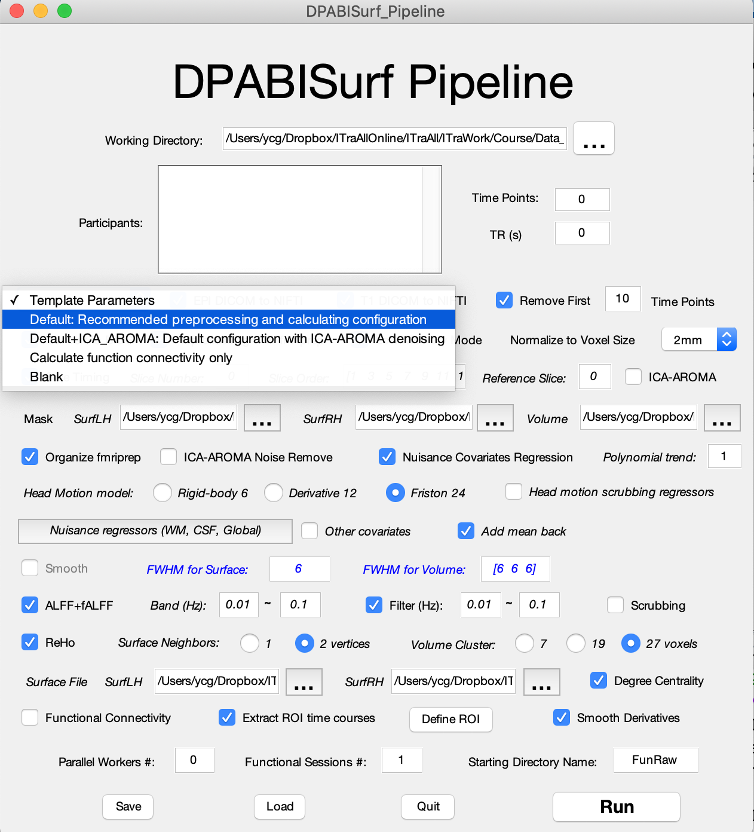
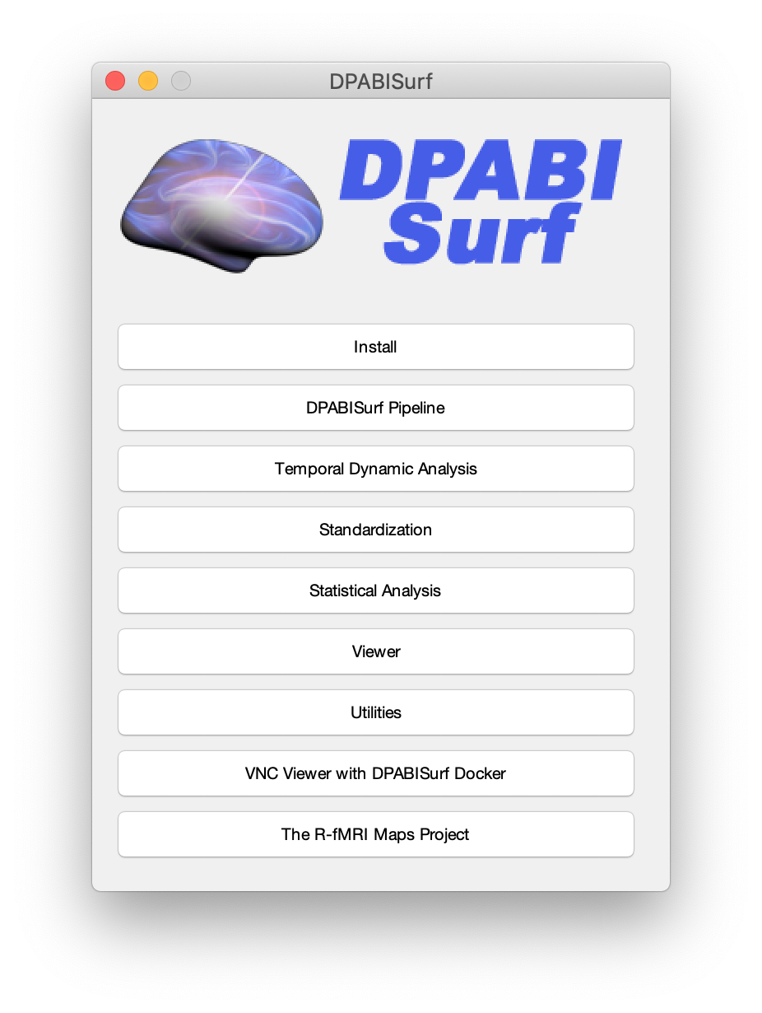
Organize Your Data (DPABISurf Results)

Slide 24
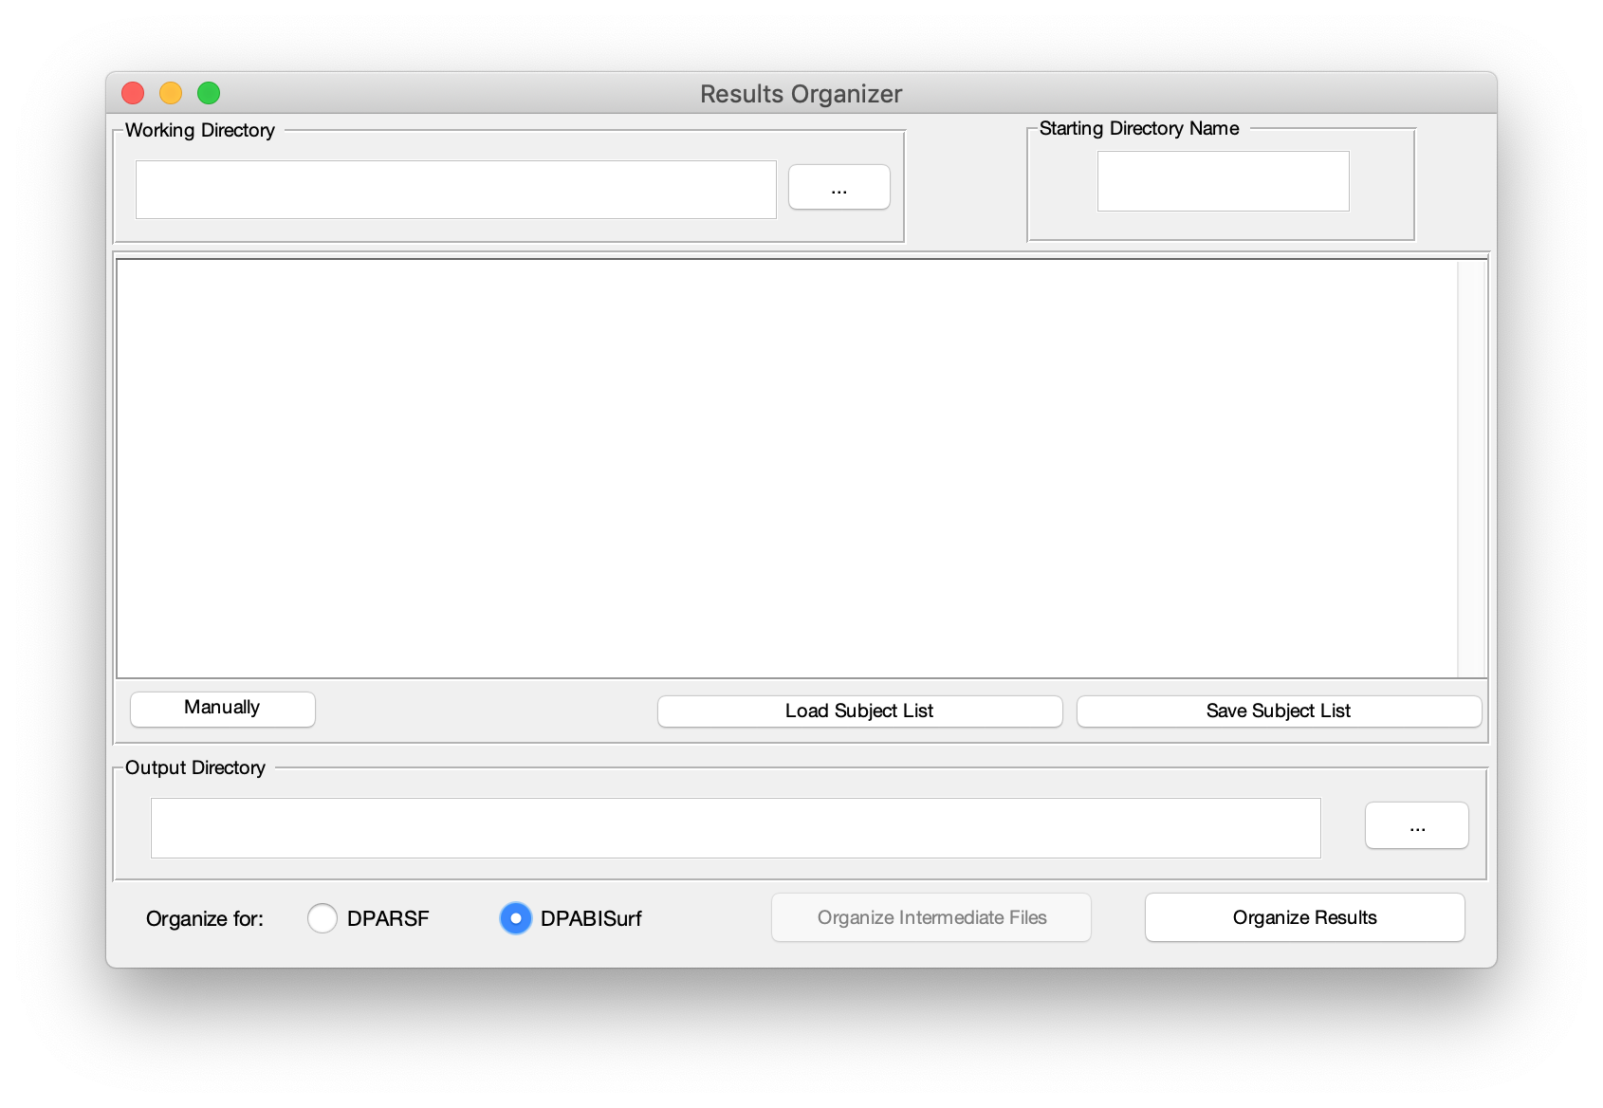
Organize Your Data (DPABISurf Results)

Slide 25
Organize Your Data (meta.csv)

Slide 26
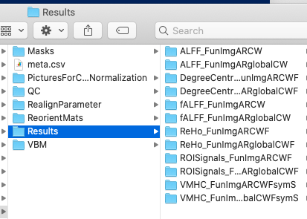
Organize Your Data (meta.csv)

Slide 27
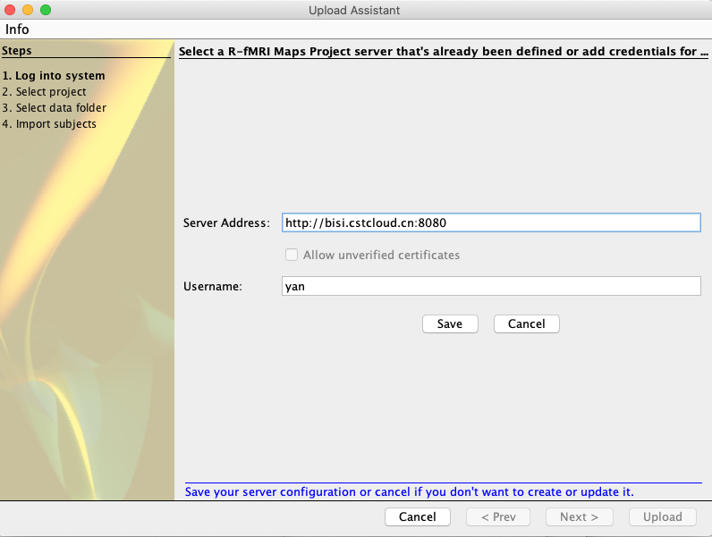
Share with BISI
27

Slide 28
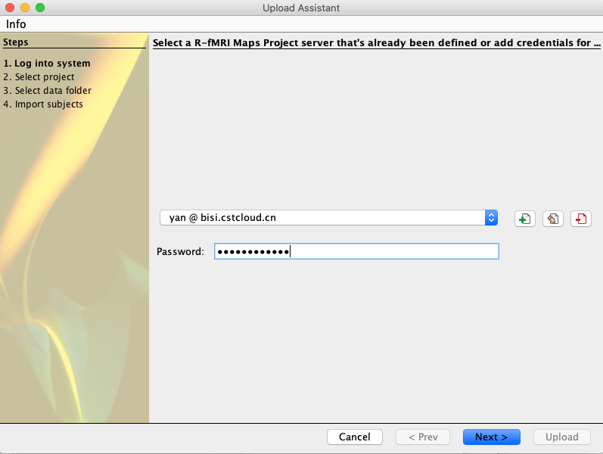
Share with BISI
28

Slide 29
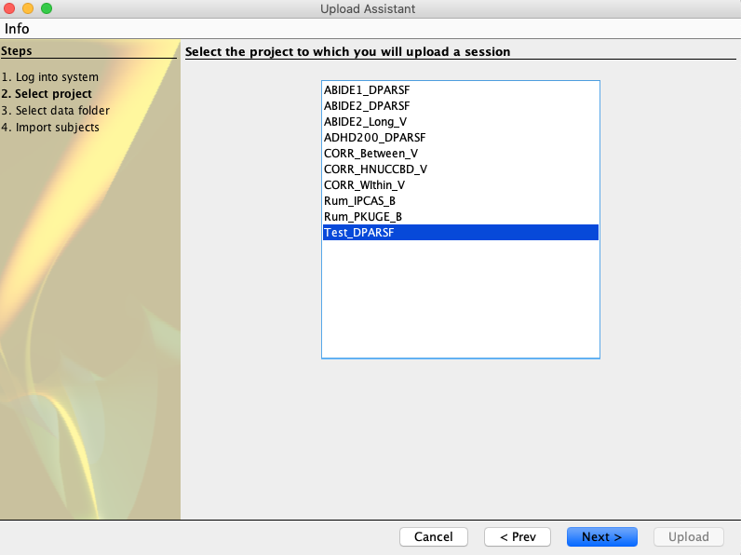
Share with BISI
29

Slide 30
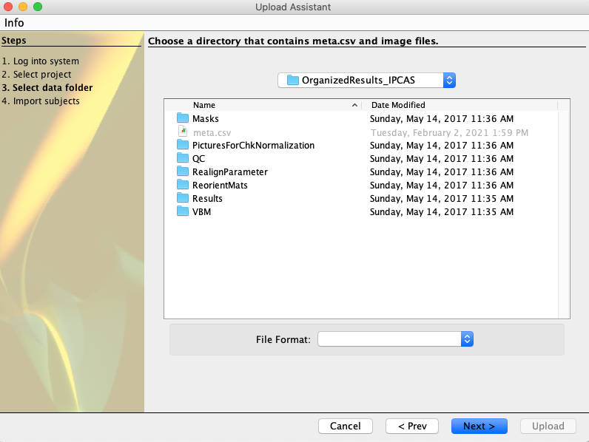
Share with BISI
30

Slide 31
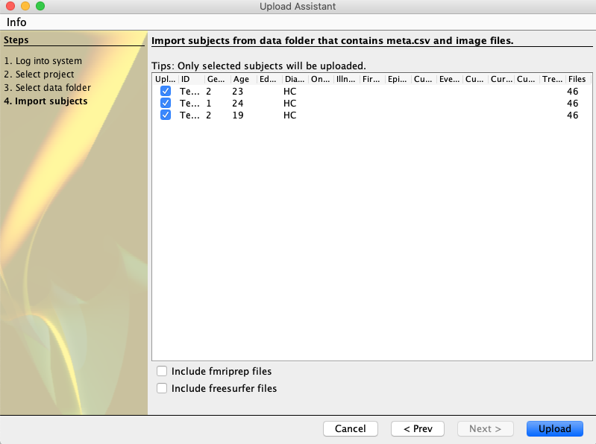
Share with BISI
31

Slide 32
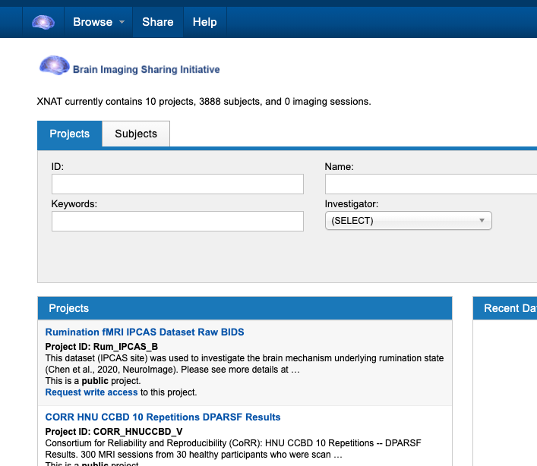
Make a post

Slide 33
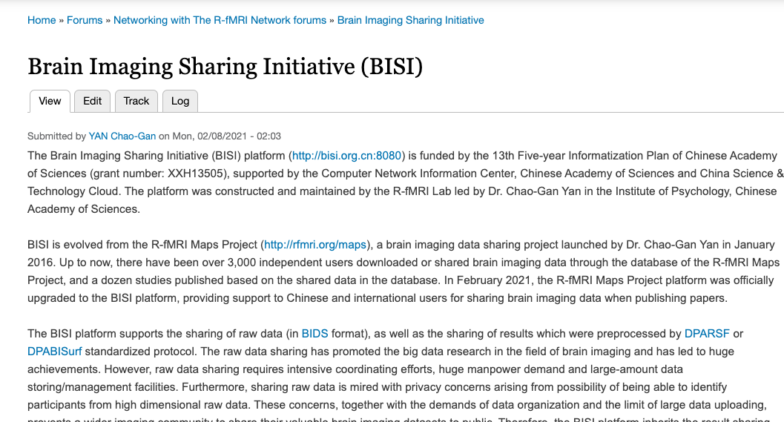
Make a post

Slide 34
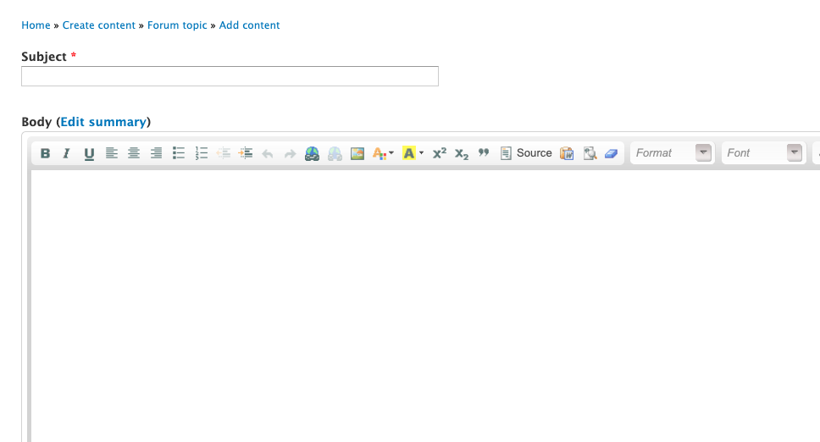
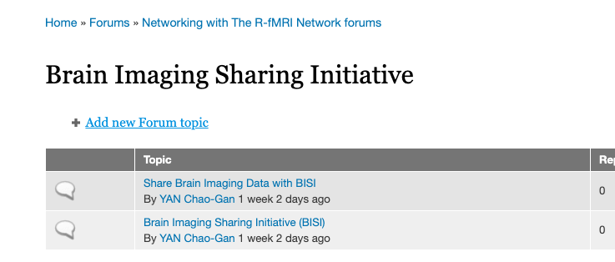
Make a post

Slide 35
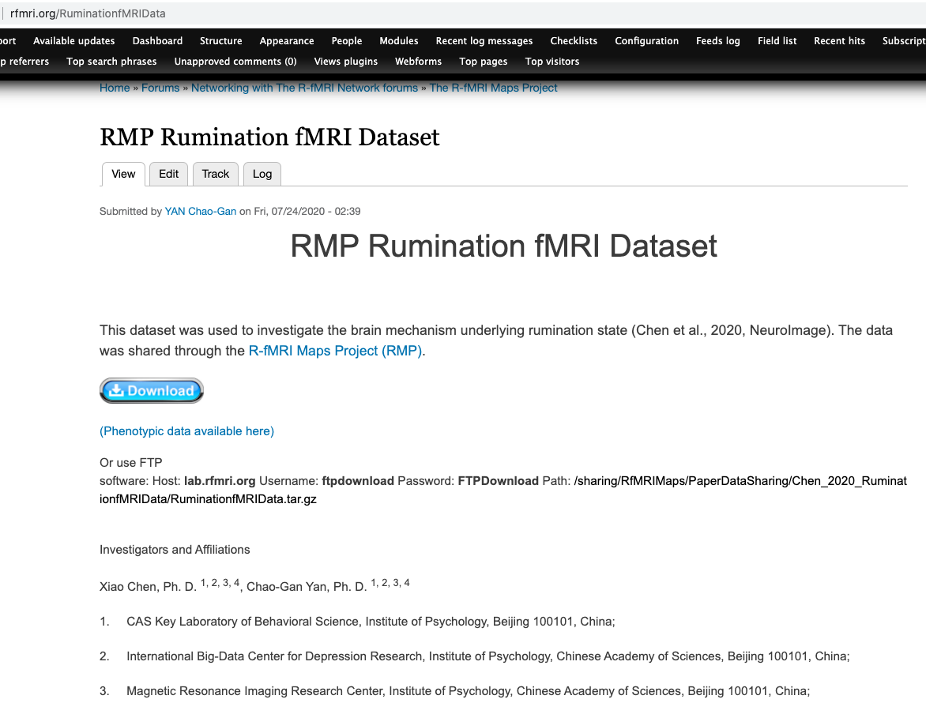
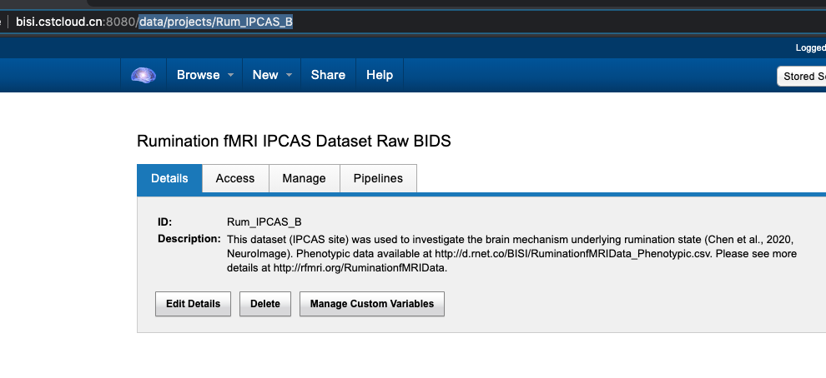
Make a post
http://bisi.cstcloud.cn:8080/data/projects/RumIPCAS_B

Slide 36
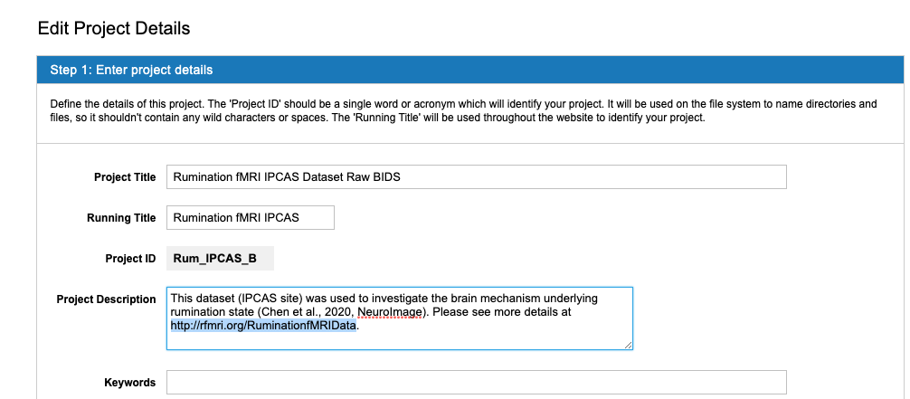
Make a post

Slide 37
Thank you very much for using BISI!

