Slide 1
Data Processing of Resting-State fMRI: DPARSF
严超赣
Chao-Gan Yan, Ph.D.
yancg@psych.ac.cn
http://rfmri.org/yan
Institute of Psychology, Chinese Academy of Sciences

Slide 2
DPARSF
(Yan and Zang, 2010)

Slide 3
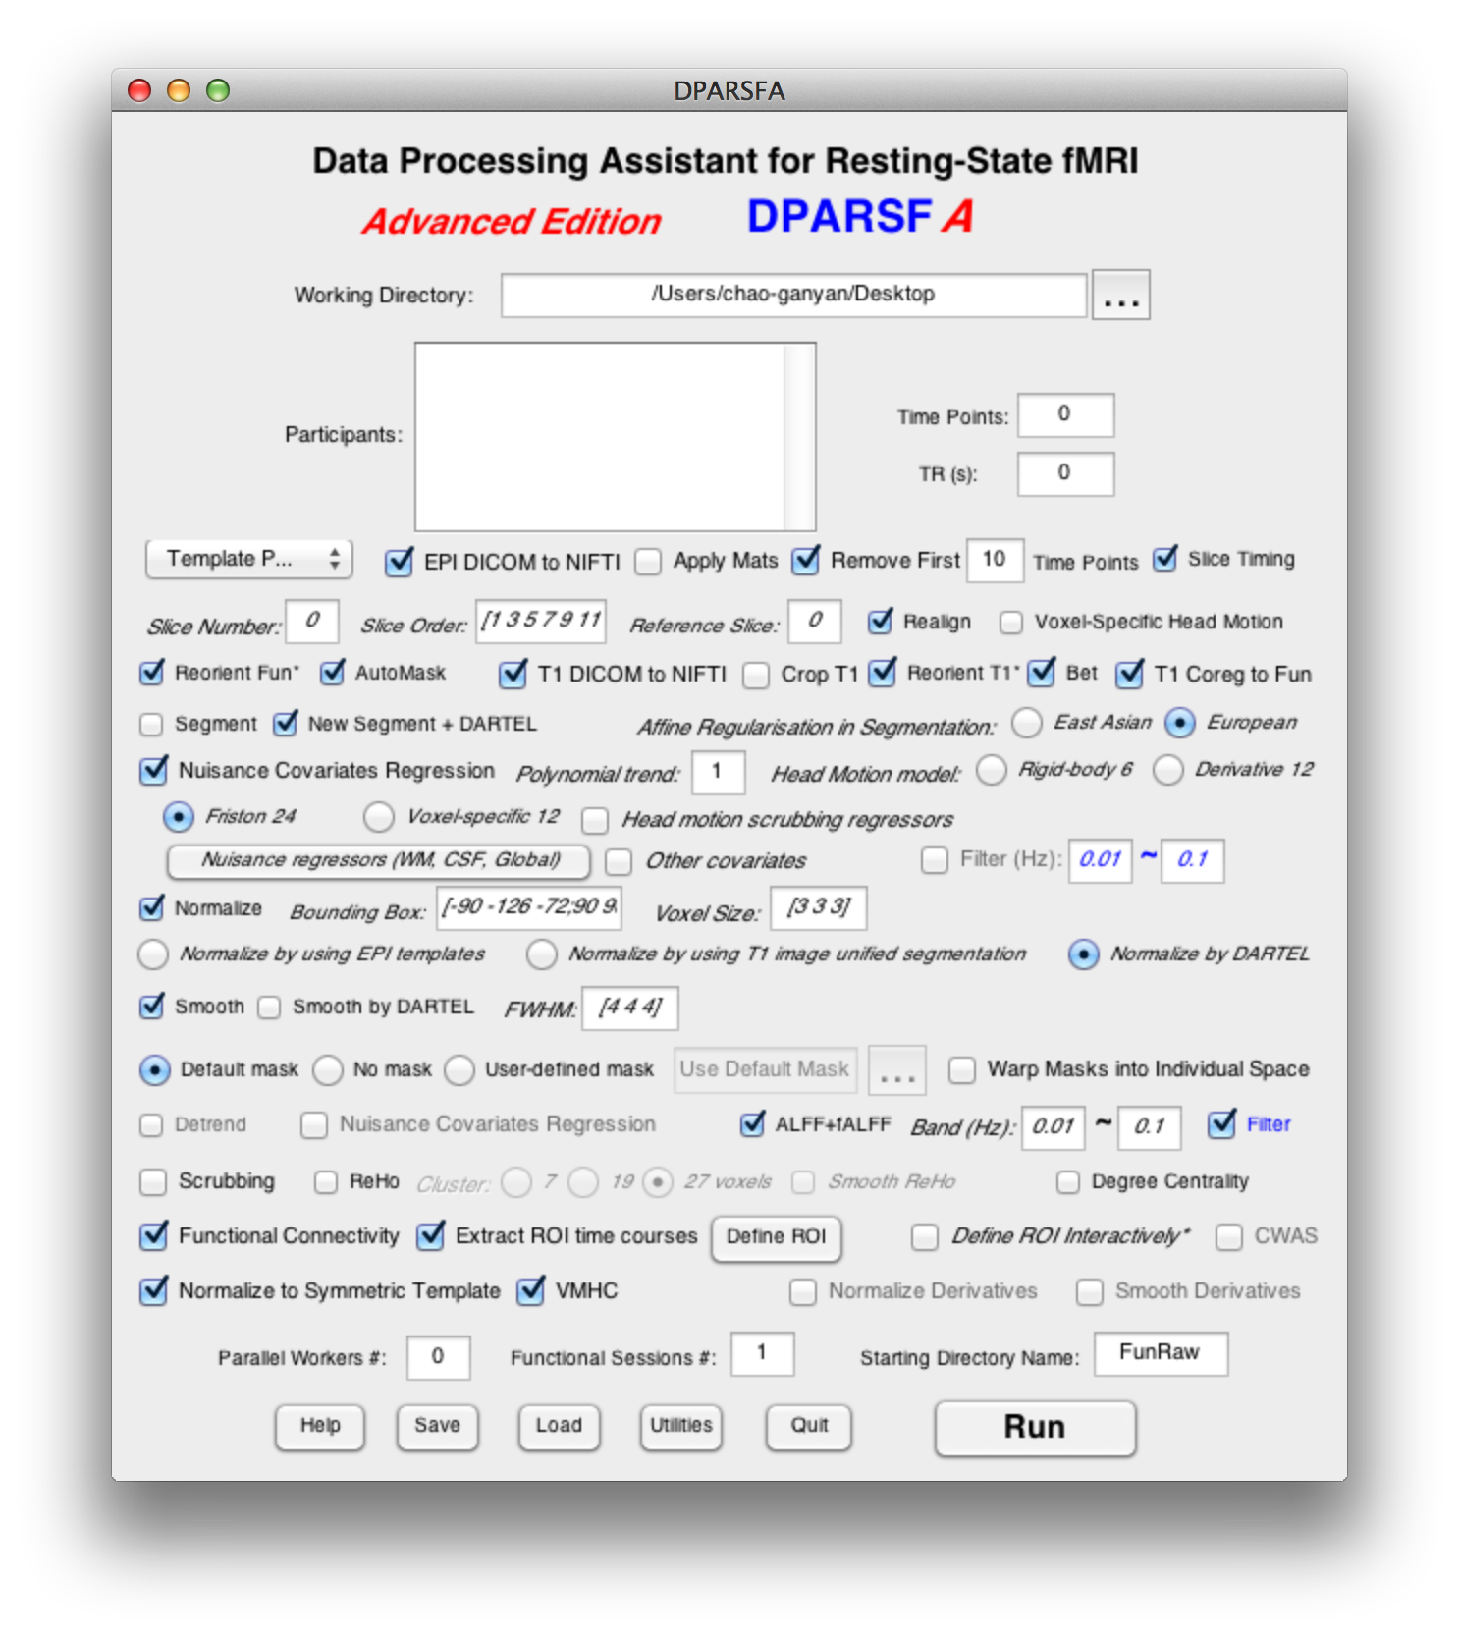
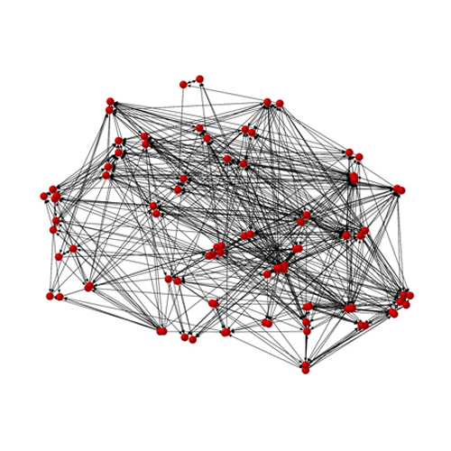
Data Processing Assistant for Resting-State fMRI (DPARSF)
Yan and Zang, 2010. Front Syst Neurosci.
http://rfmri.org/DPARSF

Slide 4
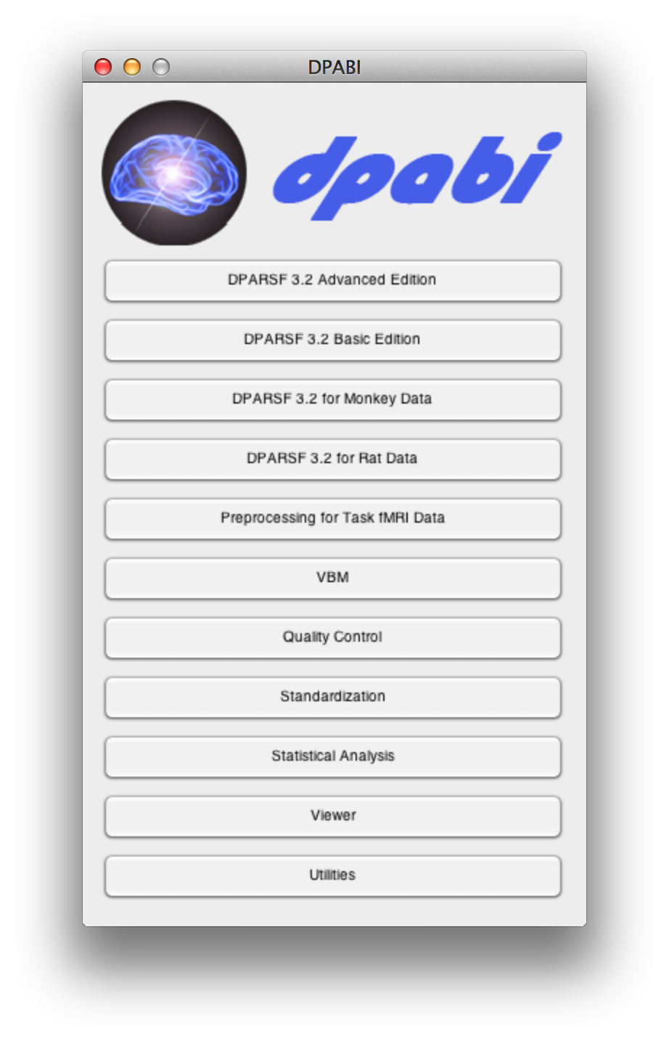
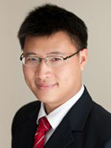
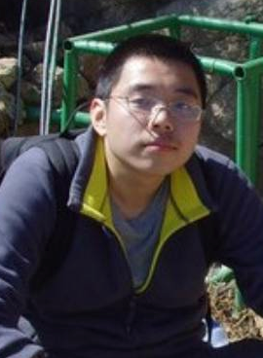
DPABI: a toolbox for Data Processing & Analysis of Brain Imaging
License: GNU GPL
Chao-Gan Yan Programmer Initiator
Xin-Di Wang Programmer
http://rfmri.org/dpabi
http://dpabi.org

Slide 5
Resting State fMRI Data Processing
FC (SCA)
ReHo
Preprocessing
ALFF/fALFF
Statistical Analysis
Results Viewing
Degree
…

Slide 6
Resting State fMRI Data Processing
Slice Timing
FC (SCA)
Realign
Nuisance Regression
ReHo
Normalize
Degree
Smooth
Filter
VMHC
Detrend
…
ALFF/fALFF
Calculate in MNI Space: TRADITIONAL order

Slide 7
Resting State fMRI Data Processing
Slice Timing
FC (SCA)
Realign
ReHo
Nuisance Regression
Filter
Degree
VMHC
Normalize
…
Smooth
ALFF/fALFF
Calculate in MNI Space: alternative order

Slide 8
Resting State fMRI Data Processing
Slice Timing
Realign
FC (SCA)
Nuisance Regression
ReHo
Normalize
Degree
Smooth
ALFF/fALFF
…
Filter
Calculate in Original Space

Slide 9
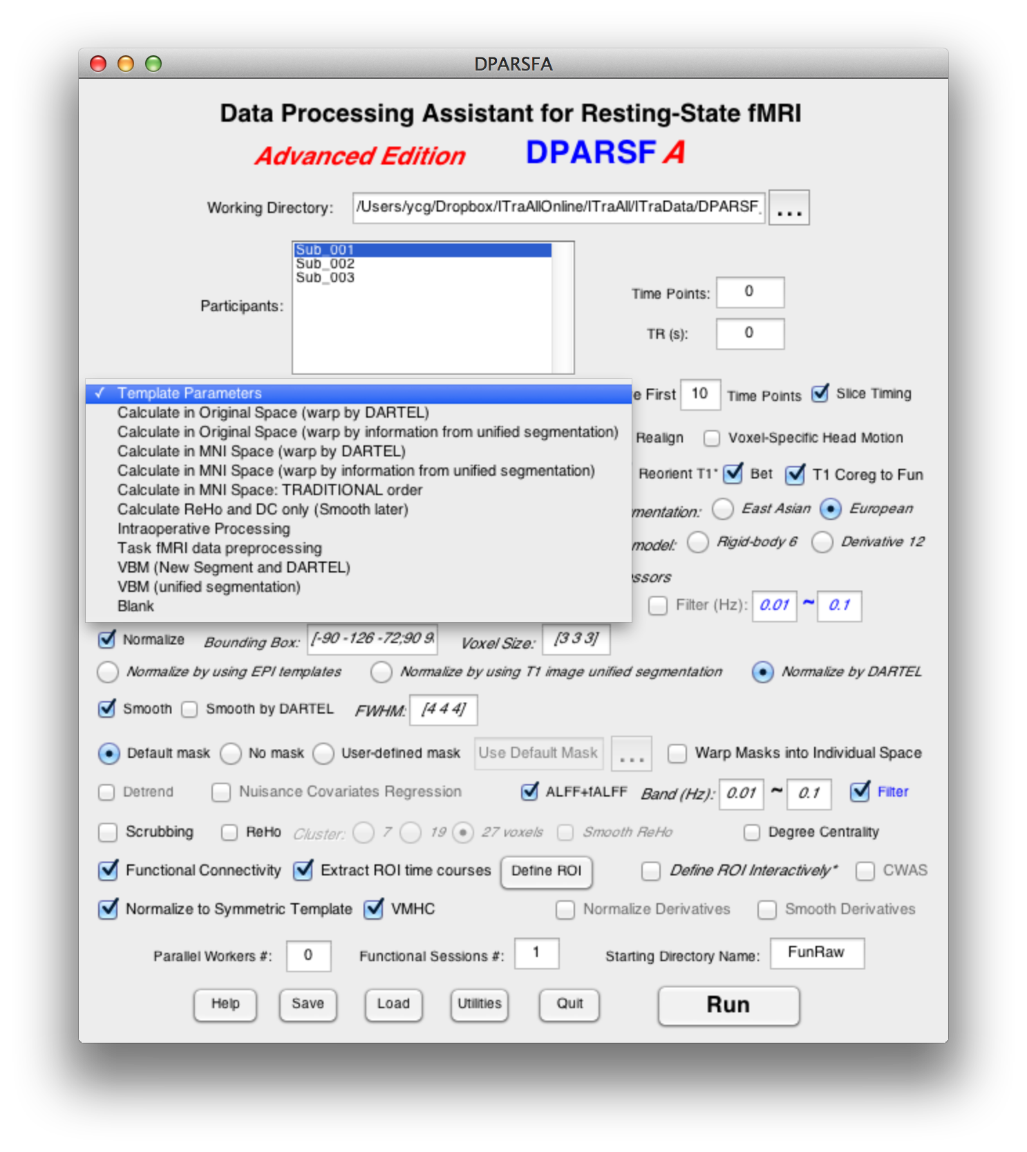
Resting State fMRI Data Processing
Template Parameters
9

Slide 10
Data Organization
ProcessingDemoData.zip
FunRaw
Sub_001
Sub_002
Sub_003
T1Raw
Sub_001
Sub_002
Sub_003
Functional DICOM data
Structural DICOM data
http://rfmri.org/DemoData

Slide 11
Data Organization
ProcessingDemoData.zip
FunImg
Sub_001
Sub_002
Sub_003
T1Img
Sub_001
Sub_002
Sub_003
Functional NIfTI data (.nii.gz., .nii or .img)
Structural NIfTI data (.nii.gz., .nii or .img)

Slide 12
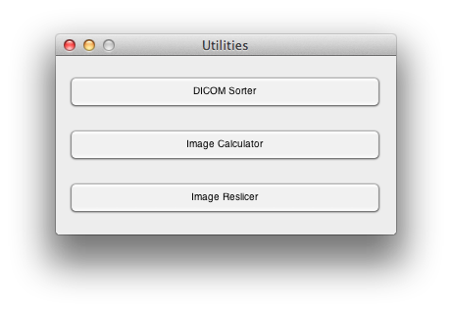

Slide 13
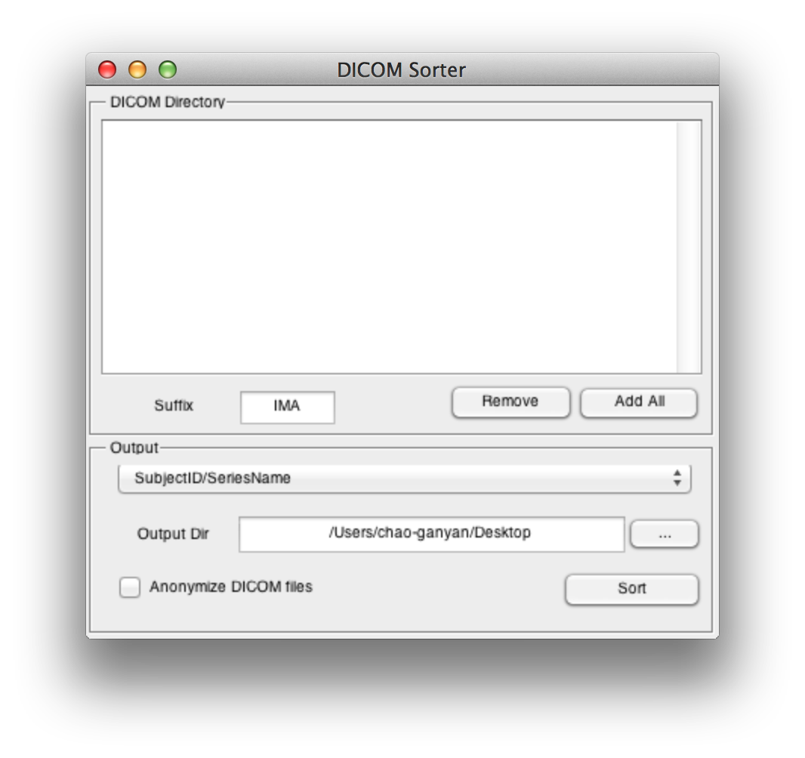
IMA
dcm
none

Slide 14
Data preparation
Arrange each subject's fMRI DICOM images in one directory, and then put them in "FunRaw" directory under the working directory.
Subject 1’s DICOM files
Subject 1’s directory
FunRaw directory, please name as this
Working directory

Slide 15
Data preparation
Arrange each subject's T1 DICOM images in one directory, and then put them in “T1Raw" directory under the working directory.
Subject 1’s DICOM files
Subject 1’s directory
T1Raw directory, please name as this
Working directory

Slide 16
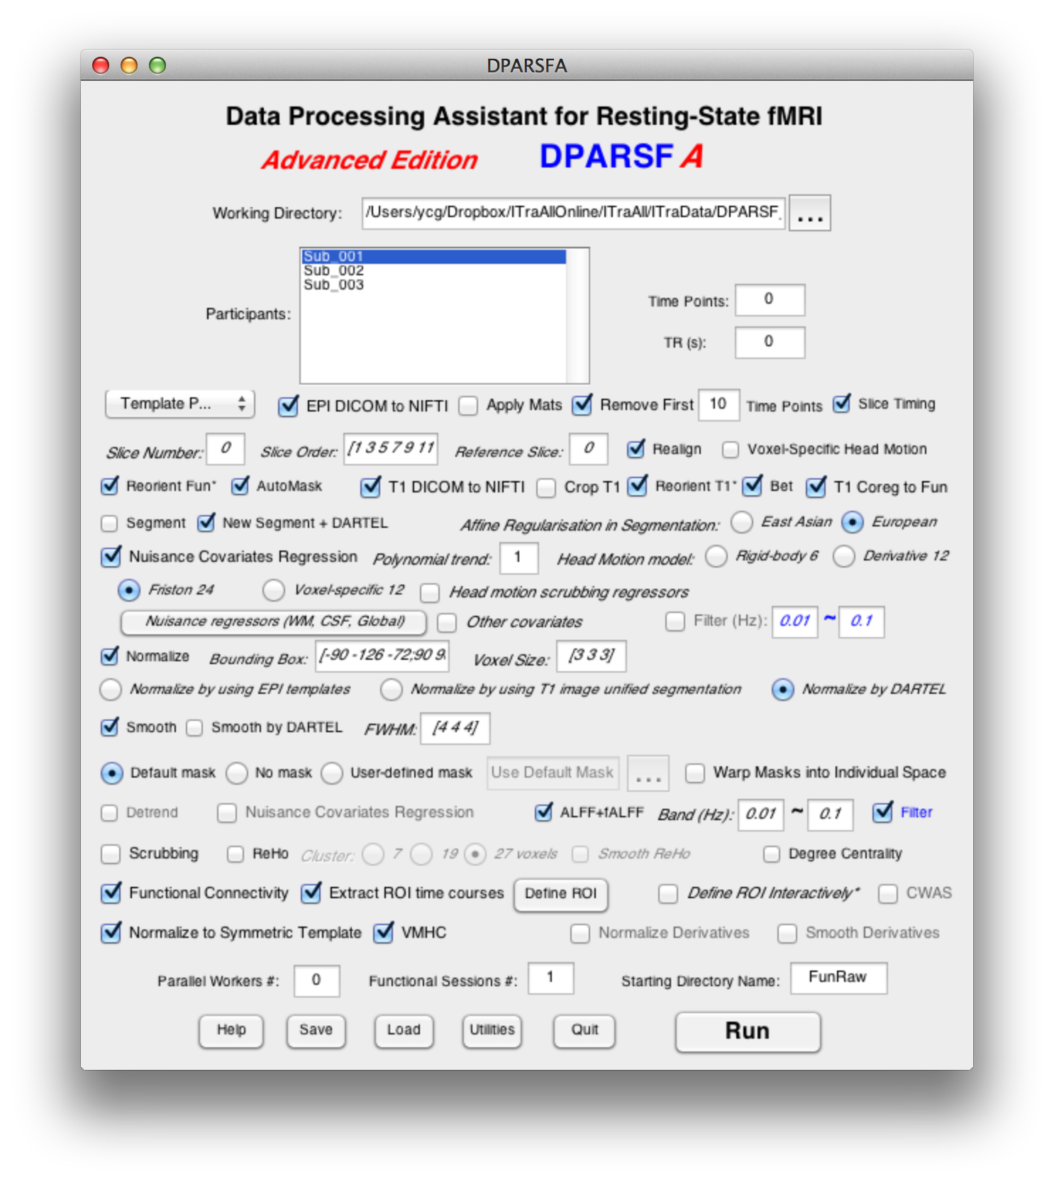
Preprocessing and R-fMRI measures Calculation
Working Dir where stored Starting Directory (e.g., FunRaw)
Detected participants
16

Slide 17
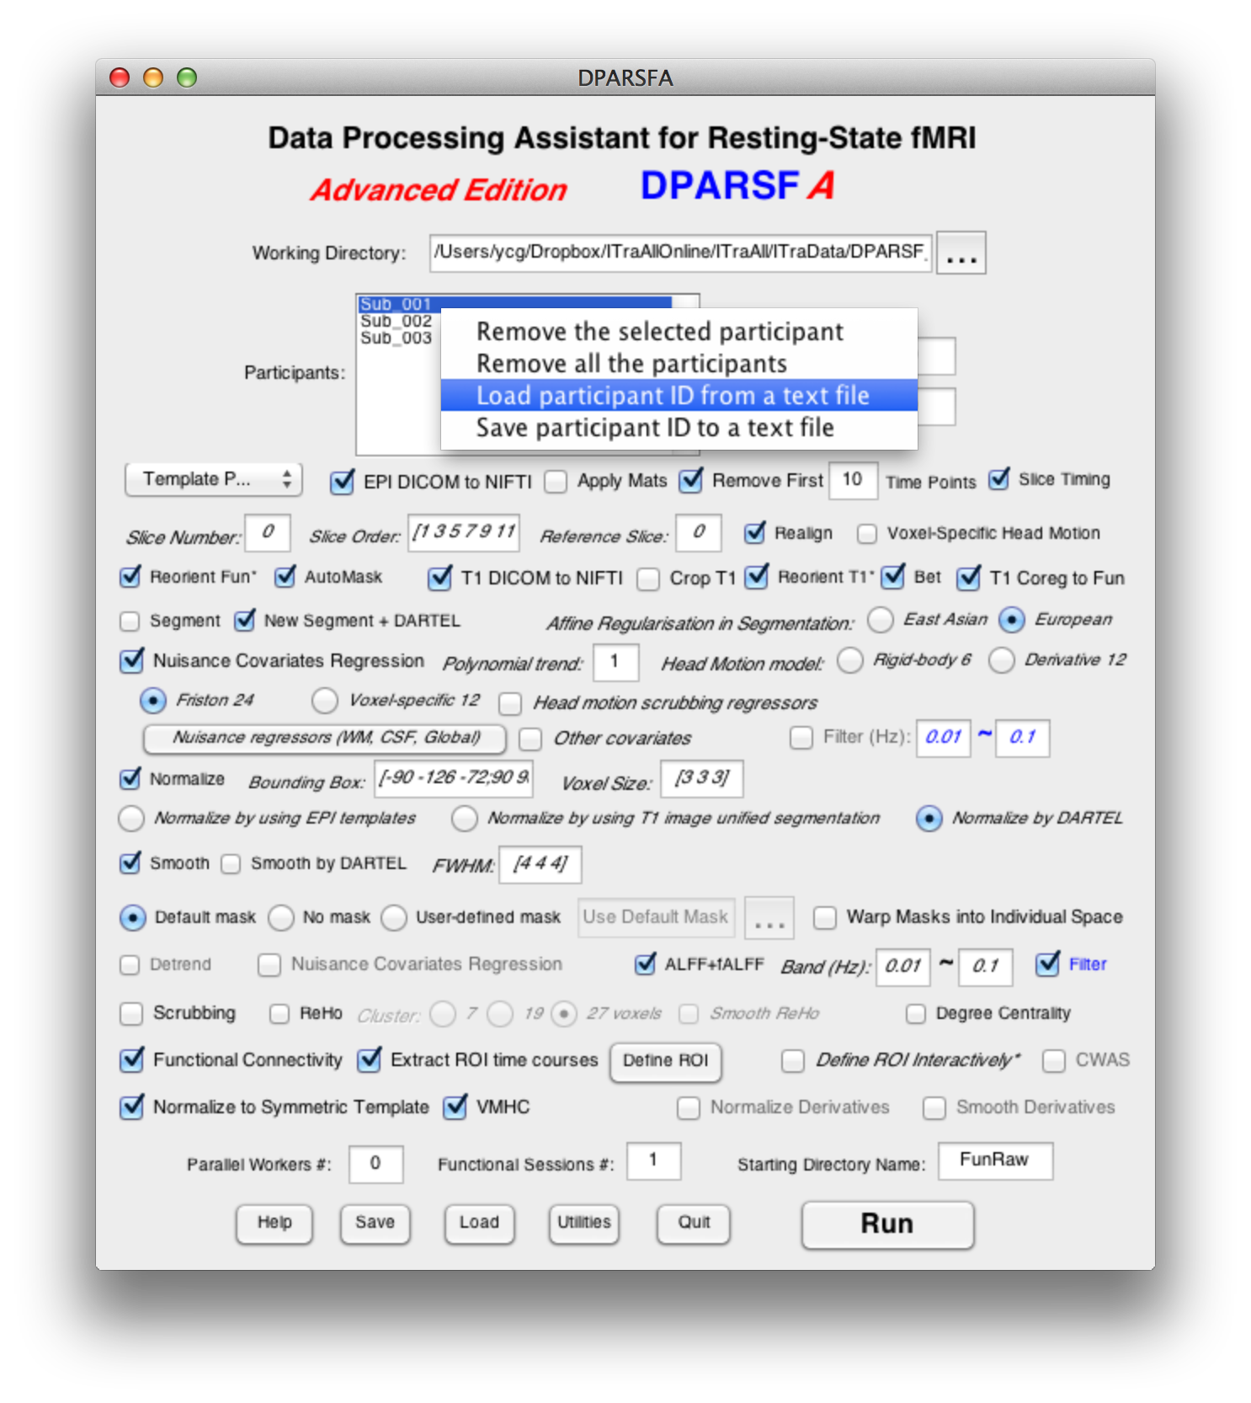
Preprocessing and R-fMRI measures Calculation
Detected participants
17

Slide 18
Preprocessing and R-fMRI measures Calculation
Number of time points
(if 0, detect automatically)
TR
(if 0, detect from NIfTI header)
Template Parameters
DICOM to NIfTI, based on MRIcroN’s
dcm2nii
Apply reorientation
matrices
18

Slide 19
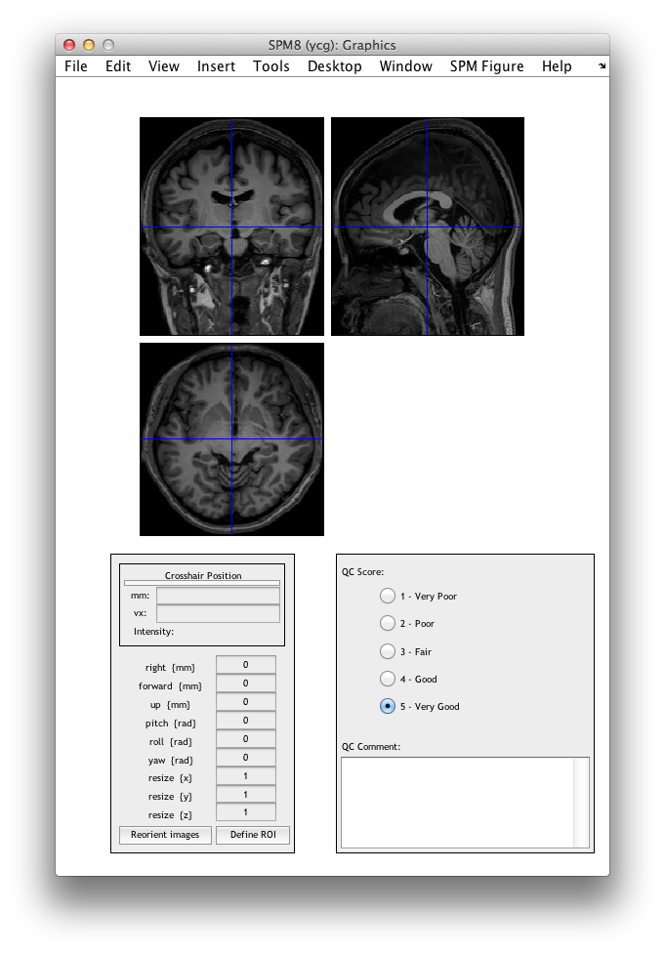
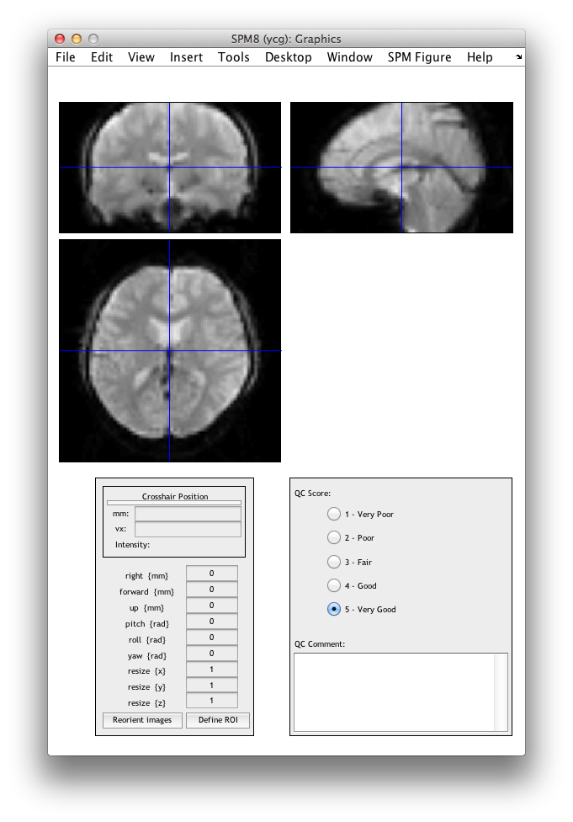
19

Slide 20
Preprocessing and R-fMRI measures Calculation
Apply reorientation matrices:
ReorientMats
Rename to:
DownloadedReorientMats

Slide 21
Preprocessing and R-fMRI measures Calculation
Remove several first time points
Slice Timing
21

Slide 22
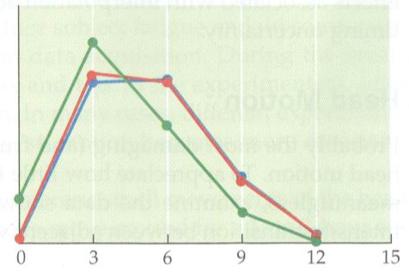
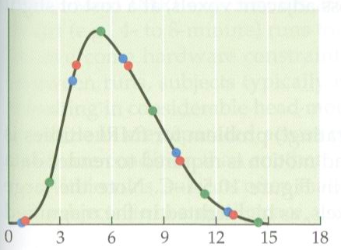
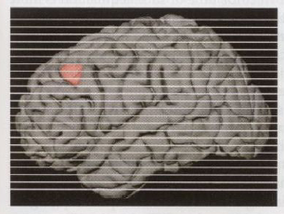
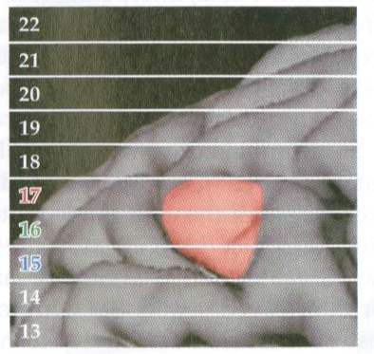
Slice Timing
Why?
Huettel et al., 2004

Slide 23
Preprocessing and R-fMRI measures Calculation
Total slice number
(if 0, The slice order is then assumed as interleaved scanning: [1:2:SliceNumber,2:2:SliceNumber]. The reference slice is set to the slice acquired at the middle time point, i.e., SliceOrder(ceil(SliceNumber/2)). SHOULD BE CAUTIOUS!!!)
Realign
Slice order: 1:2:33,2:2:32 (interleaved scanning)
Reference slice: slice acquired in the middle time of each TR
23

Slide 24
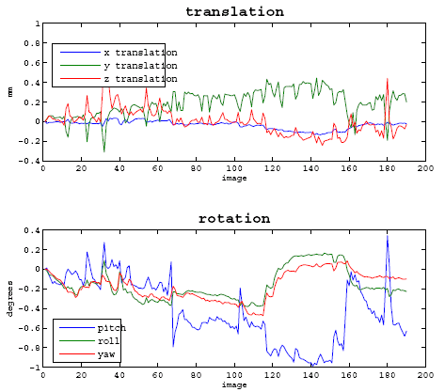
Realign
Why?

Slide 25
Realign
Check head motion:
{WorkingDir}\RealignParameter\Sub_xxx:
rp_*.txt: realign parameters
FD_Power_*.txt: Frame-wise Displacement (Power et al., 2012)
FD_VanDijk_*.txt: Relative Displacement (Van Dijk et al., 2012)
FD_Jenkinson_*.txt: Relative RMS (Jenkinson et al., 2002)

Slide 26
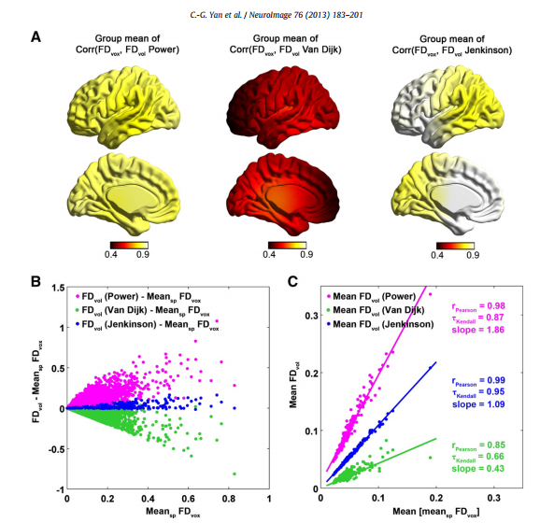
Realign
(Yan et al.,
Neuroimage
2013)
26

Slide 27
Realign
Excluding Criteria: 2.5mm and 2.5 degree in max head motion
None
Excluding Criteria: 2.0mm and 2.0 degree in max head motion
Sub_013
Excluding Criteria: 1.5mm and 1.5 degree in max head motion
Sub_013
Excluding Criteria: 1.0mm and 1.0 degree in max head motion
Sub_007
Sub_012
Sub_013
Sub_017
Sub_018
Check head motion:
{WorkingDir}\RealignParameter:
ExcludeSubjectsAccordingToMaxHeadMotion.txt
27

Slide 28
Realign
Check head motion:
HeadMotion.csv: head motion characteristics for each subject (e.g., max or mean motion, mean FD, # or % of FD>0.2)
Threshold:
Group mean (mean FD) + 2 * Group SD (mean FD)
Yan et al., in press Neuroimage; Di Martino, in press, Mol Psychiatry
28

Slide 29
Preprocessing and R-fMRI measures Calculation
Voxel-Specific Head Motion Calculation
(Yan et al.,
Neuroimage
2013)
29

Slide 30
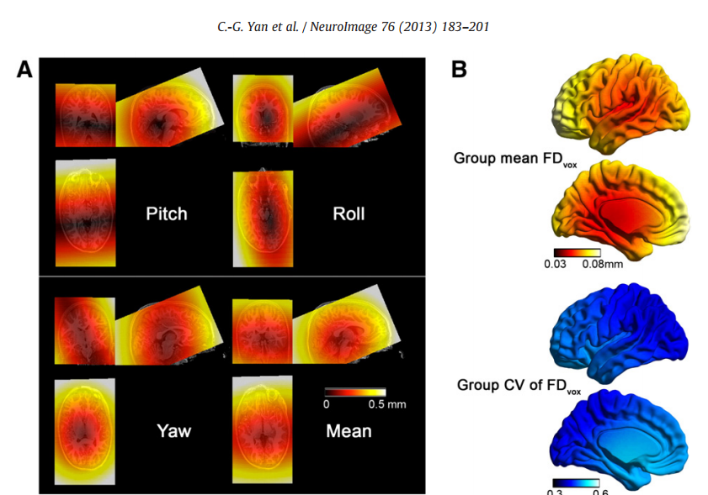
Voxel-Specific Head Motion Calculation
{WorkingDir}\VoxelSpecificHeadMotion\Sub_xxx:
HMvox_x_*.nii: voxel specific translation in x axis
FDvox_*.nii: Frame-wise Displacement (relative to the previous time point) for each voxel
TDvox_*.nii: Total Displacement (relative to the reference time point) for each voxel
MeanFDvox.nii: temporal mean of FDvox for each voxel
MeanTDvox.nii: temporal mean of TDvox for each voxel

Slide 31
Preprocessing and R-fMRI measures Calculation
Reorient Interactively
This step could improve the accuracy in coregistration, segmentation and normalization, especially when images had a bad initial orientation.
Also can take as a QC step.

Slide 32
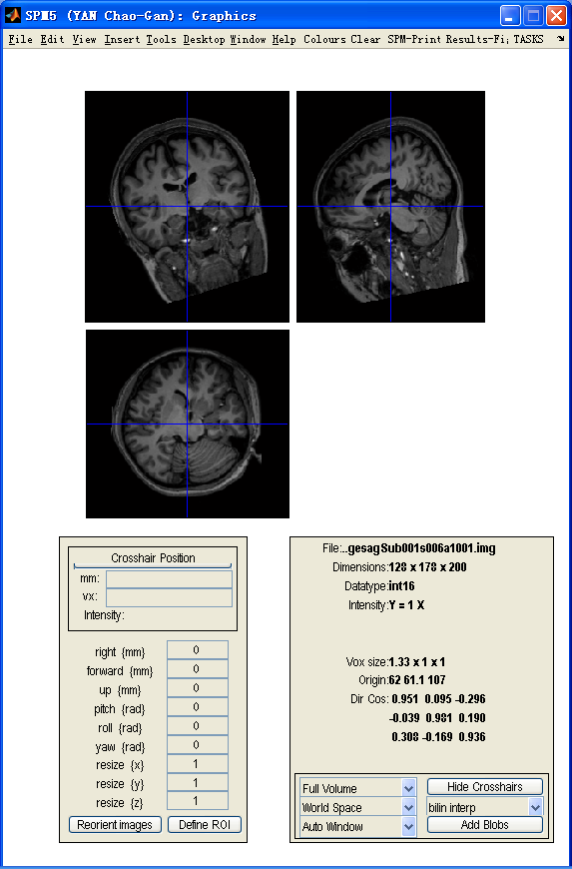
32

Slide 33
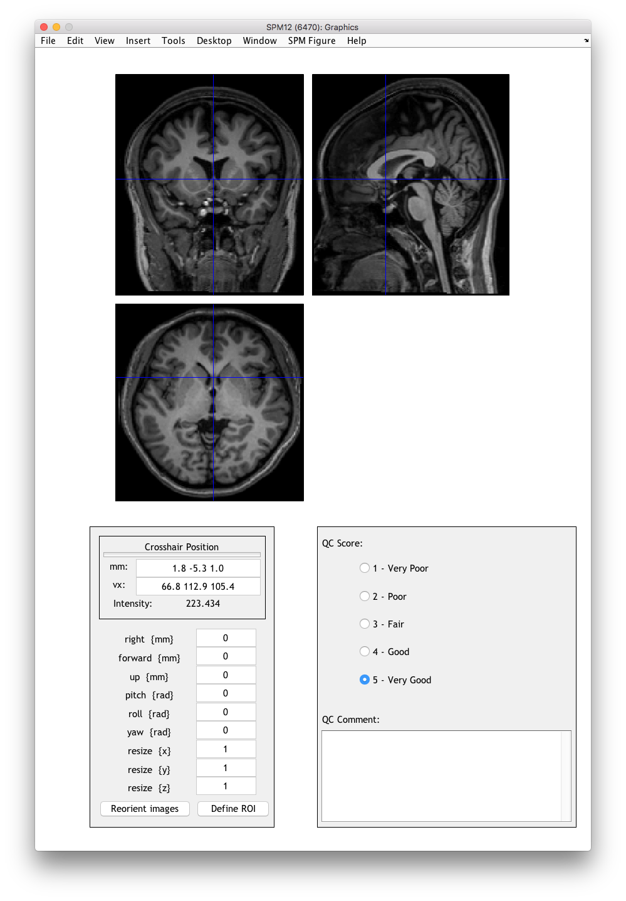
33

Slide 34
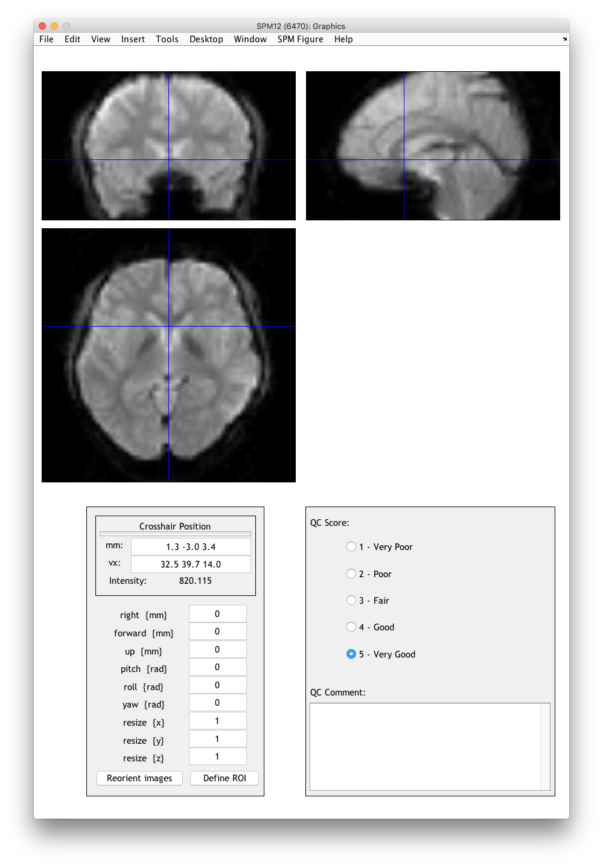
Display the mean image after realignment. (Could take this step as a QC procedure.)
The reorientation effects on and realigned functional images and voxel-specific head motion images.
QC scores and comments are stored at {WorkDir}/QC
34

Slide 35
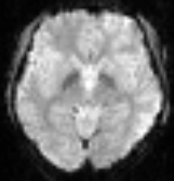
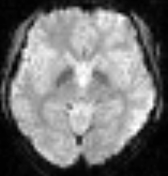
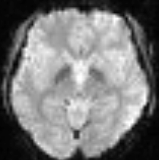
Automask generation
For checking EPI coverage and generating group mask
FunImgAR/Sub_001
Masks/AutoMasks/
35

Slide 36
Preprocessing and R-fMRI measures Calculation
T1 DICOM files to NIfTI (based on MRIcroN’s
dcm2nii)
Crop T1 image (.nii, .nii.gz, .img)
(based on MRIcroN’s
Dcm2nii)
Reorient T1 image Interactively
36

Slide 37
Brain extraction (Skullstrip)
For better coregistration
For Linux and Mac: Need to install FSL.
For Windows:
Thanks to Chris Rorden's compiled version of bet in MRIcroN, our modified version can work on NIfTI images directly.
37

Slide 38
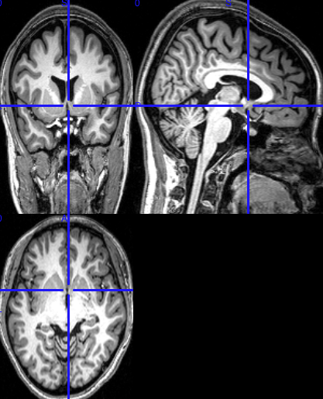
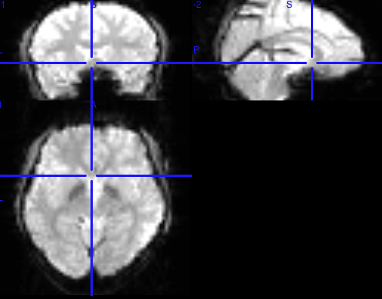
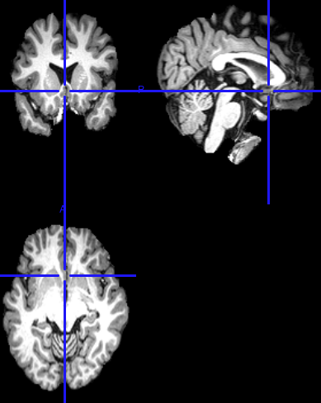
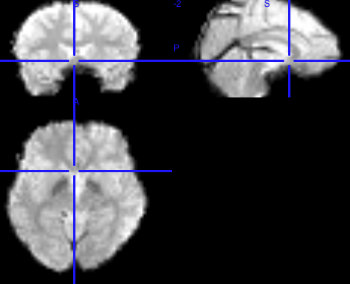
Bet & Coregistration
T1ImgCoreg/Sub_001
Segment
bet
T1Img/Sub_001
RealignParameter/Sub_001/mean*.nii
Apply
Coregister
T1ImgBet/Sub_001
RealignParameter/Sub_001/Bet_mean*.nii
38

Slide 39
Preprocessing and R-fMRI measures Calculation
Coregister T1 image to functional space

Slide 40
Preprocessing and R-fMRI measures Calculation
Unified Segmentation.
Information will be used in spatial normalization.
(In SPM12: old segment)
New Segment and DARTEL.
Information will be used in spatial normalization.
Affine regularisation in segmentation
40

Slide 41
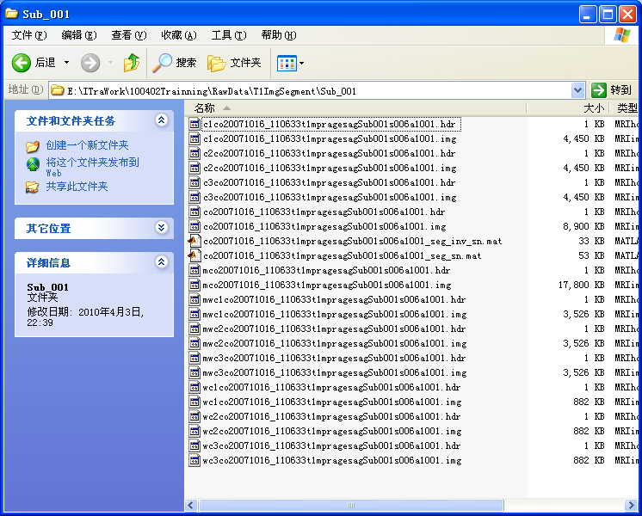
By-Product: VBM
GM in original space
WM in original space
CSF in original space
Modulated GM in normalized space
GM in normalized space

Slide 42
Preprocessing and R-fMRI measures Calculation
Nuisance Covariates Regression
Polynomial trends as regressors:
0: constant (no trends)
1: constant + linear trend (same as linear detrend)
2: constant + linear trend + quadratic trend
3: constant + linear trend + quadratic trend + cubic trend
...
42

Slide 43
Preprocessing and R-fMRI measures Calculation
Head Motion regression model
6 head motion parameters
Derivative 12: 6 head motion parameters, 6 first derivatives
Friston 24-parameter model: 6 head motion parameters, 6 head motion parameters one time point before, and the 12 corresponding squared items (Friston et al., 1996).
43

Slide 44
Preprocessing and R-fMRI measures Calculation
Voxel-specific 12-parameter model: the 3 voxel-specific translation motion parameters in x, y, z, the same 3 parameters for one time point before, and the 6 corresponding squared items
Head Motion Scrubbing Regressors
44

Slide 45
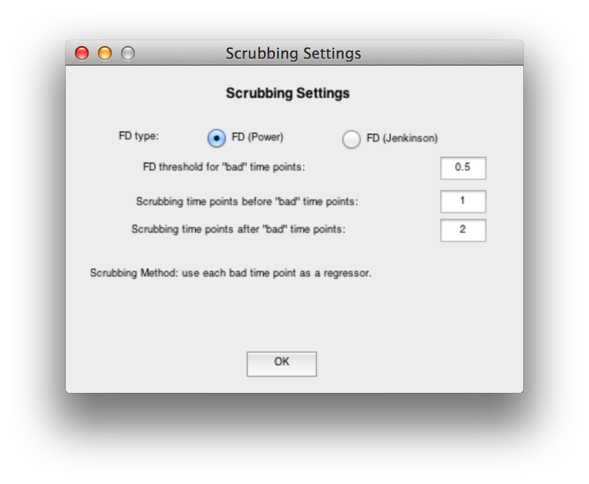
Each “bad” time point defined by FD will be used as a separate regressor.

Slide 46
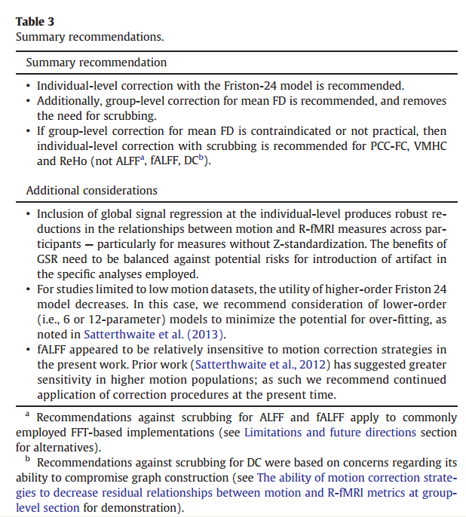
Yan et al., 2013, Neuroimage

Slide 47
Preprocessing and R-fMRI measures Calculation
Nuisance Regressors
(WM, CSF, Global)

Slide 48
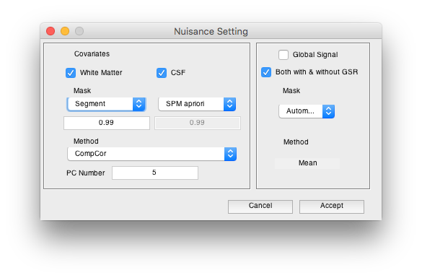
Nuisance Regression
Mask based on segmentation or SPM apriori
CompCor or mean [note: for CompCor, detrend (demean) and variance normalization will be applied before PCA, according to Behzadi et al., 2007]
Global Signal based on Automask
48

Slide 49
Preprocessing and R-fMRI measures Calculation
Define other covariates

Slide 50
Preprocessing and R-fMRI measures Calculation
Filtering
The filtering parameters will be used later (Blue checkbox).
50

Slide 51
Preprocessing and R-fMRI measures Calculation
Spatial Normalization

Slide 52
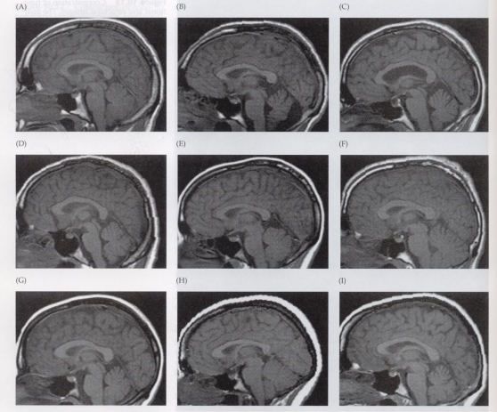
Normalize
Huettel et al.,
2004

Slide 53
Normalize
Methods:
I. Normalize by using EPI templates
II. Normalize by using T1 image unified segmentation
III. Normalize by using DARTEL
IV. Normalize by using T1 templates (hidden)

Slide 54
Normalize
III. Normalize by using DARTEL
Structural image was coregistered to the mean functional image after motion correction
The transformed structural image was then segmented into gray matter, white matter, cerebrospinal fluid by using a unified segmentation algorithm (New Segment)
DARTEL: create template
DARTEL: Normalize to MNI space. The motion corrected functional volumes were spatially normalized to the MNI space using the normalization parameters estimated in DARTEL.

Slide 55
Preprocessing and R-fMRI measures Calculation
Smooth
For ReHo, Degree Centrality: don’t smooth before calculation
FWHM kernel settings can be applied to later steps

Slide 56
Smooth
Why?
Reduce the effects of bad normalization
Increase SNR
…

Slide 57
Mask
Default mask: SPM5 apriori mask (brainmask.nii) thresholded at 50%.
User-defined mask
Warp the masks into individual space by the information of DARTEL or unified segmentation.
57

Slide 58
Preprocessing and R-fMRI measures Calculation
Linear detrend
(NO need since included in nuisance covariate regression)
58

Slide 59
Preprocessing and R-fMRI measures Calculation
Nuisance Covariates Regression
If needed, then use the parameters set in the upper section.
59

Slide 60
Preprocessing and R-fMRI measures Calculation
ALFF and fALFF calculation
(Zang et al., 2007; Zou et al., 2008)
60

Slide 61
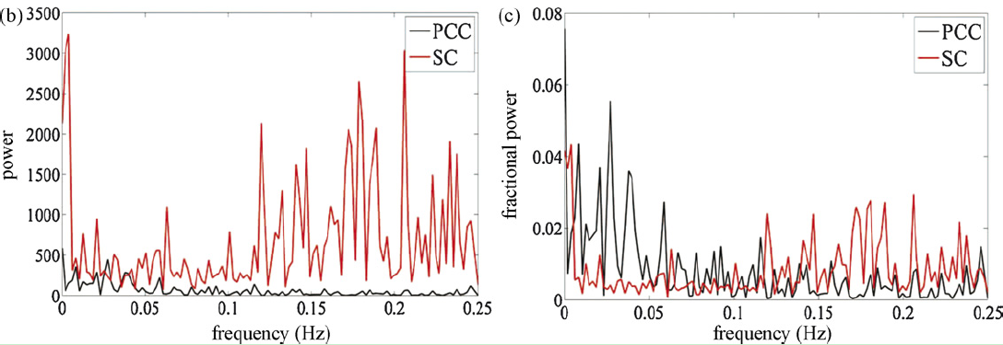
ALFF/fALFF
Amplitude of low frequency fluctuation / Fractional ALFF
PCC: posterior cingulate cortex
SC: suprasellar cistern
Zang et al., 2007; Zou et al., 2008
61

Slide 62
Preprocessing and R-fMRI measures Calculation
Filtering
Use the parameters set in the blue edit boxes.
62

Slide 63
Preprocessing and R-fMRI measures Calculation
Scrubbing
63

Slide 64
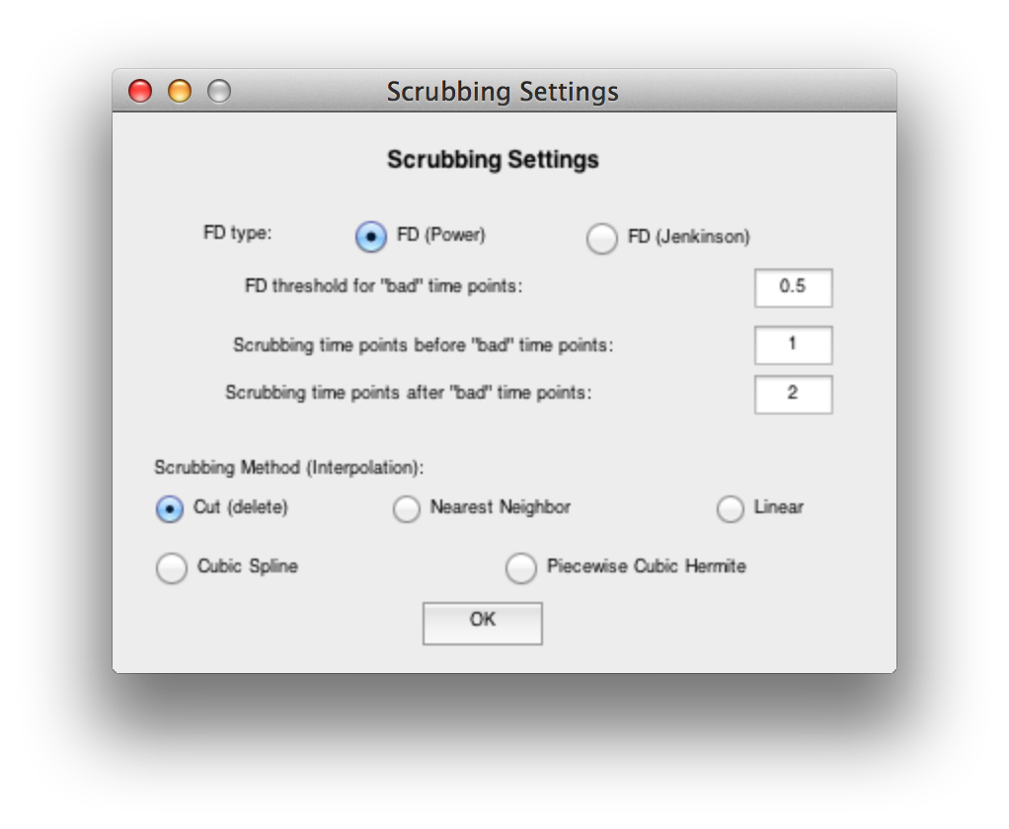
The “bad” time points defined by FD_Power (Power et al., 2012) will be interpolated or deleted as the specified method.

Slide 65
Preprocessing and R-fMRI measures Calculation
Regional Homogeneity (ReHo) Calculation
(Zang et al., 2004)
65

Slide 66
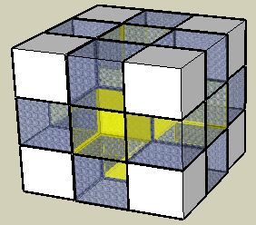
ReHo (Regional Homogeneity)
Zang et al., 2004
Zang YF, Jiang TZ, Lu YL, He Y, Tian LX (2004) Regional homogeneity approach to fMRI data analysis. Neuroimage 22: 394–400.

Slide 67
Preprocessing and R-fMRI measures Calculation
Regional Homogeneity (ReHo) Calculation
(Zang et al., 2004)
67

Slide 68
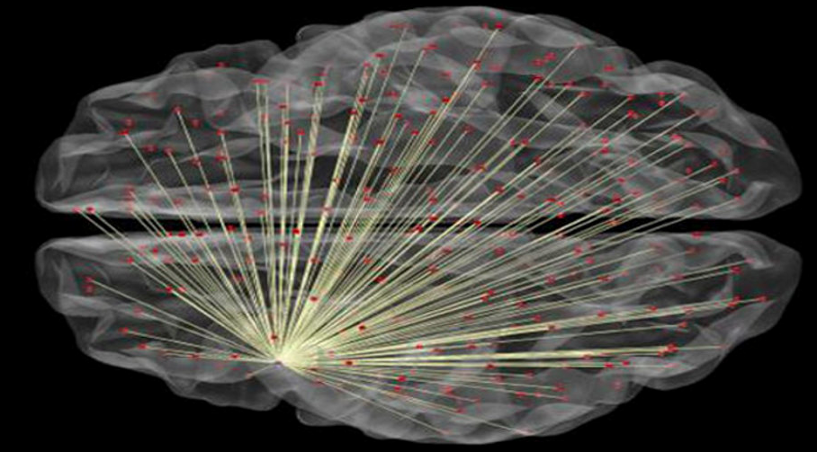
Preprocessing and R-fMRI measures Calculation
Degree Centrality Calculation
(Buckner et al., 2009; Zuo et al, 2012)
> r Threshold
(default 0.25)
68

Slide 69
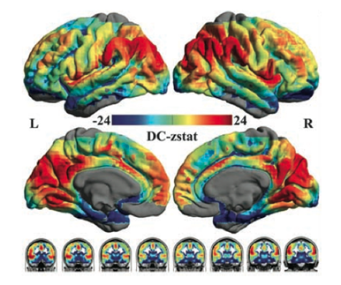
Zuo et al., 2012

Slide 70
Preprocessing and R-fMRI measures Calculation
Functional Connectivity (voxel-wise seed based correlation analysis)
Extract ROI time courses (also for ROI-wise Functional Connectivity)
Define ROI
70

Slide 71
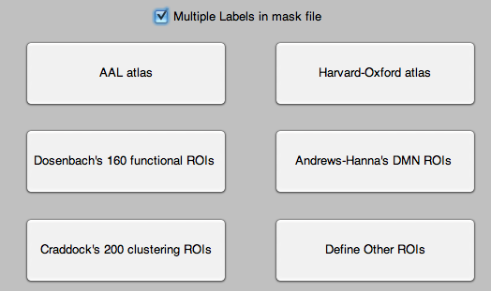
Define ROI
Multiple labels in mask file: each label is considered as one ROI
Dosenbach et al., 2010
Andrews-Hanna et al., 2010
Craddock et al., 2011
Define other ROIs
71

Slide 72
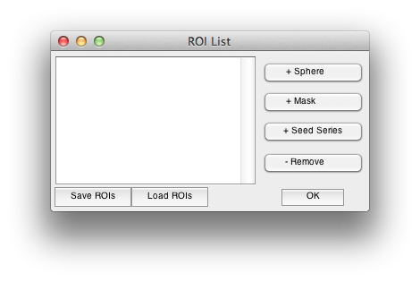

Slide 73
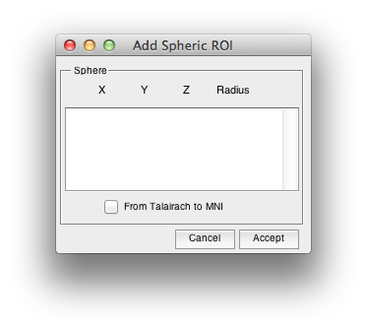

Slide 74
Preprocessing and R-fMRI measures Calculation
Define ROI Interactively
74

Slide 75
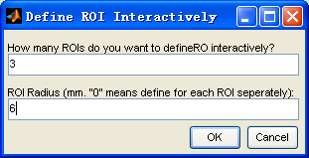
0 means define ROI Radius for each ROI seperately
75

Slide 76
76

Slide 77
Functional Connectivity
You will get the Voxel-wise functional connectivity results of each ROI in {working directory}\Results\FC:
zROI1FCMap_Sub_001.img
zROI2FCMap_Sub_001.img
For ROI-wise results, please see {working directory}\Results\FunImgARCW*_ROISignals.

Slide 78
Preprocessing and R-fMRI measures Calculation
Voxel-mirrored homotopic connectivity (VMHC) (Zuo et al., 2010)
Prepare for VMHC: Further register to a symmetric template
78

Slide 79
Preprocessing and R-fMRI measures Calculation
Voxel-mirrored homotopic connectivity (VMHC) (Zuo et al., 2010)
79

Slide 80
VMHC
1) Get the T1 images in MNI space (e.g., wco*.img or wco*.nii under T1ImgNewSegment or T1ImgSegment) for each subject, and then create a mean T1 image template (averaged across all the subjects).
2) Create a symmetric T1 template by averaging the mean T1 template (created in Step 1) with it's flipped version (flipped over x axis).
3) Normalize the T1 image in MNI space (e.g., wco*.img or wco*.nii under T1ImgNewSegment or T1ImgSegment) for each subject to the symmetric T1 template (created in Step 2), and apply the transformations to the functional data (which have been normalized to MNI space beforehand). Please see a reference from Zuo et al., 2010.
80

Slide 81
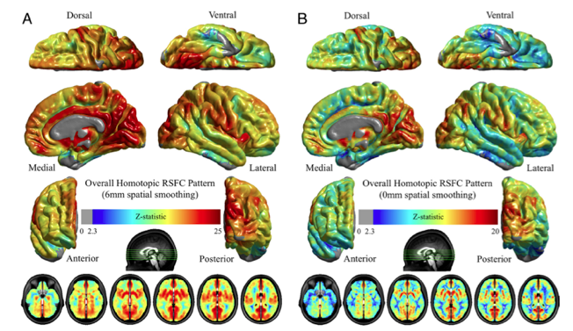
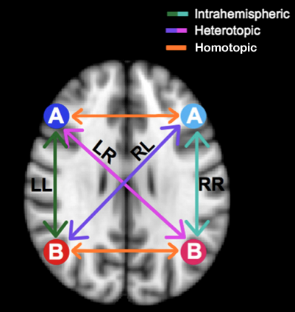
Gee et al., 2011
Zuo et al., 2010
81

Slide 82
Preprocessing and R-fMRI measures Calculation
Parallel Workers (if parallel computing toolbox is installed)
Each subject is distributed into a different worker. (Except DARTEL-Create Template)
82

Slide 83
Preprocessing and R-fMRI measures Calculation
Multiple functional sessions
1st session: FunRaw
2nd session: S2_FunRaw
3rd session: S3_FunRaw
…
83

Slide 84
Starting Directory Name
If you do not start with raw DICOM images, you need to specify the Starting Directory Name.
E.g. "FunImgARW" means you start with images which have been slice timed, realigned and normalized.
Abbreviations:
A - Slice Timing
R - Realign
W - Normalize
S - Smooth
D - Detrend
F - Filter
C - Covariates Removed
B - ScruBBing
84

Slide 85
Preprocessing and R-fMRI measures Calculation
Connectome-wide association studies based on multivariate distance matrix regression (Shehzad et al., 2014)
Resource consuming as compared to other measures
85

Slide 86
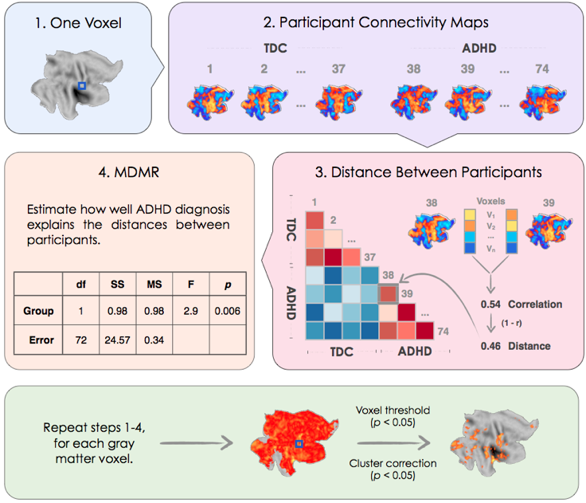
Shehzad et al., 2014. Neuroimage
86

Slide 87
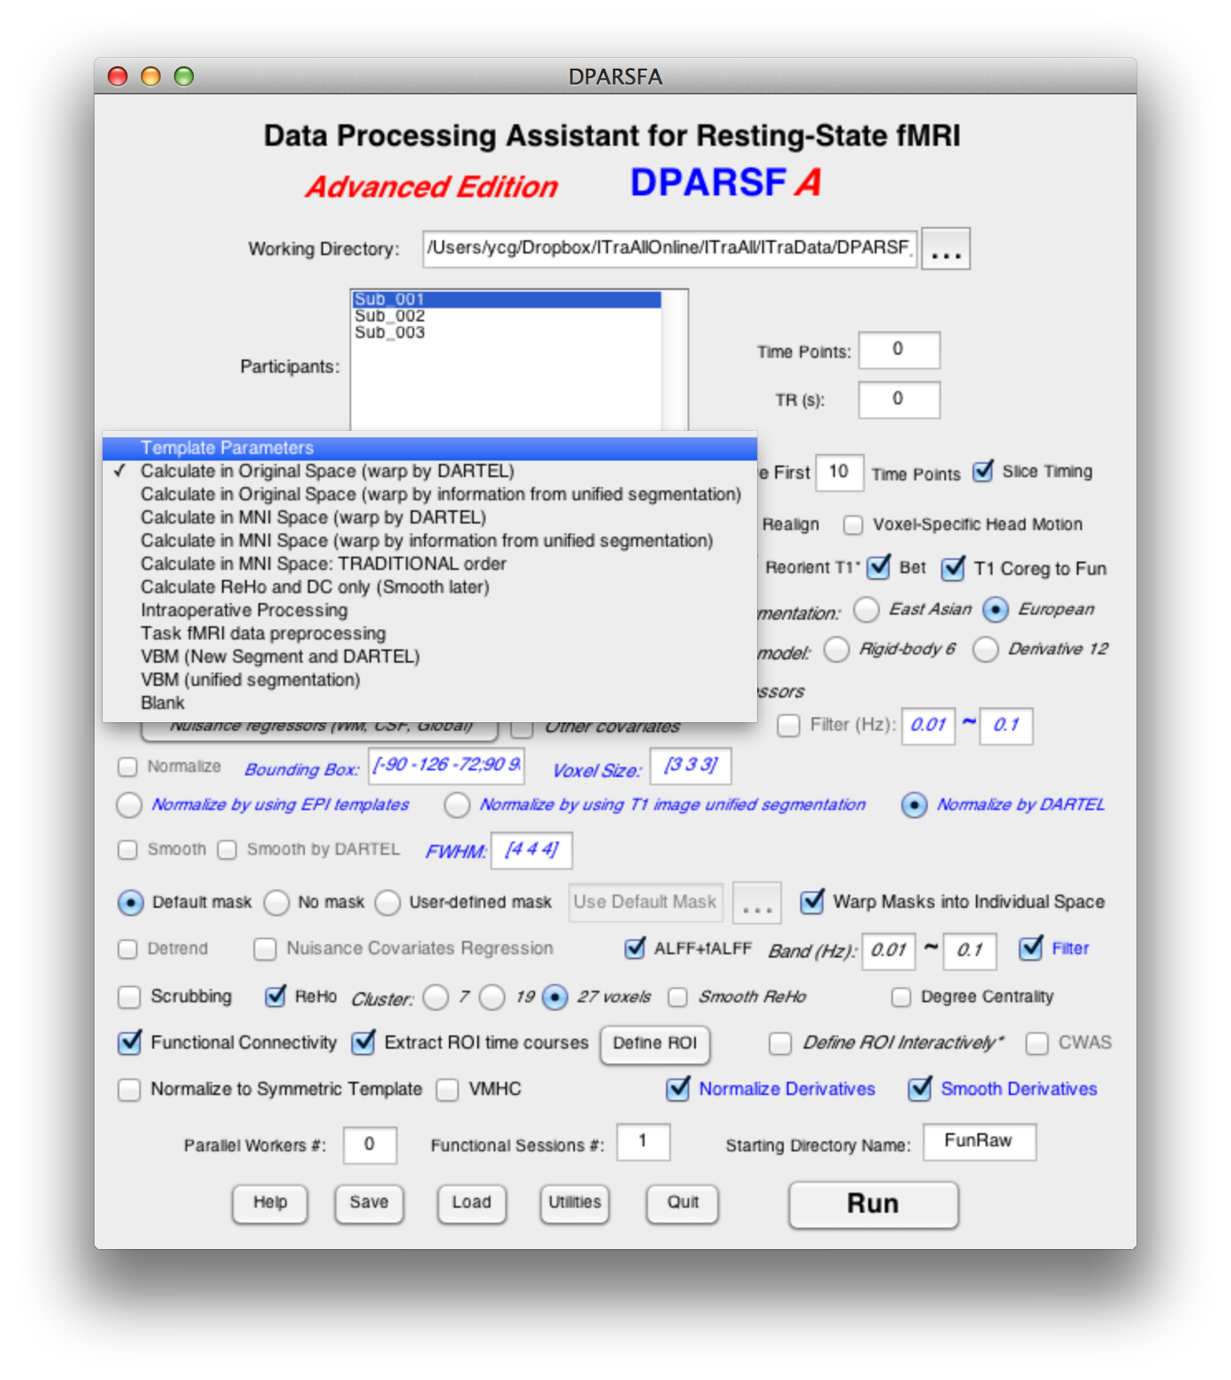
Resting State fMRI Data Processing
Template Parameters
87

Slide 88
Resting State fMRI Data Processing
Calculate in MNI space
Calculate in Original space
88

Slide 89
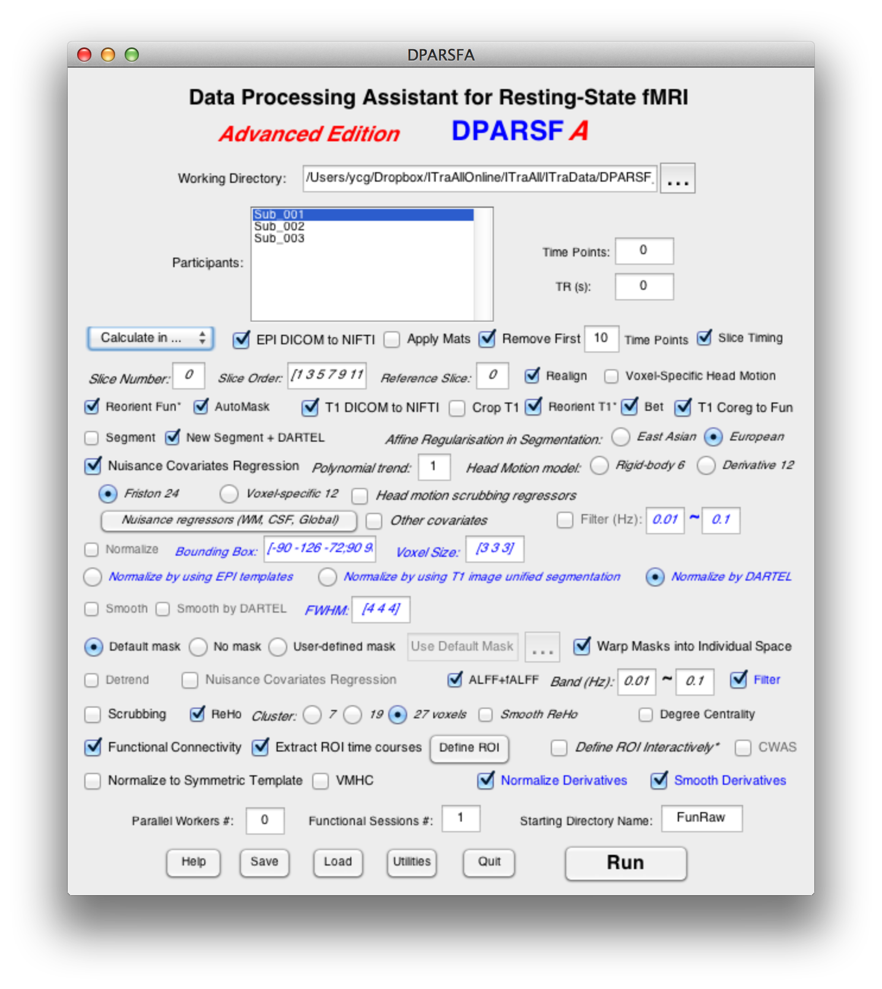
Preprocessing and R-fMRI measures Calculation
Normalize measures (derivatives) calculated in original space into MNI space
Use the parameters set in the upper section.
89

Slide 90
Preprocessing and R-fMRI measures Calculation
Smooth R-fMRI measures (derivatives)
Use the parameters set in the upper section.
90

Slide 91
Preprocessing and R-fMRI measures Calculation
Warp masks into original space
91

Slide 92
Resting State fMRI Data Processing
Intraoperative Processing
92

Slide 93
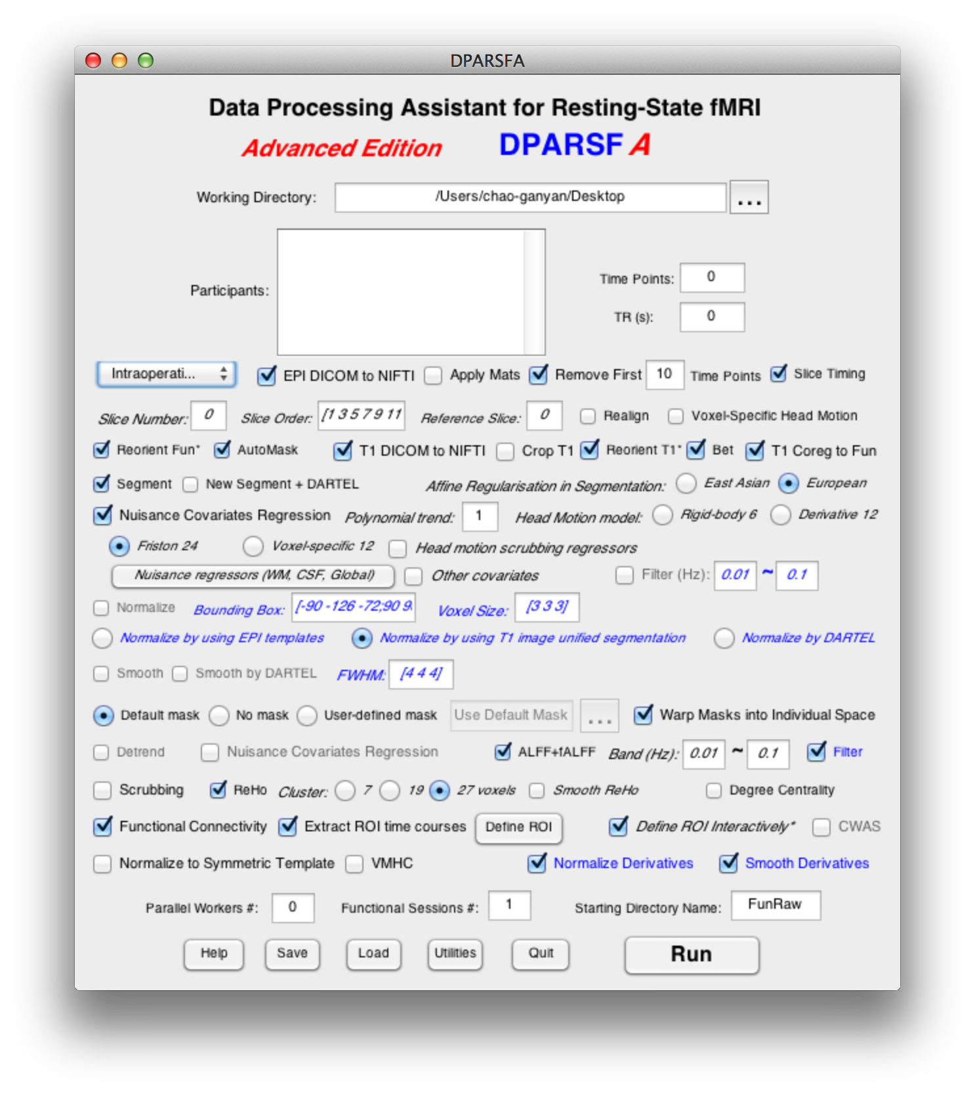
Preprocessing and R-fMRI measures Calculation
No realign since there is no head motion. DPARSFA will generate the mean functional images automatically.
Define ROI Interactively
93

Slide 94
Resting State fMRI Data Processing
VBM
94

Slide 95
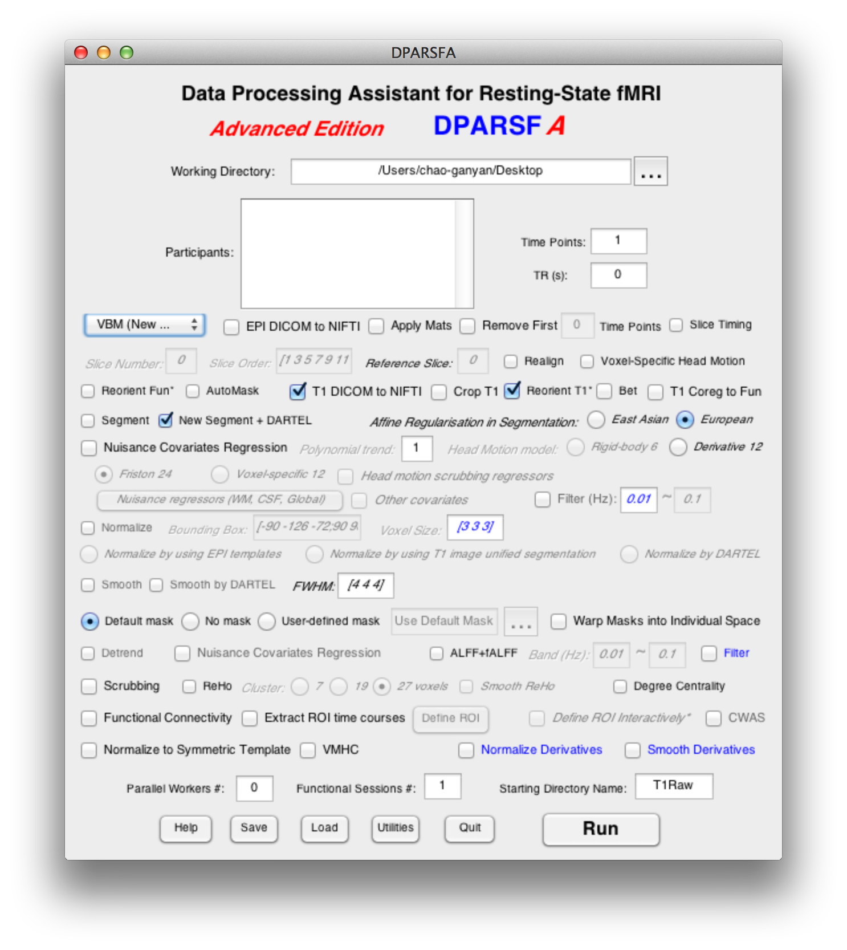
VBM
Only New Segment + DARTEL is checked
Define the Starting Directory Name as T1Raw
95

Slide 96
Resting State fMRI Data Processing
Blank
96

Slide 97
Blank
97

Slide 98
Save and Load Parameters
Save parameters to *.mat
Load parameters from *.mat

Slide 99
Further Help
Further questions:
http://rfmri.org/dpabi
The R-fMRI Network
99

Slide 100
Further Help
100

Slide 101
101

Slide 102
102

Slide 103
Send emails only to rfmri.org@gmail.com: 1) sending new email means you are posting your personal blogs, 2) replying email means you are posting comments to that topic/blog, 3) then all the other R-fMRI nodes will receive email updates of your posts.
103

Slide 104
104

Slide 105
The R-fMRI Maps Project
105

Slide 106
招贤纳士
博士研究生1名
硕士研究生1名
助理研究员2名
博士后1名

Slide 107
Acknowledgments
Chinese Academy of Sciences Xi-Nian Zuo
NYU Child Study Center
F. Xavier Castellanos
Hangzhou Normal University Yu-Feng Zang
Child Mind Institute
Michael P. Milham
Beijing Normal University
Yong He
Xin-Di Wang
Peking University
Jia-Hong Gao
Wei-Wei Men
Funding
National Natural Science Foundation of China
Chinese Academy of Sciences
Notes:
Different Axis!!!

Slide 108
Thanks for your attention!
108

