Slide 1


Data Processing & Analysis for (Resting-State) Brain Imaging (DPABI): Utilities
严超赣
Chao-Gan Yan, Ph.D.
yancg@psych.ac.cn
http://rfmri.org/yan
Institute of Psychology, Chinese Academy of Sciences

Slide 2
Outline
Processing for Animal Data
Standardization
Utilities
2

Slide 3
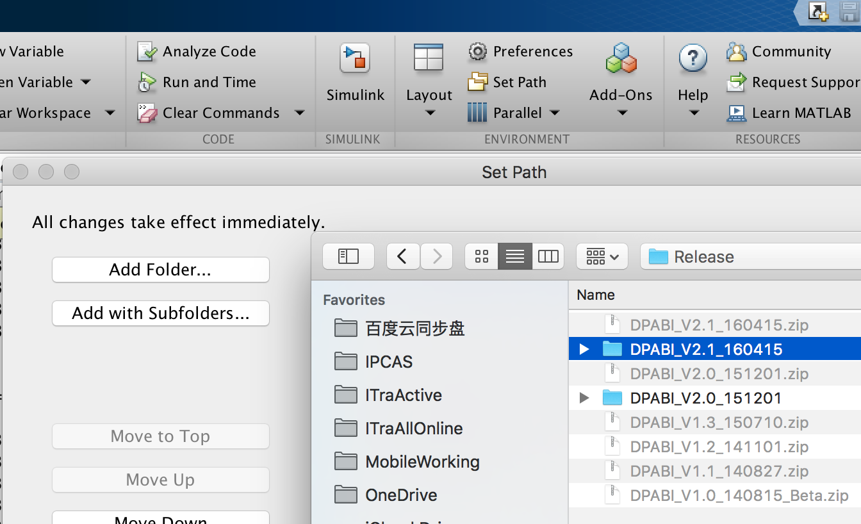
3

Slide 4
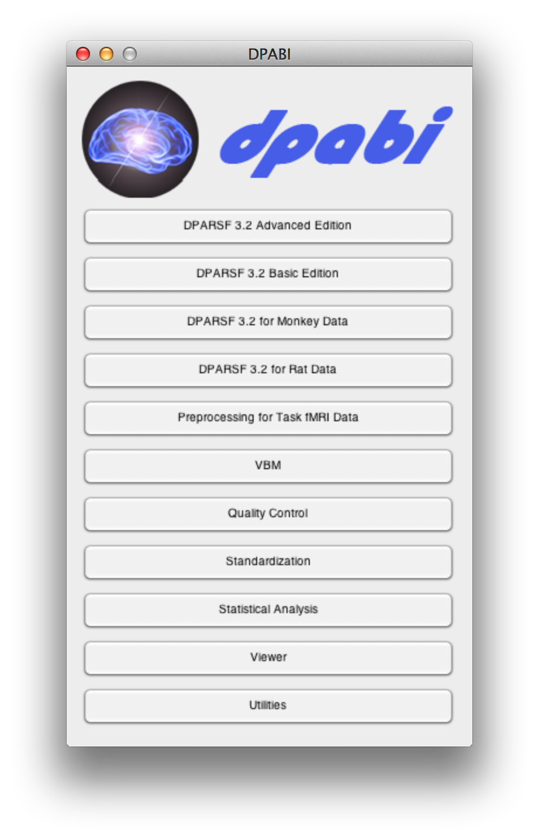

Slide 6
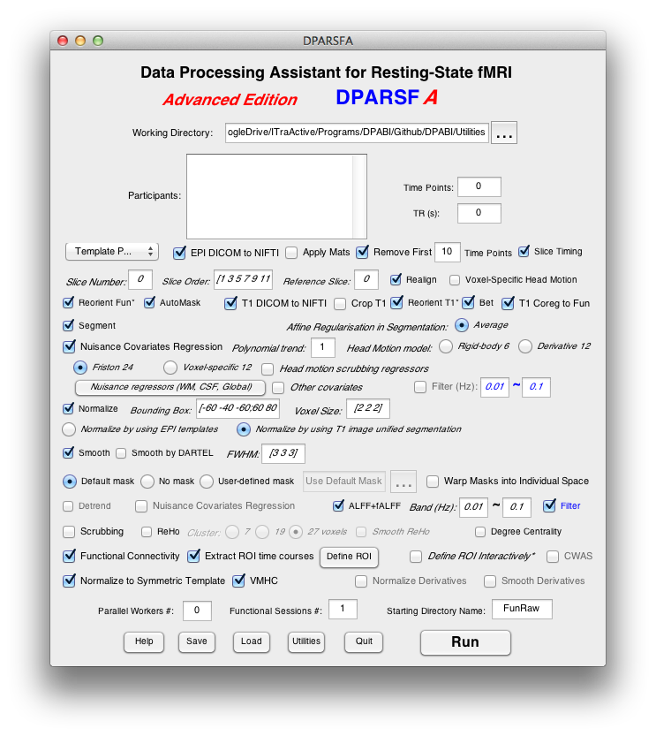
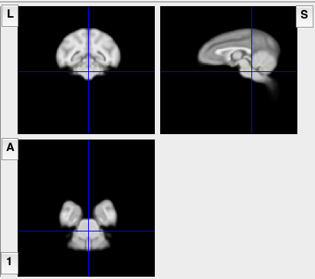
DPARSF for
Monkey Data
The monkey module is based on Rhesus Macaque Atlases for functional and structural imaging studies generated by Wisconsin ADRC Imaging Core. Please cite these papers when appropriate: McLaren, D.G., Kosmatka, K.J., Oakes, T.R., Kroenke, C.D., Kohama, S.G., Matochik, J.A., Ingram, D.K., Johnson, S.C., 2009. A population-average MRI-based atlas collection of the rhesus macaque. Neuroimage 45, 52-59.; McLaren, D.G., Kosmatka, K.J., Kastman, E.K., Bendlin, B.B., Johnson, S.C., 2010. Rhesus macaque brain morphometry: a methodological comparison of voxel-wise approaches. Methods 50, 157-165.
6

Slide 8
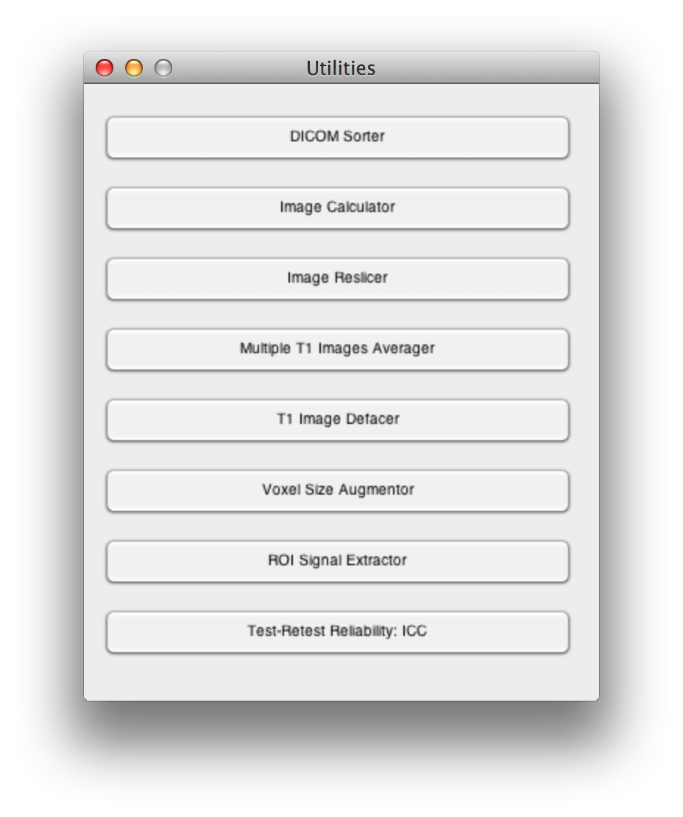

Slide 9
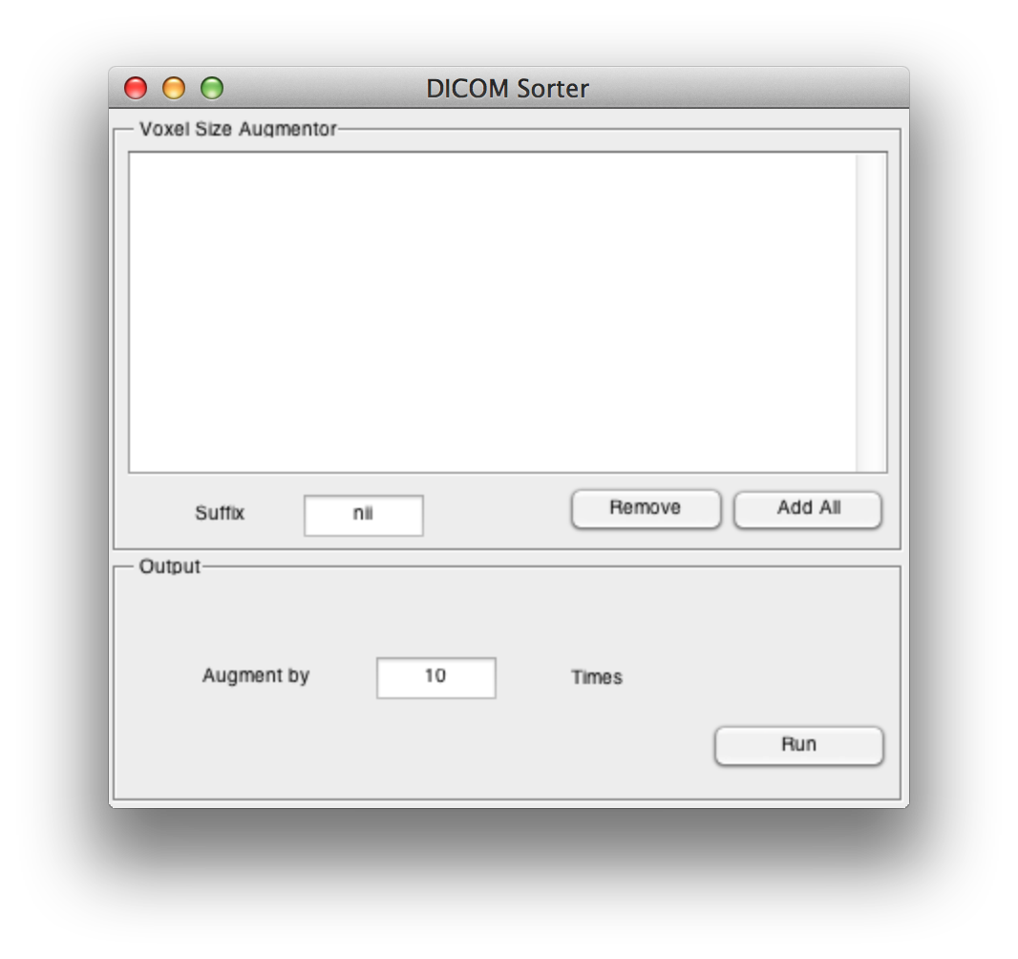

Slide 10
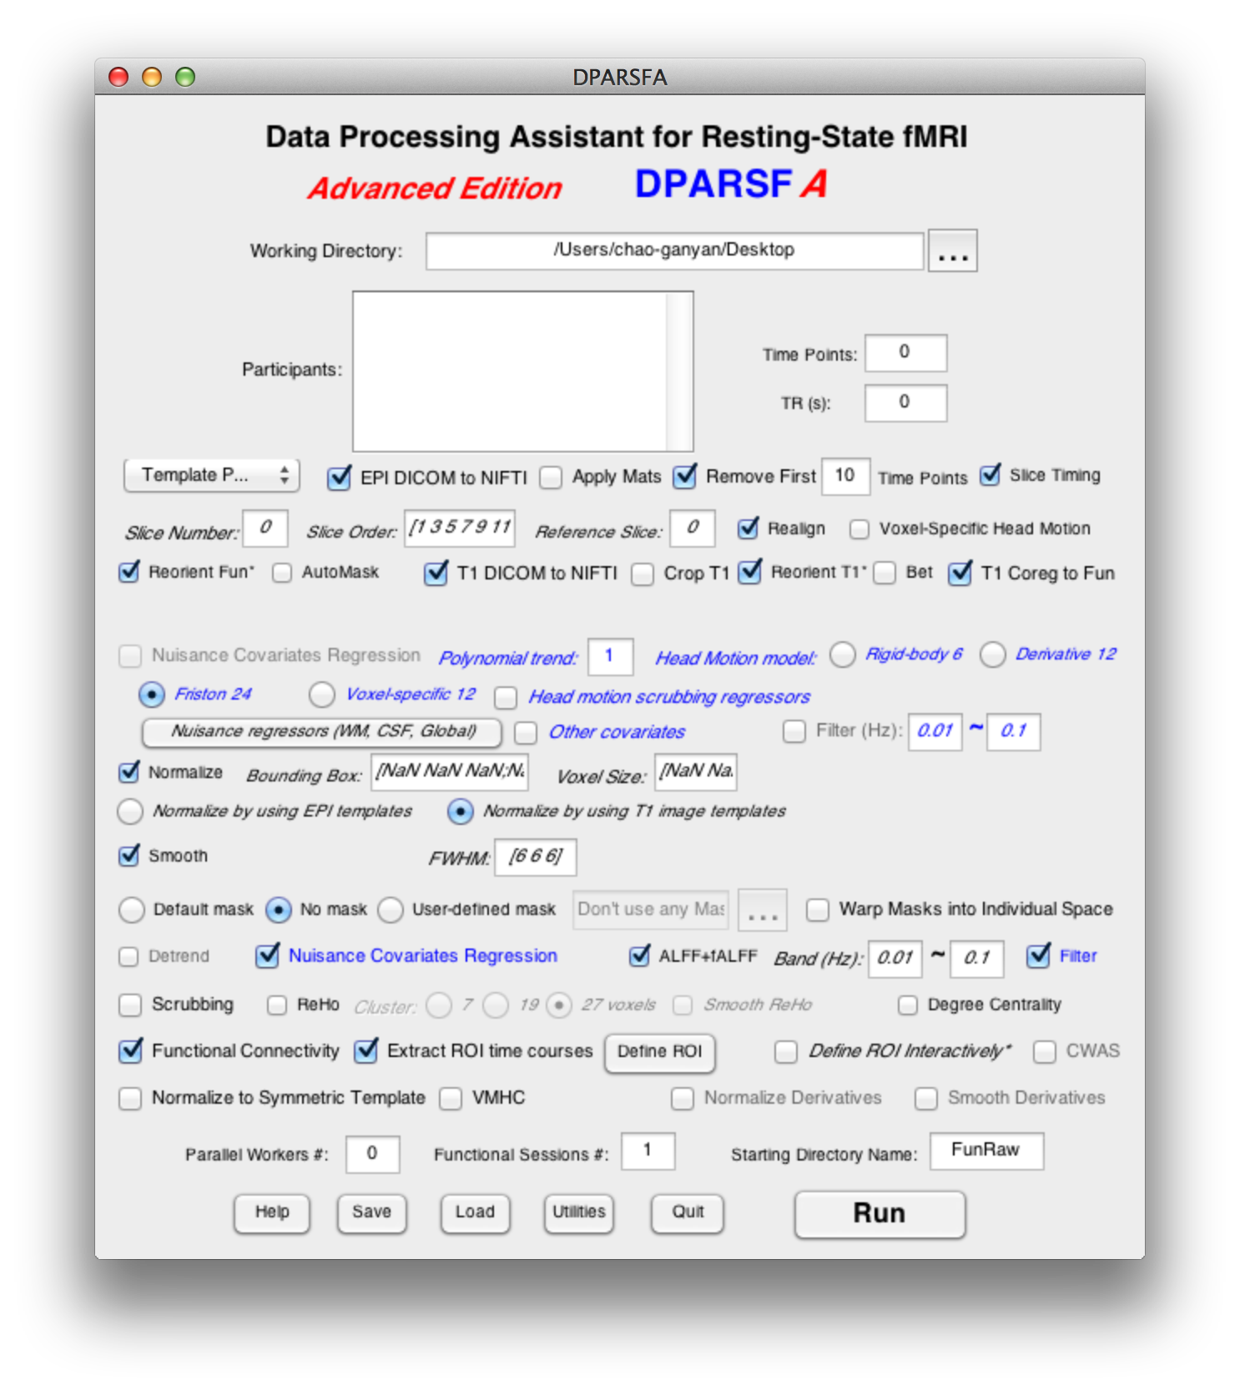
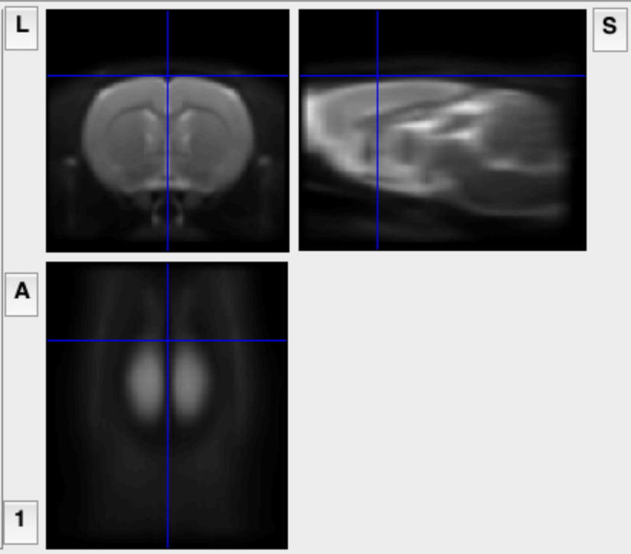
DPARSF for
Rat Data
The Rat module is based on a Rat T2 template generated by Dr. Adam J. Schwarz et al. Please cite this paper when appropriate: Schwarz, A.J., Danckaert, A., Reese, T., Gozzi, A., Paxinos, G., Watson, C., Merlo-Pich, E.V., Bifone, A., 2006. A stereotaxic MRI template set for the rat brain with tissue class distribution maps and co-registered anatomical atlas: application to pharmacological MRI. Neuroimage 32, 538-550. (A T1 template was included as well. It’s generated by normalizing 50 rats (two scans at PND45 or PND60) to that T2 template and then averaging (by Dr. Chao-Gan Yan)).
10

Slide 11
Outline
Processing for Animal Data
Standardization
Utilities
11

Slide 12
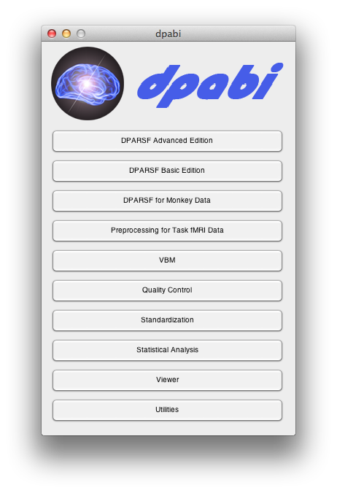

Slide 13

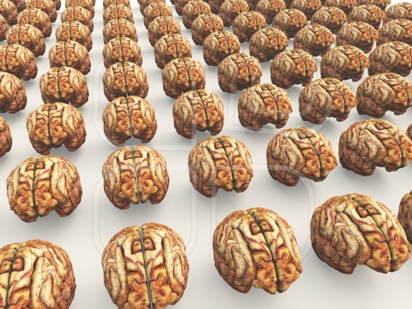
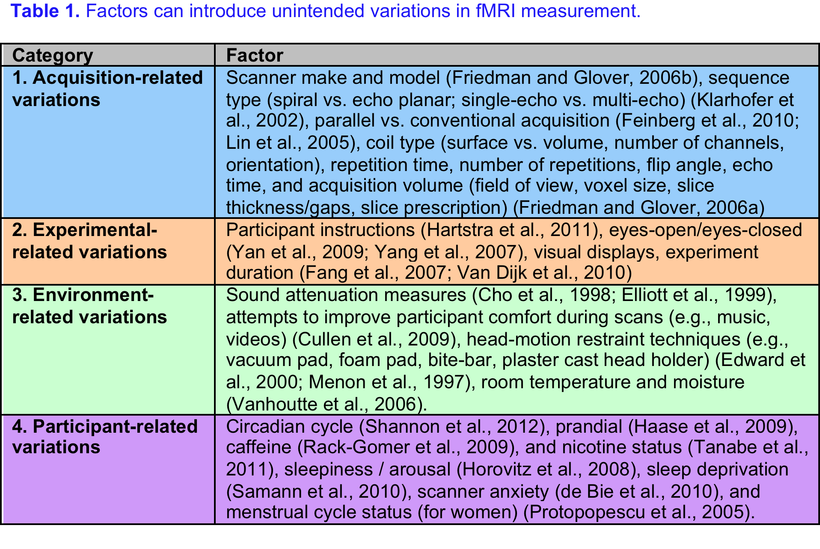
Standardization
Yan et al., 2013. Neuroimage

Slide 14
Standardization
Yan et al., 2013. Neuroimage

Slide 15
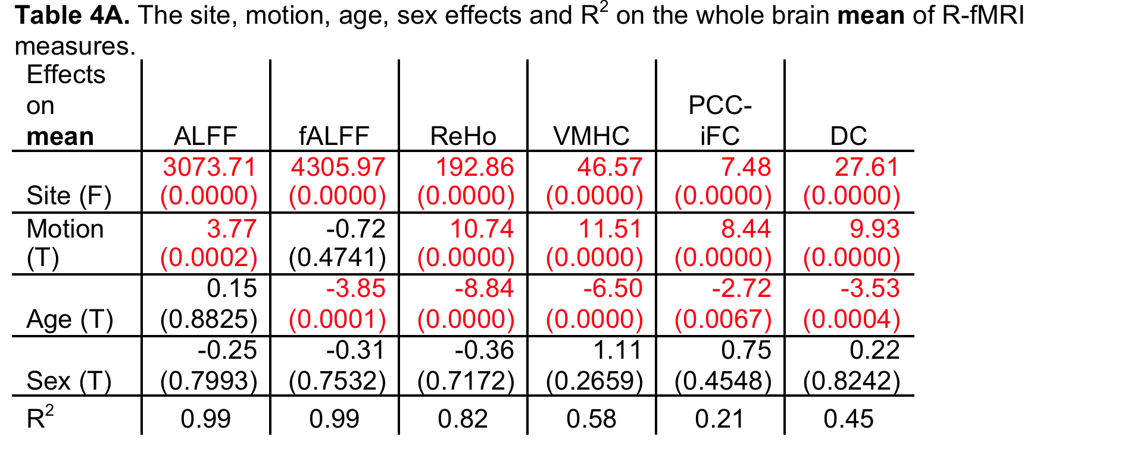
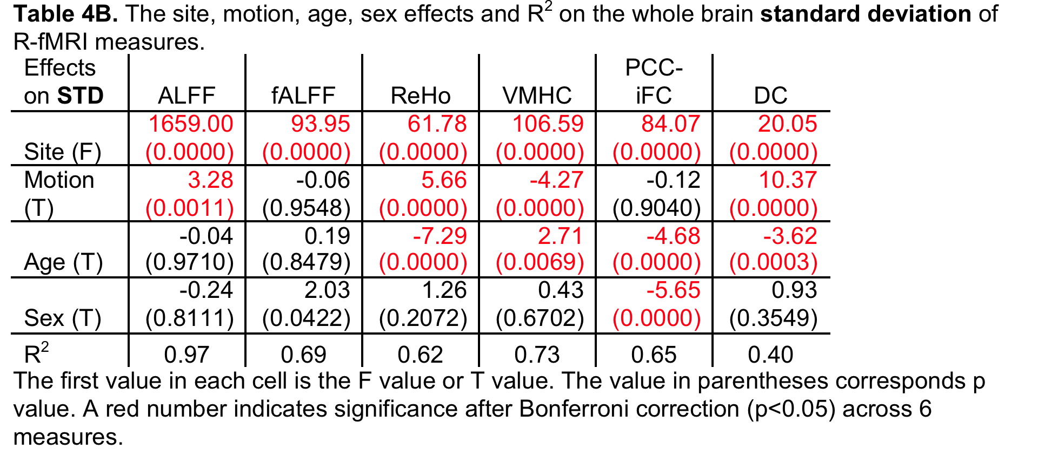
Standardization
Methodological Issues
Yan et al., 2013. Neuroimage

Slide 16
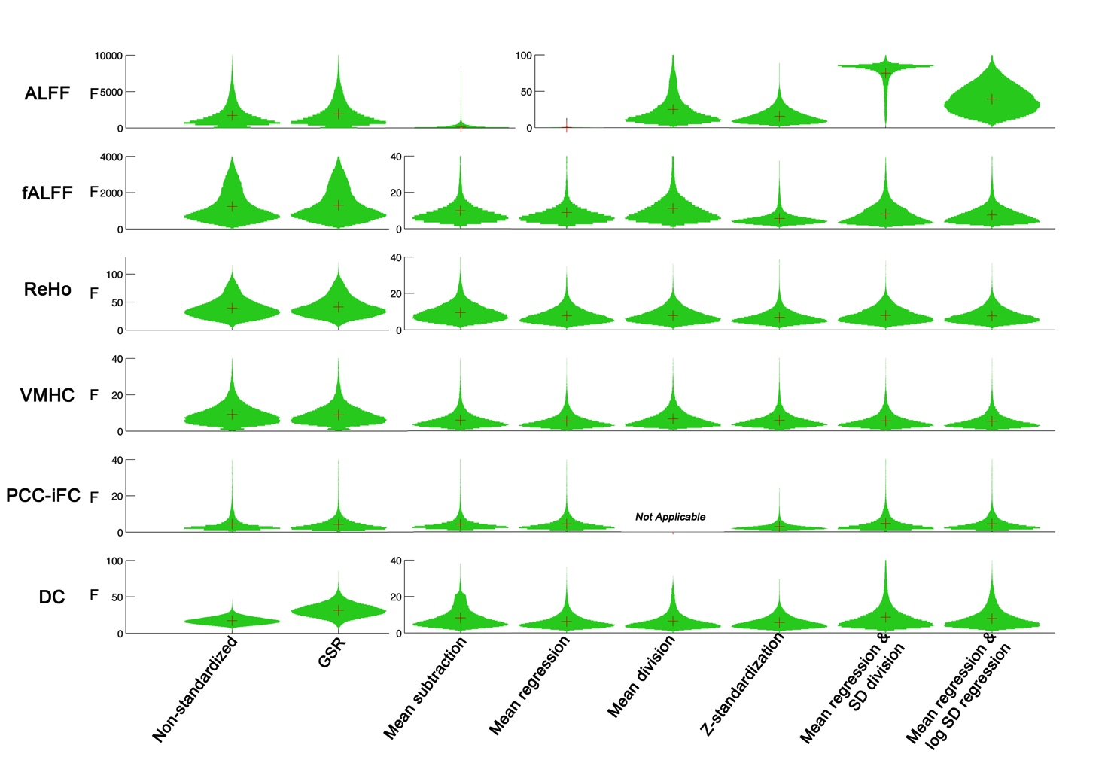
Standardization
Standardization
Yan et al., 2013. Neuroimage

Slide 17
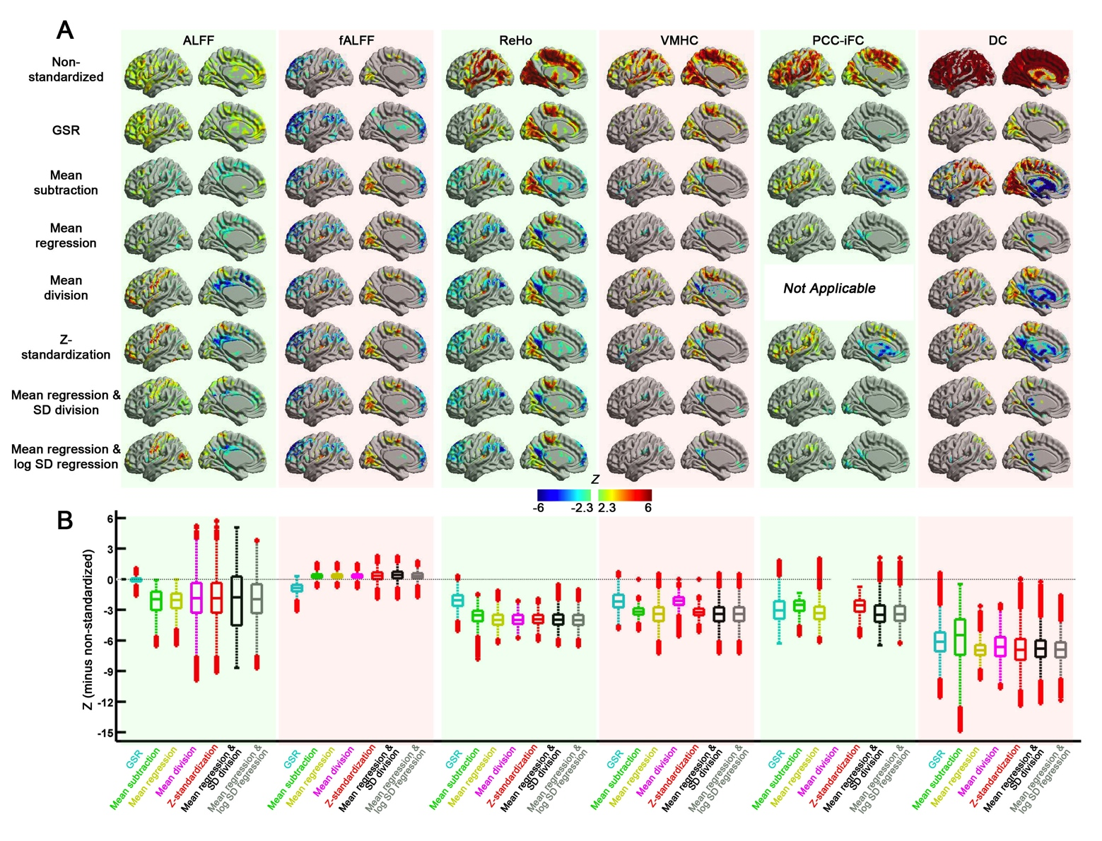
Standardization
Yan et al., 2013. Neuroimage

Slide 18
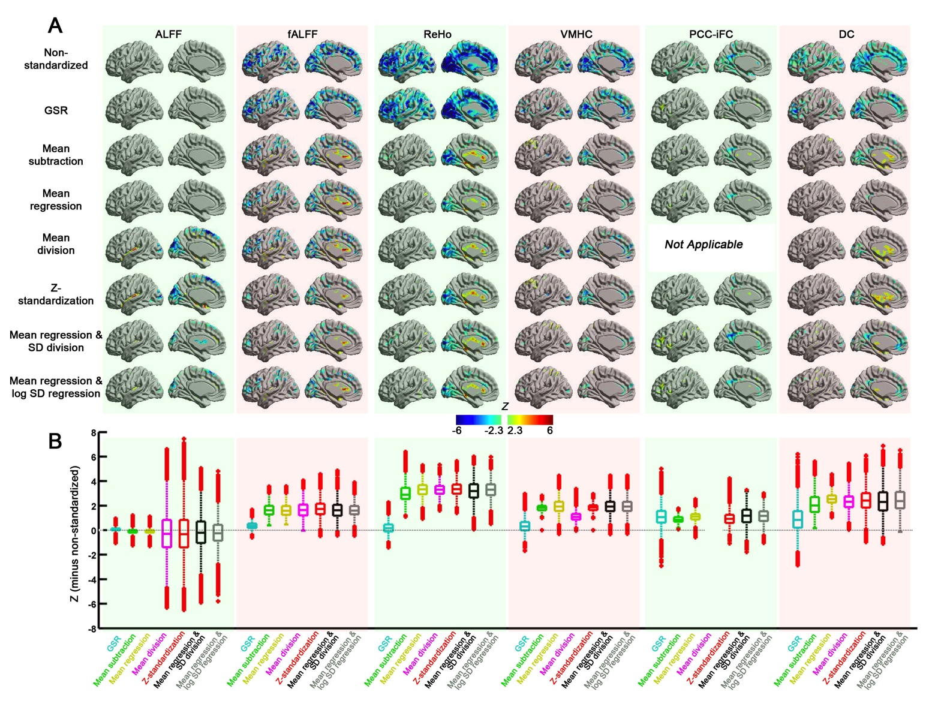
Standardization
Methodological Issues
Yan et al., 2013. Neuroimage

Slide 19
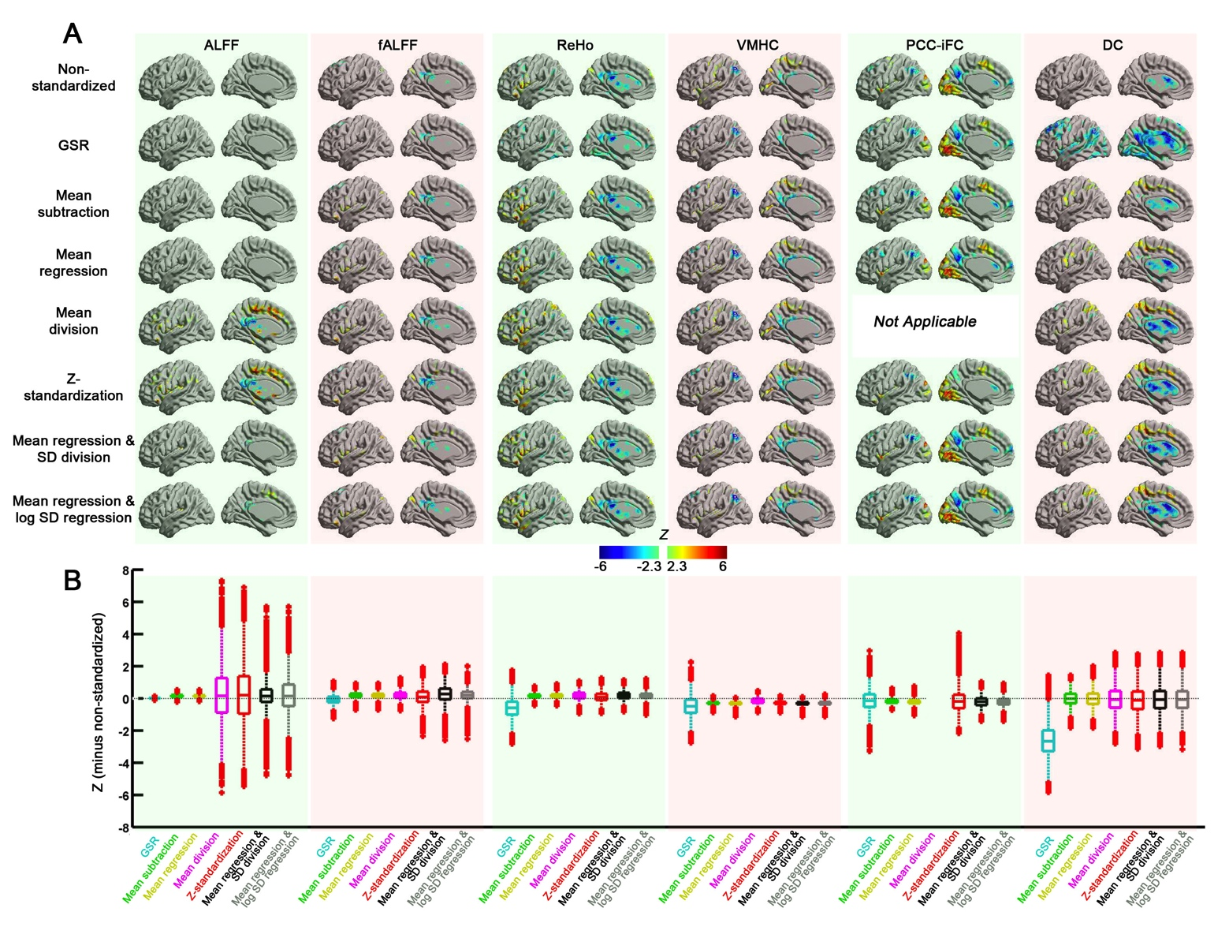
Standardization
Yan et al., 2013. Neuroimage

Slide 20
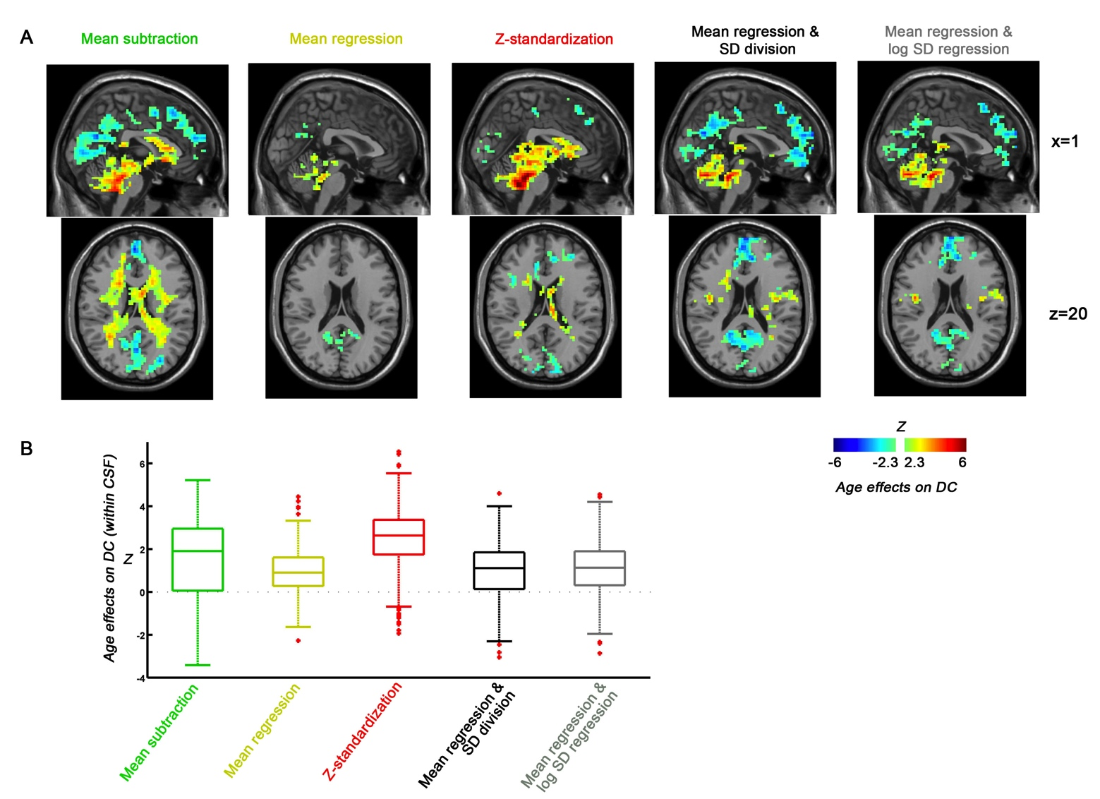
Standardization
Yan et al., 2013. Neuroimage

Slide 21
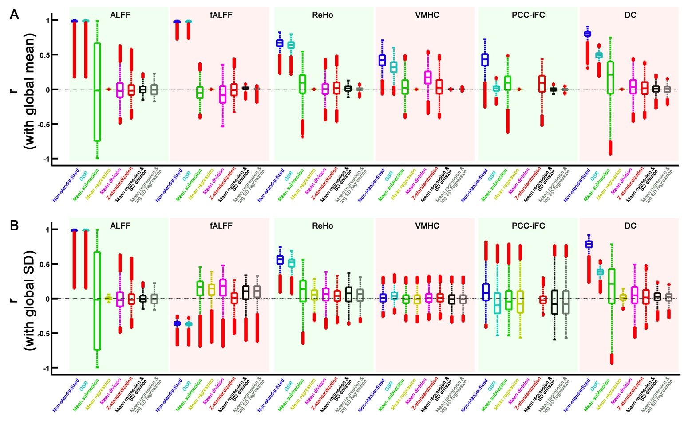
Standardization
Standardization
Yan et al., 2013. Neuroimage

Slide 22
Standardization
Mean regression-based approach.
Mean regression + SD division (for controlling mulplicative effects).

Slide 23
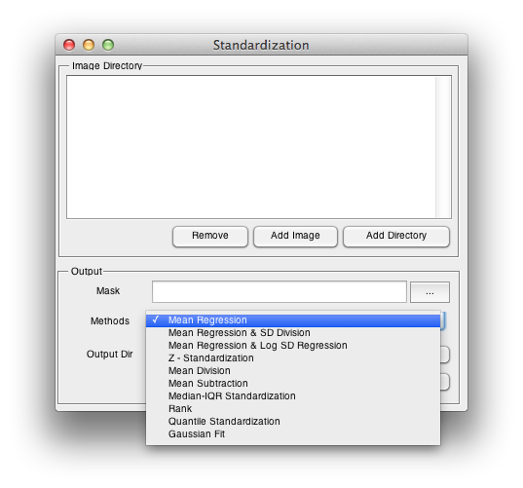
Standardization

Slide 24
Outline
Processing for Animal Data
Standardization
Utilities
24

Slide 26
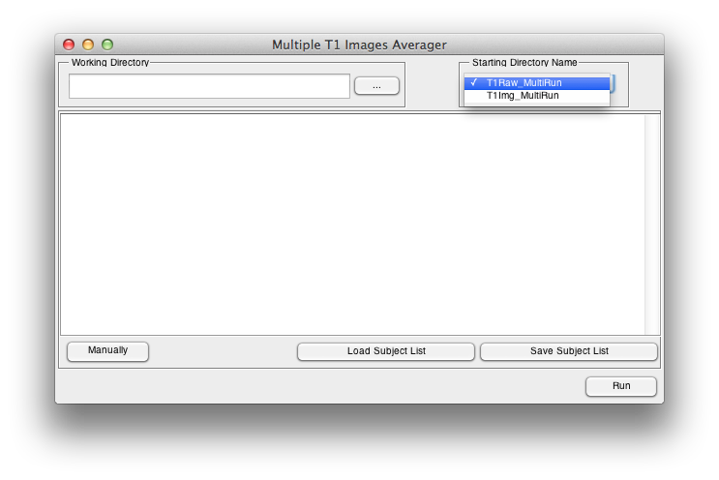
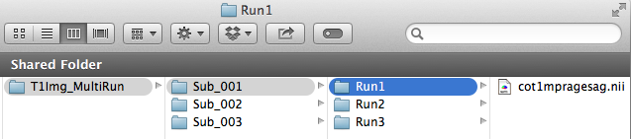
Coregister and average

Slide 28
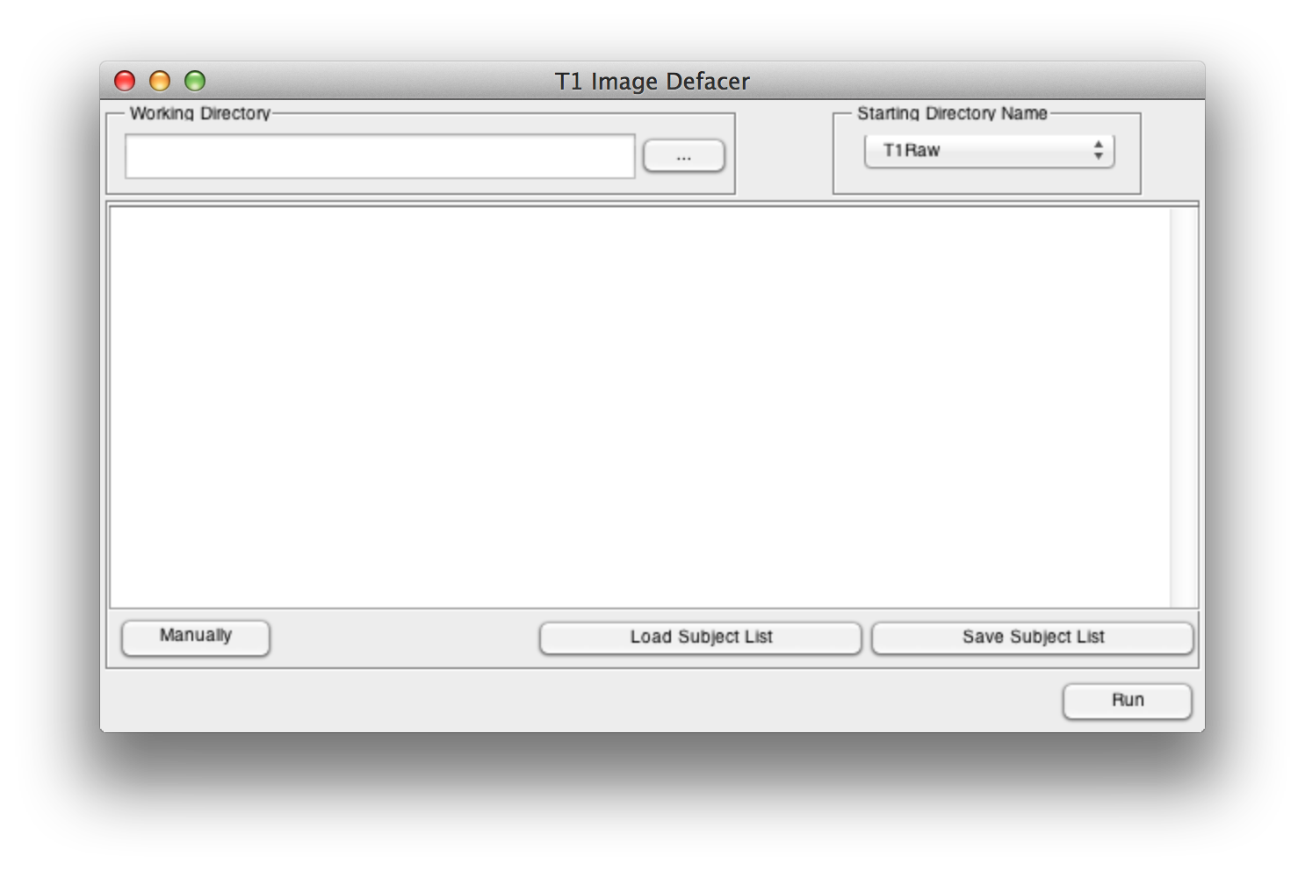

Slide 29
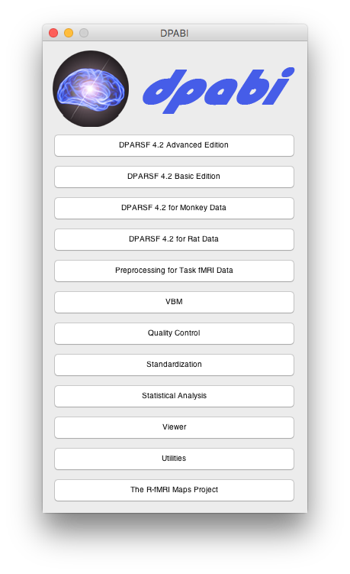

Slide 30
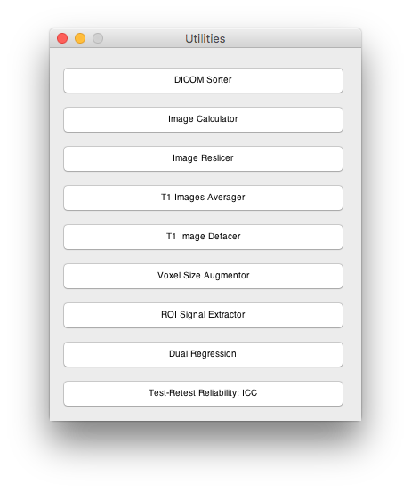

Slide 31
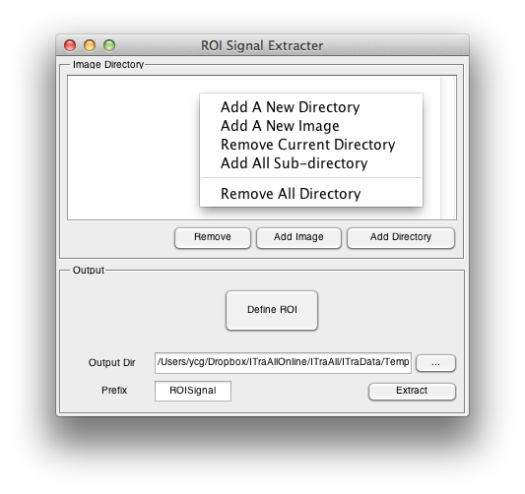
31

Slide 32
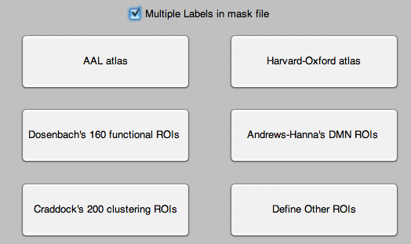

Define ROI
Multiple labels in mask file: each label is considered as one ROI
Dosenbach et al., 2010
Andrews-Hanna et al., 2010
Craddock et al., 2011
Define other ROIs
32

Slide 33
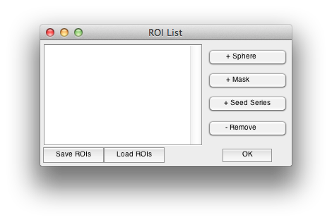

Slide 34
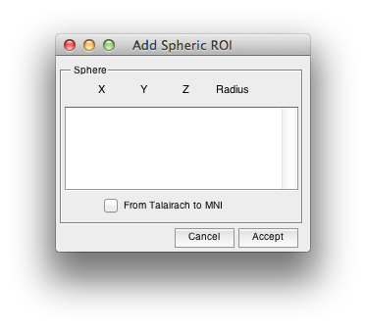

Slide 35
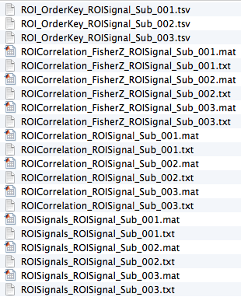
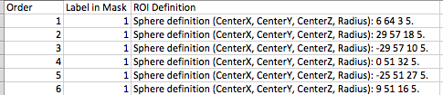
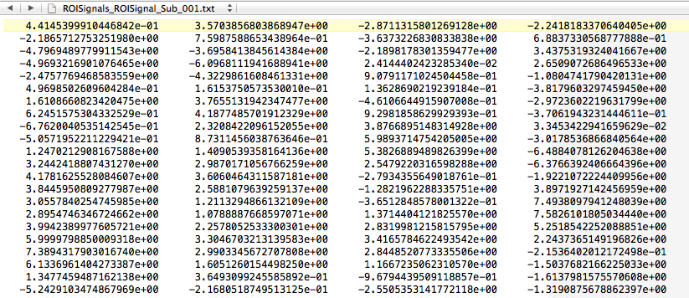

Slide 37
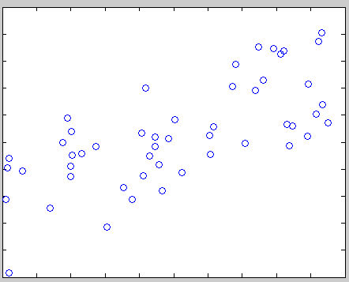
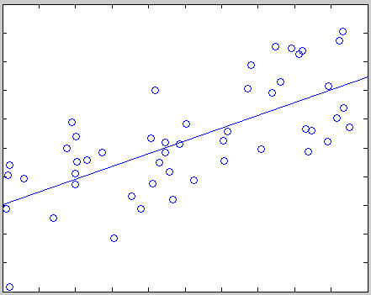
[r p]=corrcoef(ALFF,MMSE)
plot(ALFF,MMSE,’o’)
lsline
Scatter
Plot

Slide 38
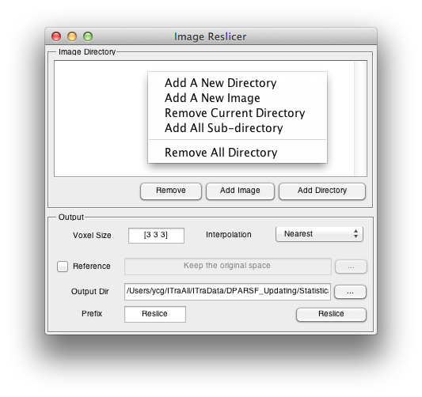
Image
Reslicer

Slide 39
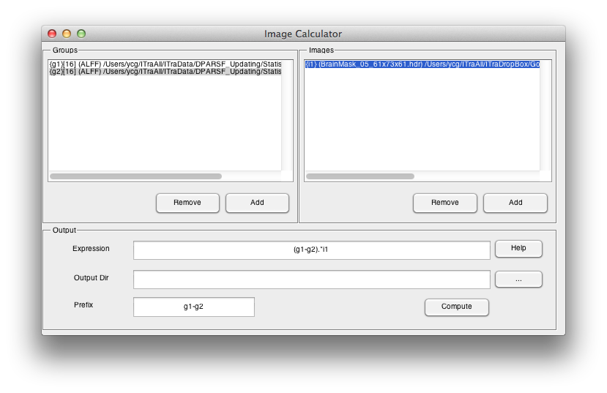
Image Calculator

Slide 40
Image Calculator
Example expressions:
(a) g1-1 Subtract 1 from each image in group 1
(b) g1-g2 Subtract each image in group 2 from each corresponding image in group1
(c) i1-i2 Subtract image 2 from image 1
(d) i1>100 Make a binary mask image at threshold of 100
(e) g1.*To4D((i1>2.3),100) Make a mask (threshold at 2.3 on i1) and then apply to each image in group 1 (group 1 has 100 images)
mean(g1) Calculate the mean image of group 1
(i1-mean(g1))./std(g1) Calculate the z value of i1 related to group 1
(h) corr(g1,g2,''temporal'') Calculate the temporal correlation between two groups, i.e. one correlation coefficient between two ''time courses'' for each voxel.
(i) corr(g1,g2,''spatial'') Calculate the spatial correlation between two groups, i.e. one correlation coefficient between two images for each ''time point''.

Slide 41
Reading and Writing functions
Reading:
[Data Header] = y_Read('brodmann.nii');
Data – 181*217*181 double
Header – Structure
Processing:
BA20Data = (Data==20);
Writing:
y_Write(BA20Data, Head, 'BA20.img');
y_ReadRPI
y_ReadAll

Slide 42
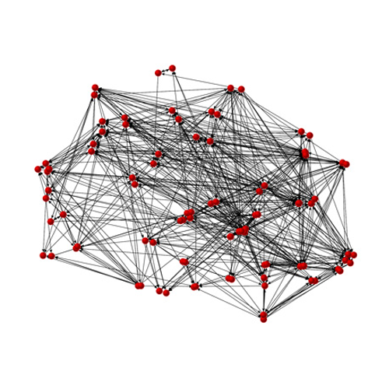
Further Help
Further questions:
http://rfmri.org/dpabi
The R-fMRI Network
42

Slide 43
Acknowledgments
Chinese Academy of Sciences Xi-Nian Zuo
NYU Child Study Center
F. Xavier Castellanos
Hangzhou Normal University Yu-Feng Zang
Child Mind Institute
Michael P. Milham
Beijing Normal University
Yong He
Xin-Di Wang
Funding
National Natural Science Foundation of China
Chinese Academy of Sciences
Notes:
Different Axis!!!

Slide 44
Thanks for your attention!
44

