Slide 1


DPABI: Quality Control, Statistical Analysis and Results Viewing
严超赣
Chao-Gan Yan, Ph.D.
yancg@psych.ac.cn
http://rfmri.org/yan
Institute of Psychology, Chinese Academy of Sciences

Slide 2
Outline
Quality Control
Statistical Analysis
Results Viewing
2

Slide 3
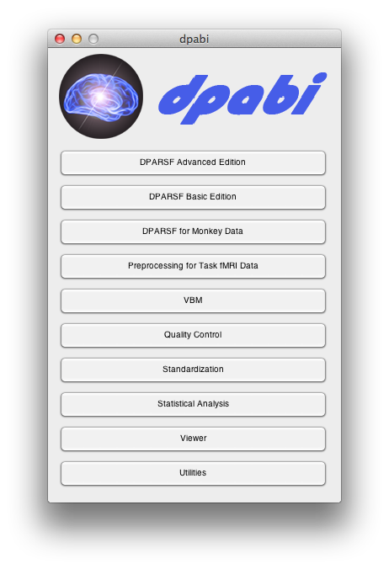

Slide 4
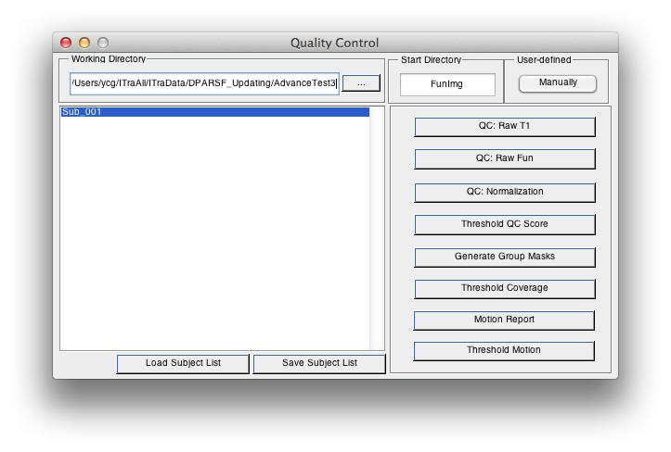
Quality Control
4

Slide 5
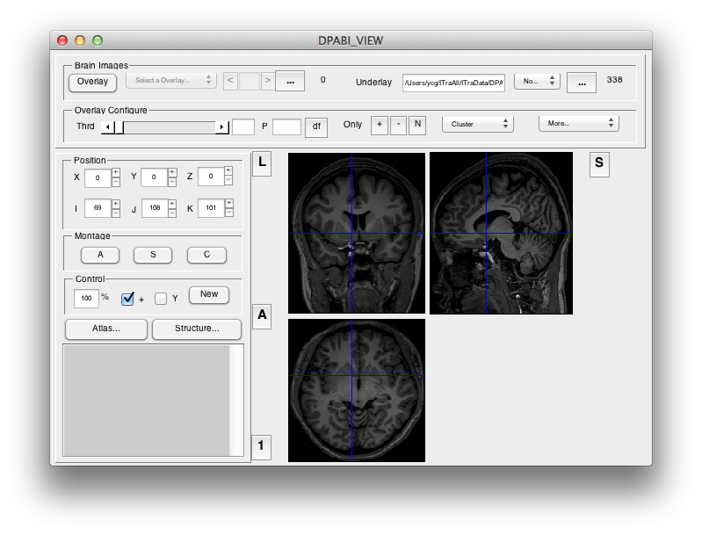
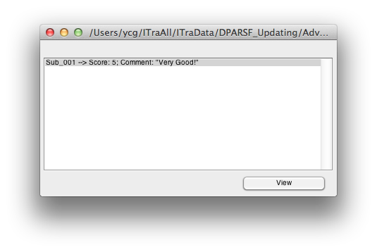
Quality Control
5

Slide 6
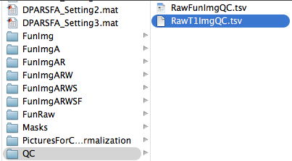

Quality Control
6

Slide 7
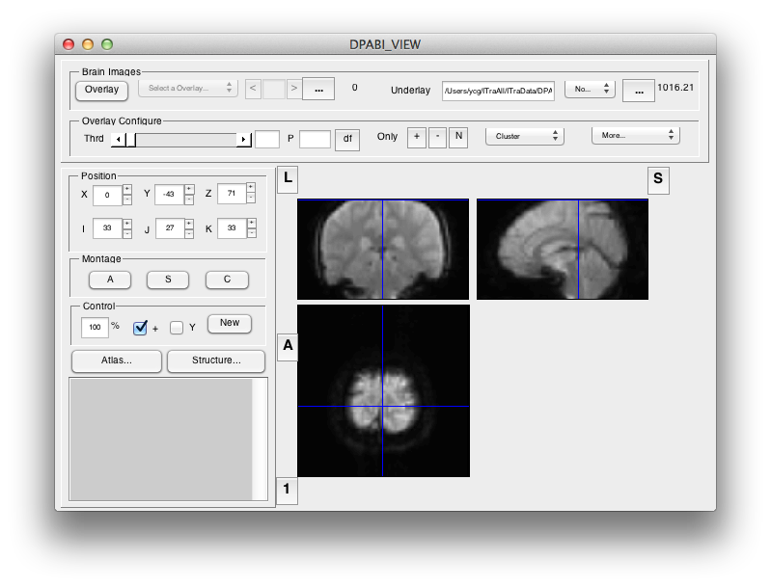
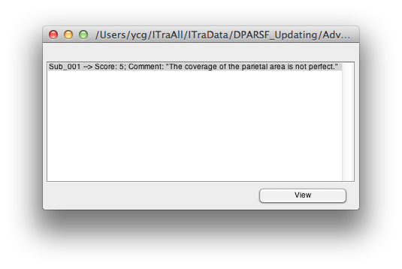
Quality Control
7

Slide 8
Quality Control
8

Slide 9
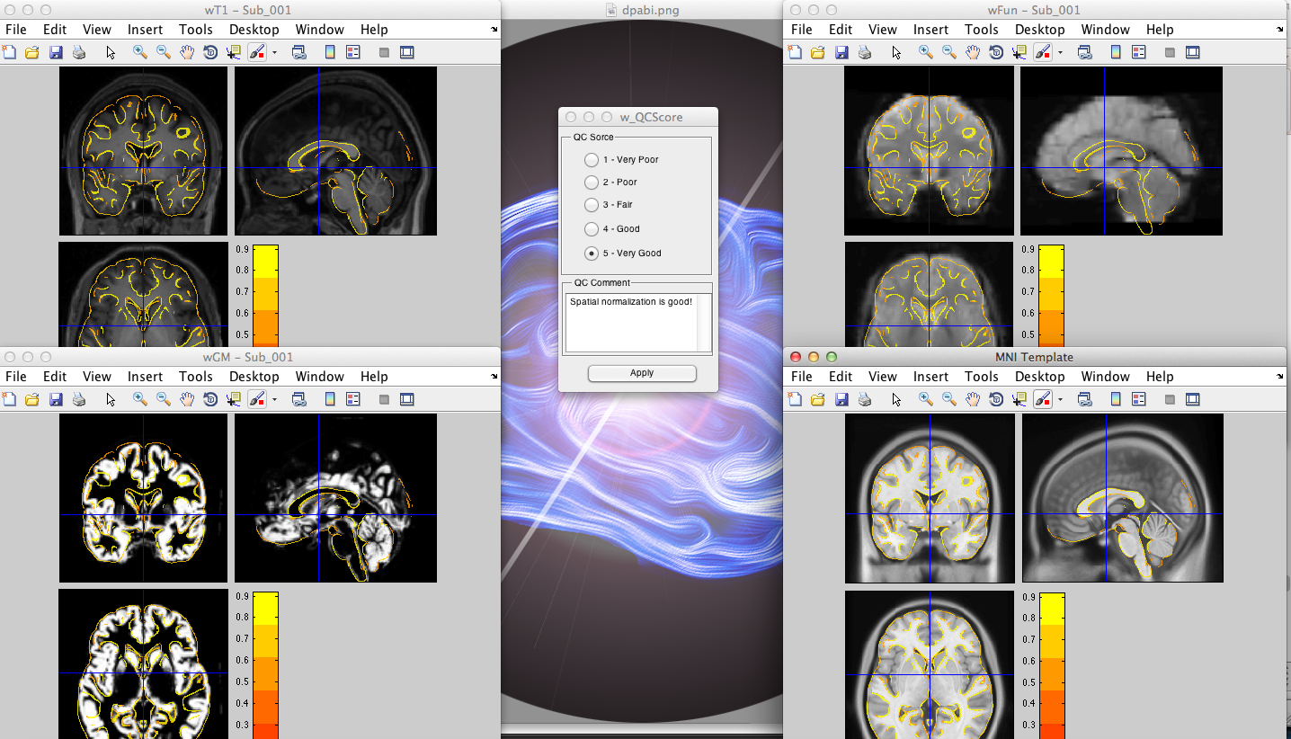
Quality Control
9

Slide 10
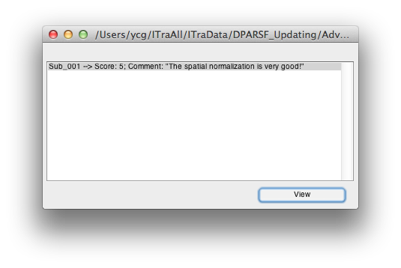
Quality Control
10

Slide 11
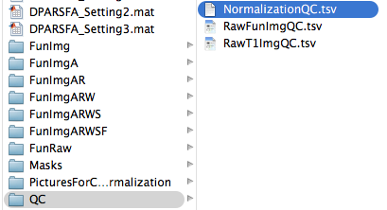

Quality Control
11

Slide 12
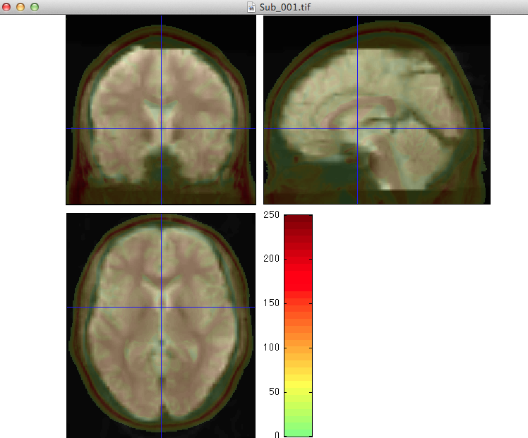
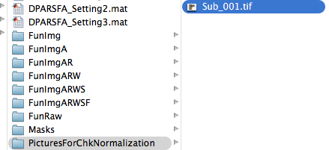
Quality Control
12

Slide 13
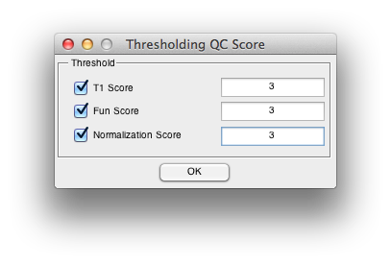
Quality Control
13

Slide 14
Quality Control
14

Slide 15
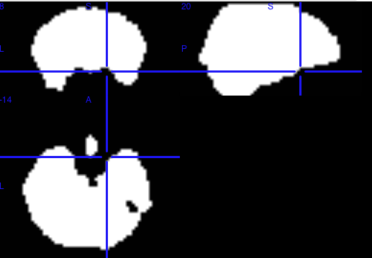
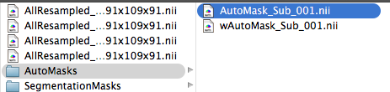
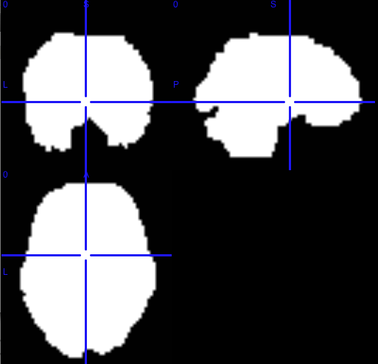
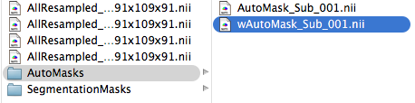
Quality Control
15

Slide 16
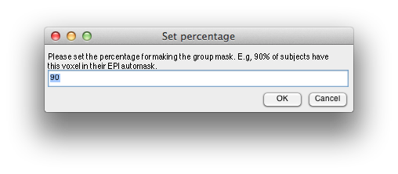
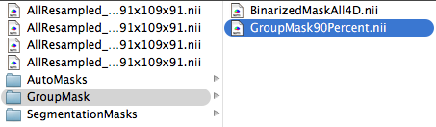
Quality Control
This mask is very important for group statistical analysis!!!
16

Slide 17
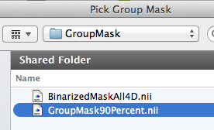
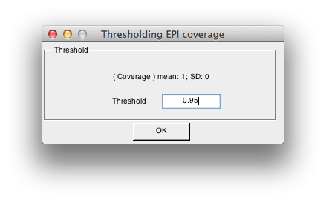
Quality Control
17

Slide 18
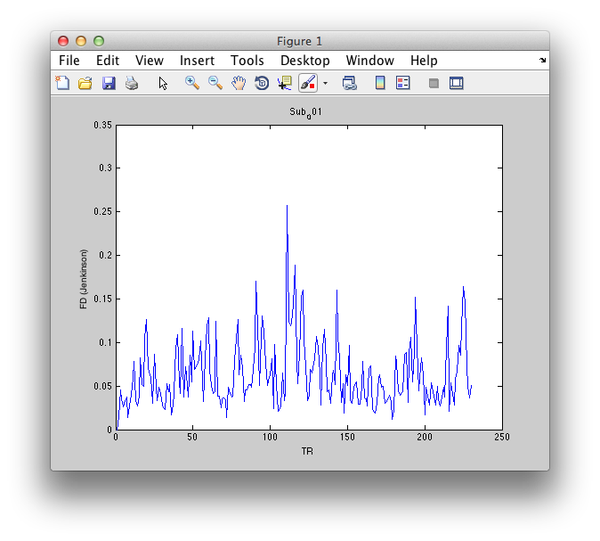
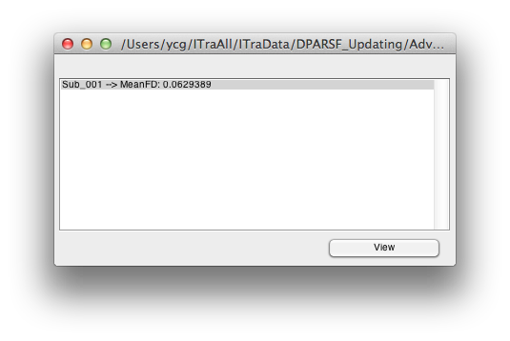
Quality Control
18

Slide 19
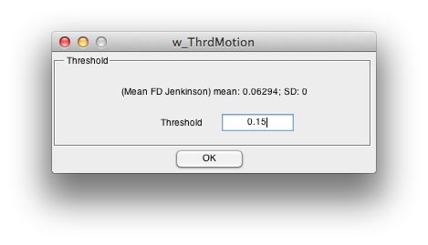
Quality Control
19

Slide 20
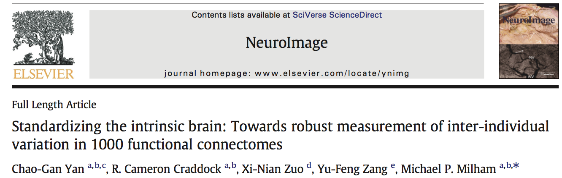
Quality Control
Using the visual inspection step within DPARSF, subjects showing severe head motion in the T1 image and subjects showing extremely poor coverage in the functional images, as well as subjects showing bad registration were excluded
Subjects with overlap with the group mask (voxels present at least 90% of the participants) less than 2*SD under the group mean overlap (threshold: 92.2%) were excluded
Subjects with motion (Mean FD Jenkinson greater than 2*SD above the group mean motion (threshold: 0.192) were excluded
Yan et al., 2013, Neuroimage
20

Slide 21
Outline
Quality Control
Statistical Analysis
Results Viewing
21

Slide 22


Slide 23
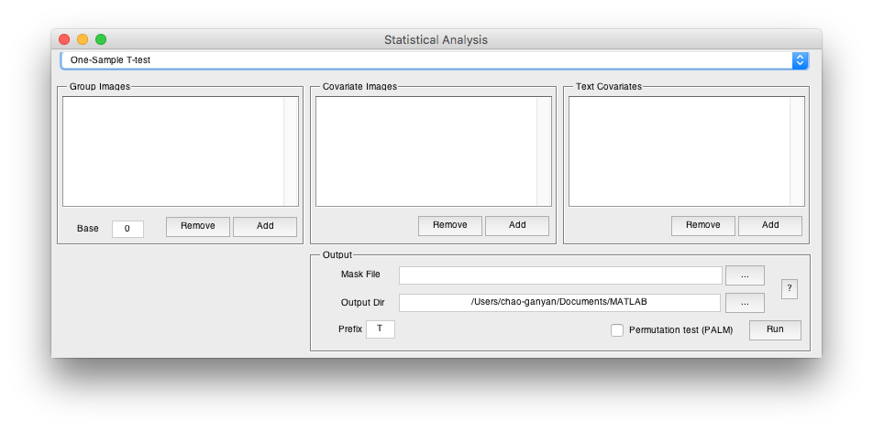
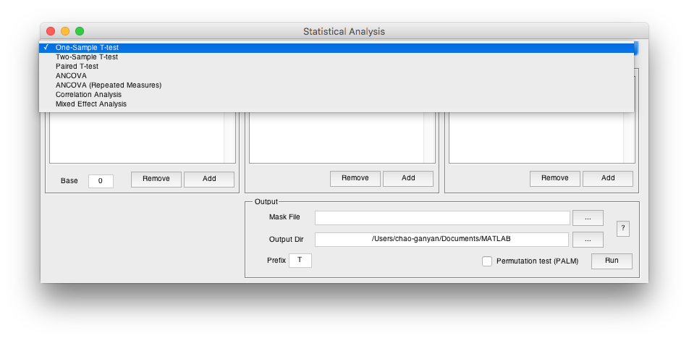
Statistical Analysis
23

Slide 24
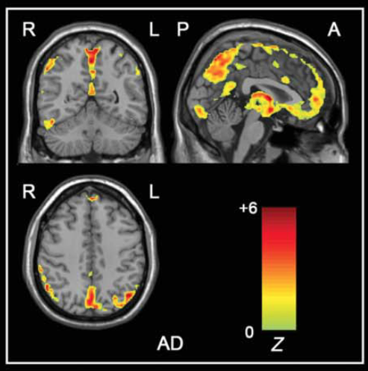
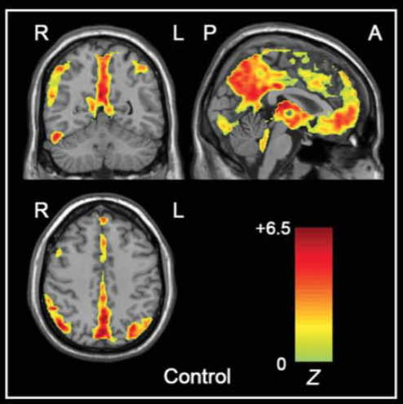
One-Sample T-Test
Wang#, Yan# et al., 2011, Hum Brain Mapp

Slide 25
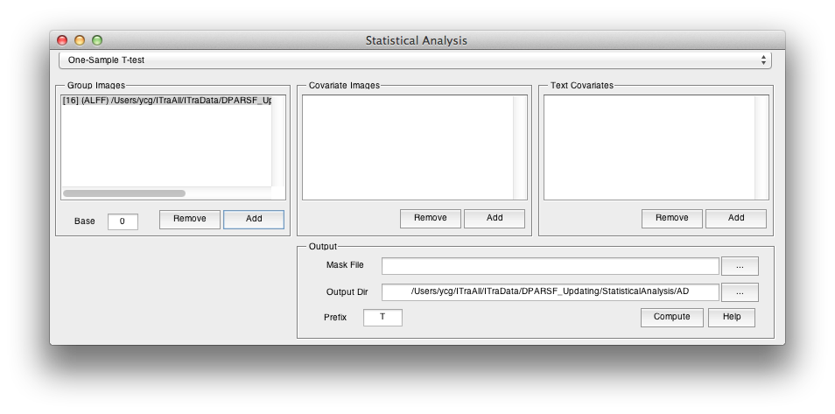
One-Sample T-Test
0 for z* images
1 for m* images
T Statistic Image
Group Mask

Slide 26
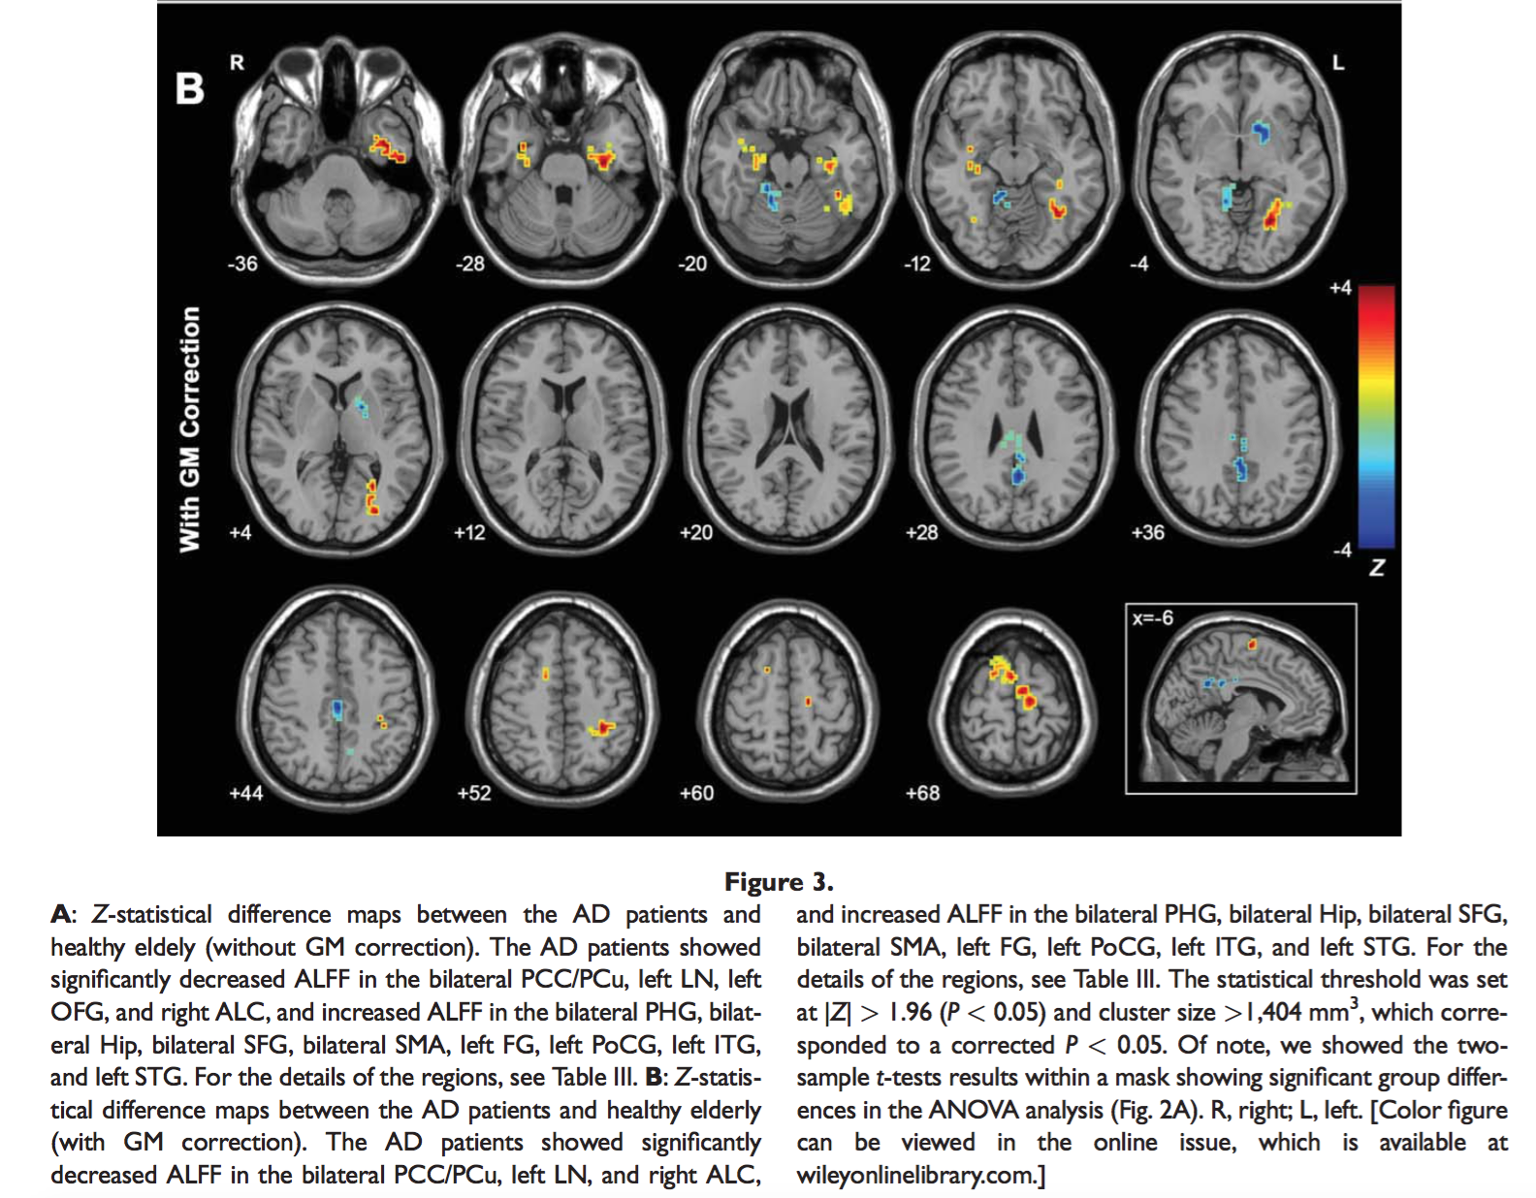
Two-Sample T-Test
Wang#, Yan# et al., 2011, Hum Brain Mapp

Slide 27
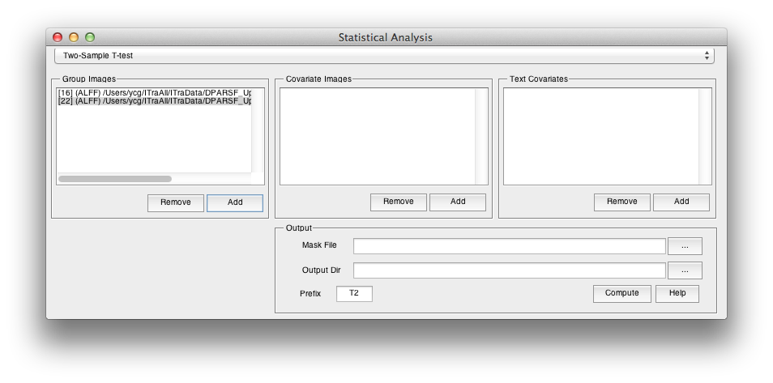
Two-Sample T-Test
T Statistic Image: positive corresponds to the mean of Group 1 is greater than the mean of Group 2

Slide 28
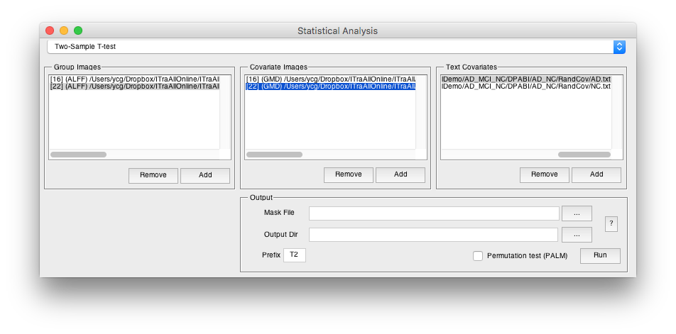

Two-Sample T-Test
Two-Sample T-Test with covariates: e.g. gray matter proportion images (Oakes et al., 2007, Neuroimage)
Please make sure the correspondence between the group images and the covariate images: order and voxel size
Other covariate can be also specified as text files. (E.g. head motion (mean FD), age, sex etc.)

Slide 29
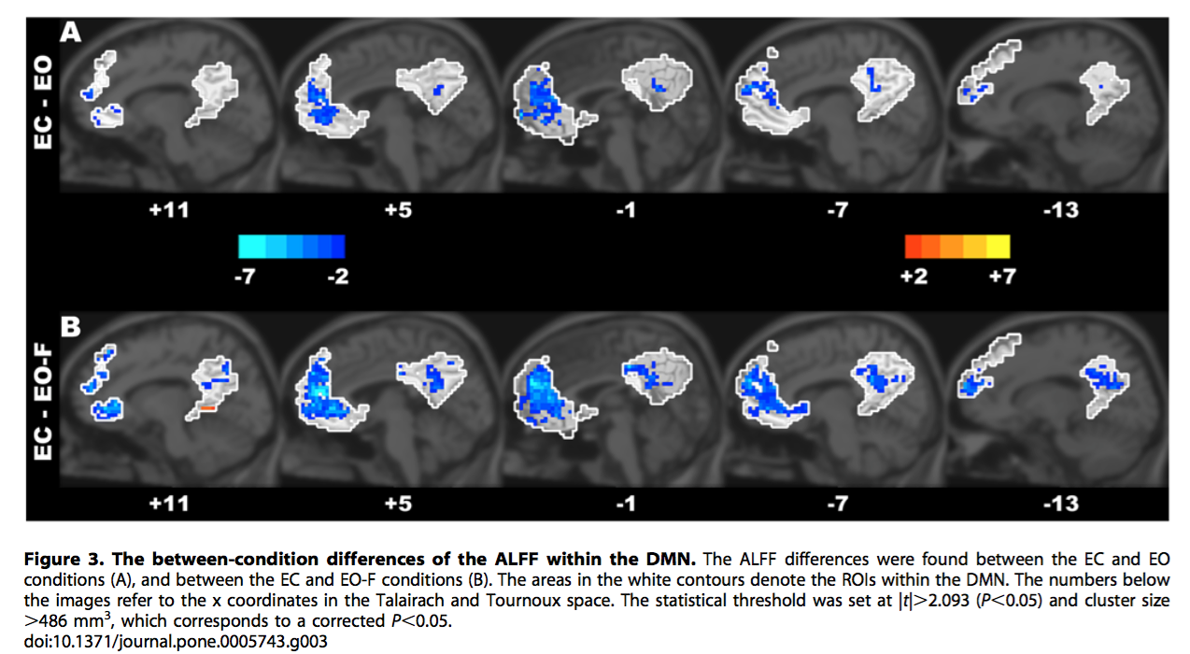
Paired T-Test
Yan et al., 2009. PLoS ONE

Slide 30

Paired T-Test
T Statistic Image
Condition 1 – Condition 2
Please make sure the correspondence

Slide 31
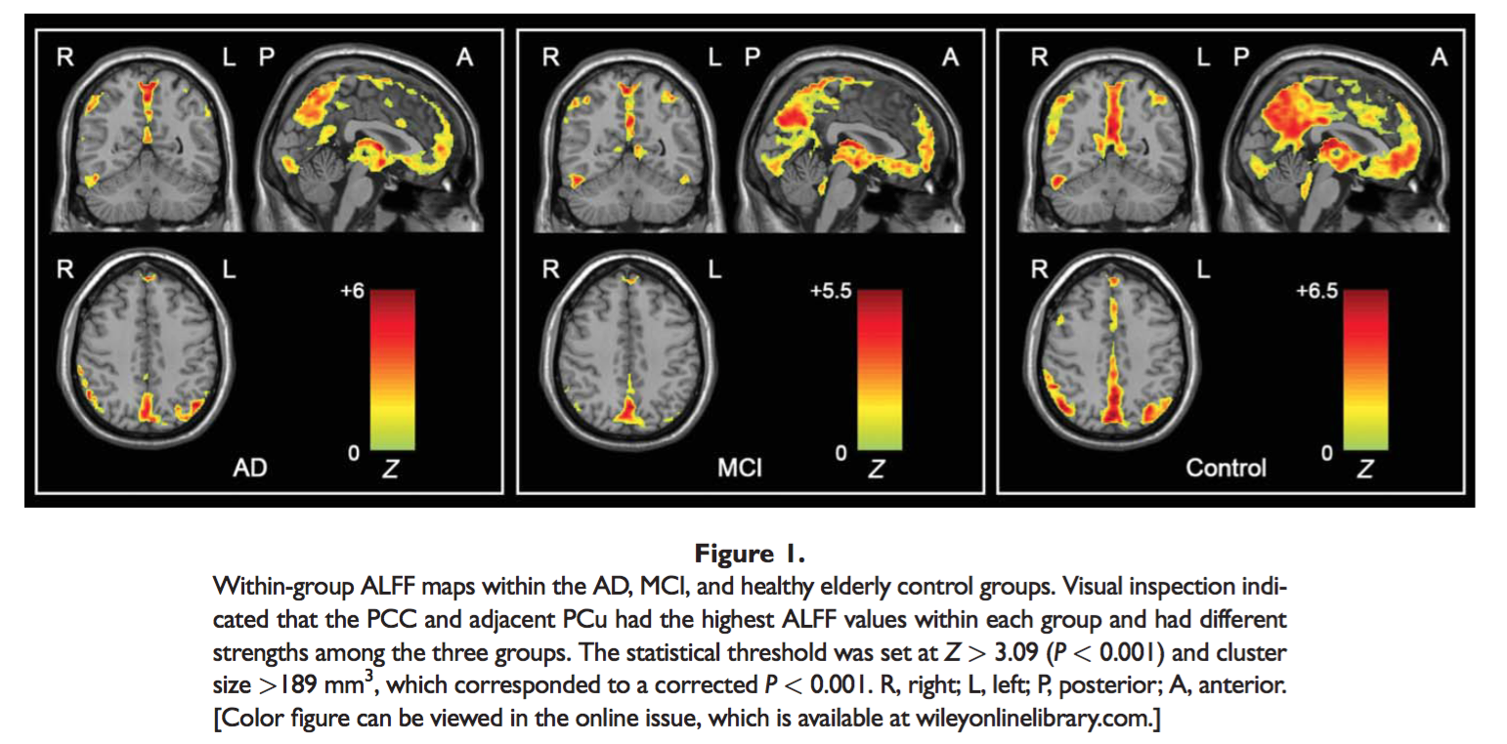
ANOVA or ANCOVA
Wang#, Yan# et al., 2011, Hum Brain Mapp

Slide 32
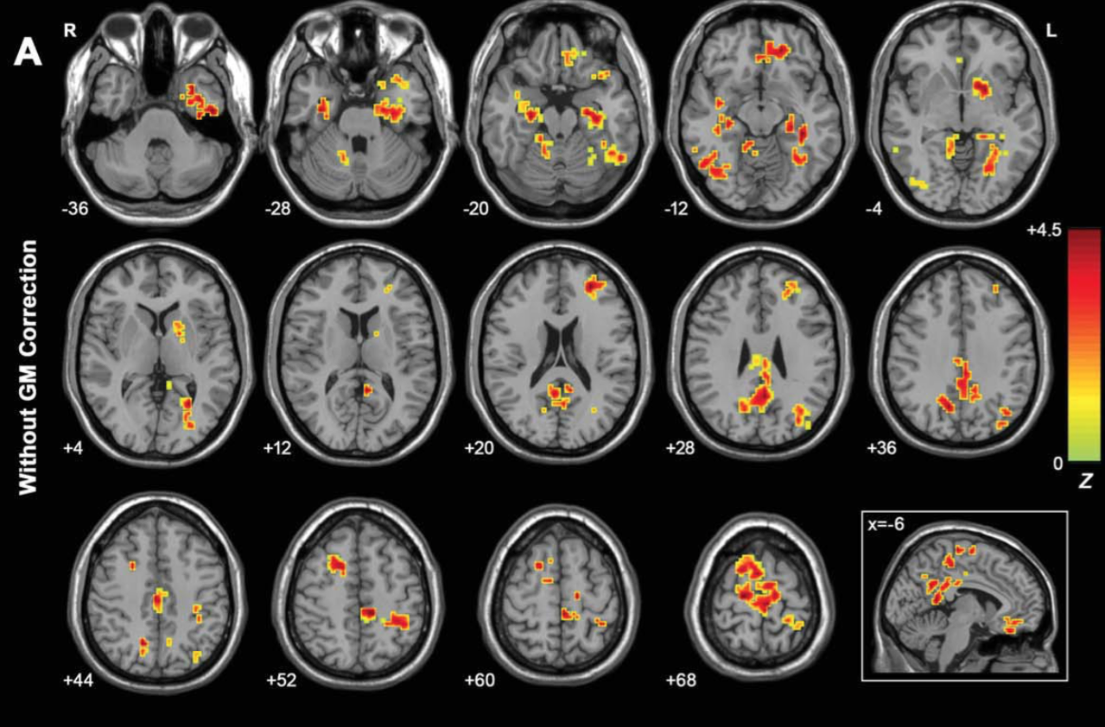
ANOVA or ANCOVA
Wang#, Yan# et al., 2011, Hum Brain Mapp

Slide 33
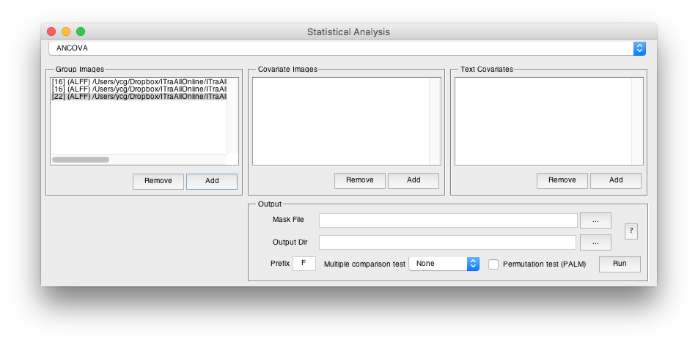
ANOVA or ANCOVA
ANCOVA: e.g. gray matter proportion images (Oakes et al., 2007, Neuroimage)
F Statistic Image
Please make sure the correspondence between the group images and the covariate images: order and voxel size
Other covariate can be also specified as text files. (E.g. age, brain size, IQ etc.)

Slide 34
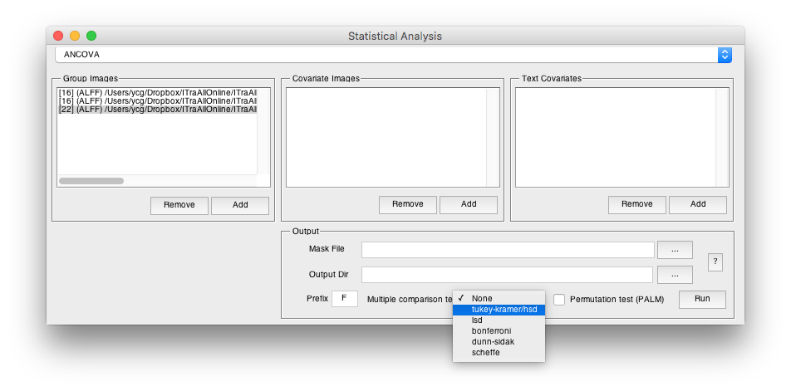
ANOVA or ANCOVA
Post-hoc procedures: the corrected p values under a given control procedure for comparing group means of any pairs were calculated (e.g., through Studentized Range statistic for Tukey-Kramer correction) with the same route as MATLAB command multcompare. The p maps were then converted to Z maps according to the Normal inverse cumulative distribution function (norminv), with the sign of group mean differences applied.

Slide 35
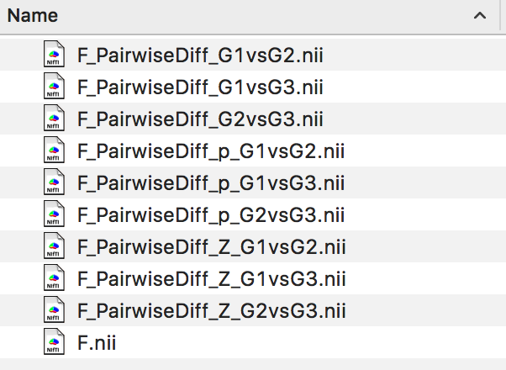
ANOVA or ANCOVA
ANOVA F image
The difference of mean between groups
The corrected p of difference between groups
The corrected Z values of difference between groups, can be forwarded to further multiple comparison correction
Yan et al., 2016. Neuroinformatics

Slide 36
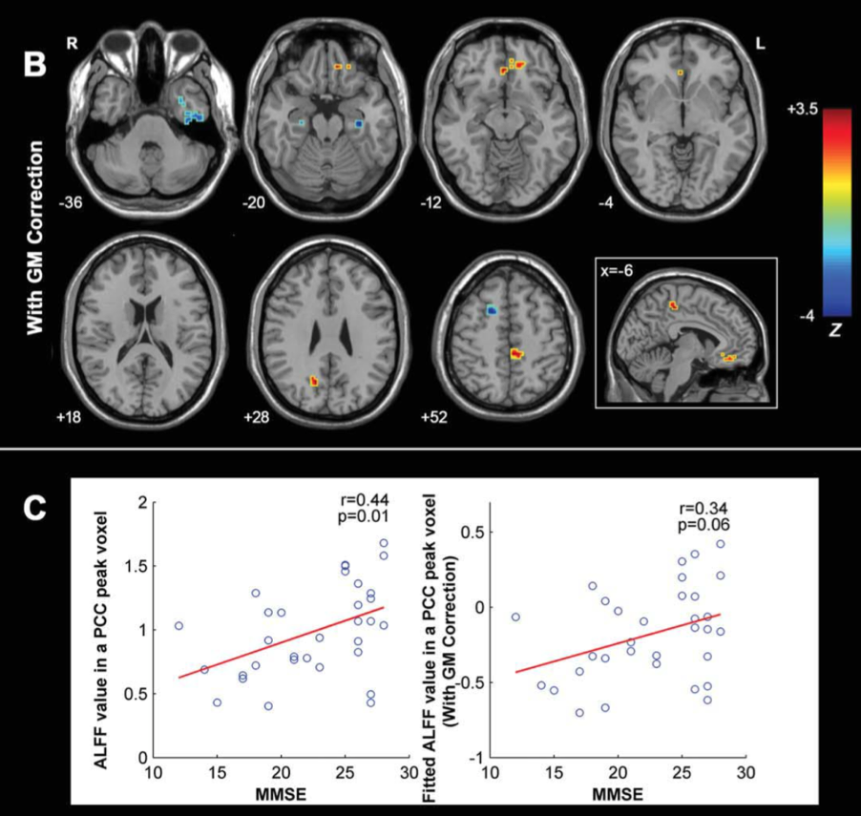
Correlation Analysis
Wang#, Yan# et al., 2011, Hum Brain Mapp

Slide 37
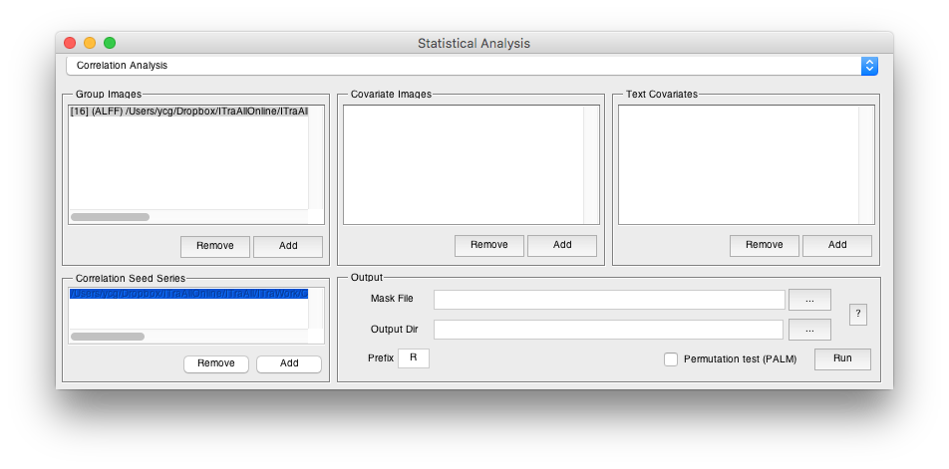
Correlation Analysis
Traits: e.g.
MMSE.txt
19
15
…
The imaging measure:
ALFF maps

Slide 38
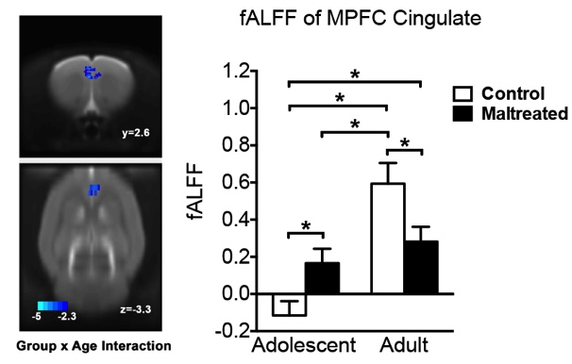
Mixed Effect Analysis
Yan et al., 2016. Translational Psychiatry

Slide 39
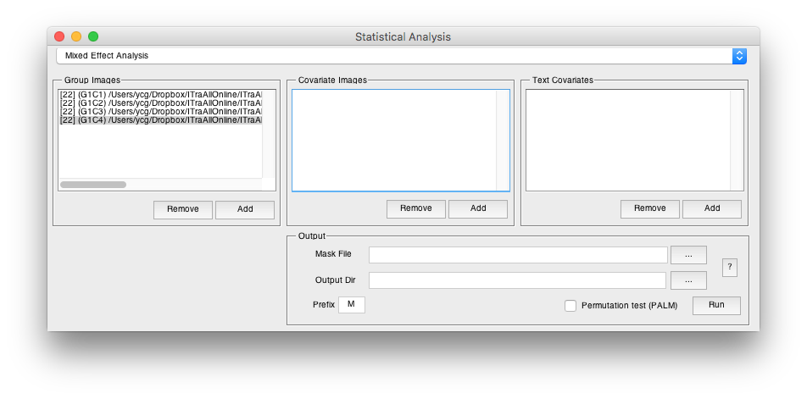
Mixed Effect Analysis
The imaging measure should be: Group1Condition1 Group1Condition2 Group2Condition1 Group2Condition2

Slide 40
Mixed Effect Analysis
*_ConditionEffect_T.nii - the T values of condition differences (corresponding to the first condition minus the second condition) (WithinSubjectFactor)
*_Interaction_F.nii - the F values of interaction (BetweenSubjectFactor by WithinSubjectFactor)
*_Group_TwoT.nii - the T values of group differences (corresponding to the first group minus the second group). Of note: the two conditions will be averaged first for each subject. (BetweenSubjectFactor)

Slide 41
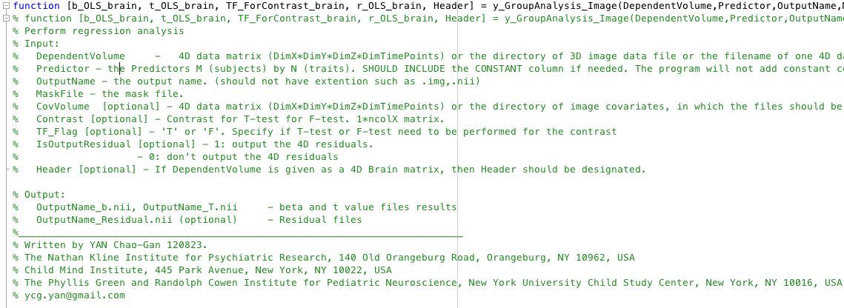
Statistical Analysis
{DPABI_Dir}/StatisticalAnalysis/y_GroupAnalysis_Image.m
41

Slide 42

Attention!!!
42

Slide 43
Statistical Analysis
{DPABI_Dir}/StatisticalAnalysis/y_GroupAnalysis_Image.m
Smoothness estimation based on the 4D residual is built in this function!!!
43

Slide 44
Statistical Analysis
http://rfmri.org/DemoData
{Download}/ProcessingDemoData/StatisticalDemo/AD_MCI_NC/
ALFF: AD – NC Two Sample T Test:
Applied smooth kernel in preprocessing: [4 4 4]
Smooth kernel estimated on 4D residual: [6.77 6.88 6.71]
Smooth kernel estimated on statistical image (T to Z, as in easythresh): [6.90 7.33 6.94]
ReHo: AD – NC Two Sample T Test:
Applied smooth kernel in preprocessing: [4 4 4]
Smooth kernel estimated on 4D residual: [8.10 8.50 7.93]
Smooth kernel estimated on statistical image (T to Z, as in easythresh): [8.33 8.94 8.24]
Thus, only using smooth kernel applied in preprocessing is NOT sufficient!!!
44

Slide 45
Statistical Analysis
45

Slide 46
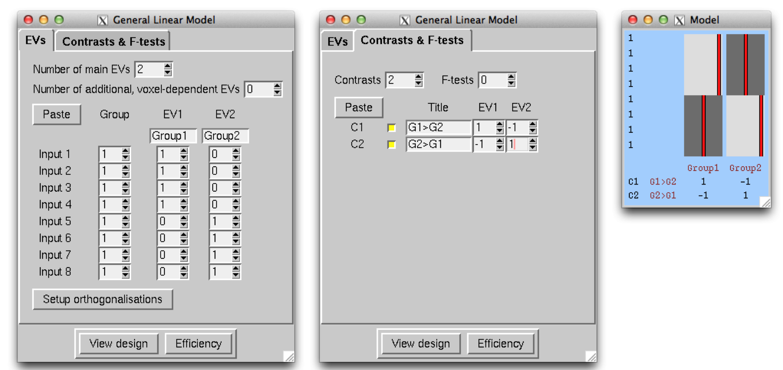
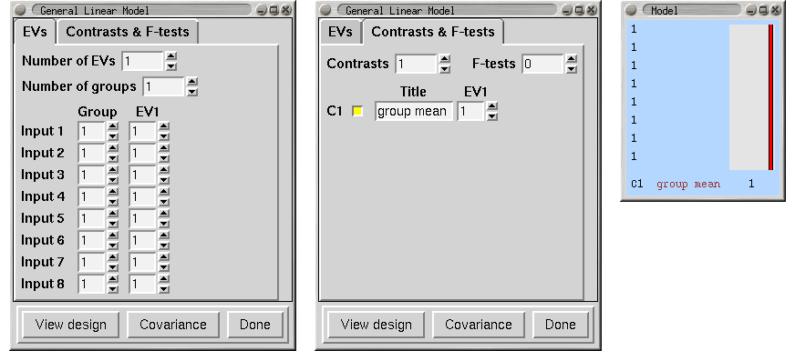
Statistical Analysis
http://fsl.fmrib.ox.ac.uk/fsl/fslwiki/GLM
46

Slide 47
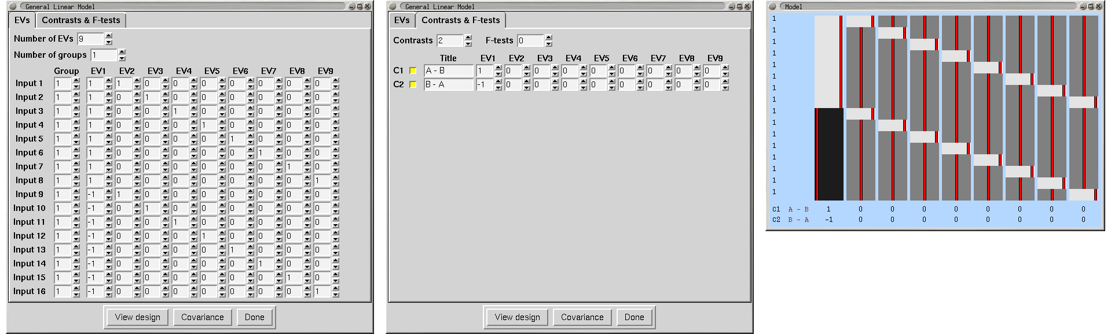
Statistical Analysis
http://fsl.fmrib.ox.ac.uk/fsl/fslwiki/GLM
47

Slide 48
Multiple Comparison Correction
48

Slide 49

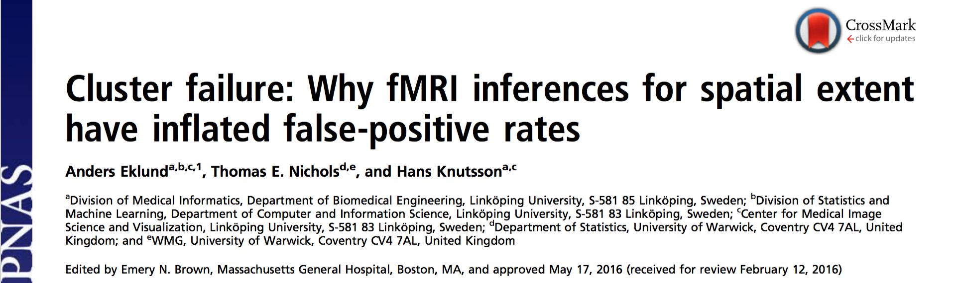
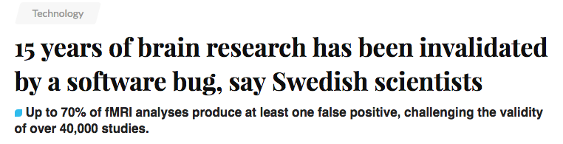
Multiple Comparison Correction
Eklund et al., 2016. PNAS
49
Notes:
Two Subjects
C: Scrubbed - unscrubbed

Slide 50
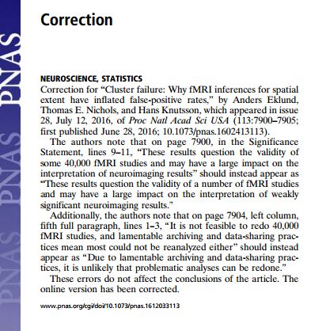
Multiple Comparison Correction
July 12, 2016
… I estimate about 15,000 papers use cluster size inference with correction for multiple testing; of these, around 3,500 use a CDT of P=0.01…So, are we saying 3,500 papers are “wrong”? It depends….
-- Thomas Nichols
July 06, 2016
50

Slide 51
Multiple Comparisons
P=0.05
Probability of not getting a false positive result:
1 - 0.05 = 0.95
P=0.05
Probability of not getting a false positive result:
1 - 0.05 = 0.95
P=0.05
Probability of not getting a false positive result:
1 - 0.05 = 0.95
P=0.05
Probability of not getting a false positive result:
1 - 0.05 = 0.95
P=0.05
Probability of not getting a false positive result:
1 - 0.05 = 0.95
0.95 0.95 0.95 0.95 0.95
0.95⁵=0.774

Slide 52
  Bonferroni correction: p=0.05/5=0.01
0.01 0.01 0.01 0.01 0.01

Slide 53
Multiple Comparisons
False Discovery Rates (FDR) correction
Family-Wise Error (FWE) correction
  Bonferroni correction: 0.05/5=0.01
  Gaussian Random Field theory correction
  Monte Carlo simulations (AlphaSim)
  Threshold-Free Cluster Enhancement
  Permutation test

Slide 54

FDR Theory
False discovery rate Q_{e}=E(V/(V+S))=E(V/R)
Benjamini and Hochberg, 1995, Journal of the Royal Statistical Society
54
Notes:
54

Slide 55
FDR Theory
Let H₁, …, H_{m} be the null hypotheses and P₁, …, P_{m} their corresponding p-values. Order these values in increasing order and denote them by P₍₁₎, …, P_{(m)}. For a given q, find the largest k such that P_{(k)} ≦ kq/m.
Then reject (i.e. declare positive) all H_{(i)} for i = 1, …, k.
55
Notes:
55

Slide 56

FDR in REST
56
Notes:
56

Slide 57

FDR
57
Notes:
57

Slide 58
Multiple Comparisons
Gaussian Random Field Theory Correction
Monte Carlo simulations (AlphaSim)
?

Slide 59


59

Slide 60

Voxel Z > 2.3, Cluster P < 0.05, Two One-Tailed Corrections:
equivalent to
Voxel P < 0.0214, Cluster P < 0.1, Two Tailed.

Slide 61


Slide 62
Cl Size Frequency Cum Prop p/Voxel Max Freq Alpha
1 235971 0.619898 0.009613 0 1.000000
2 76150 0.819945 0.006282 0 1.000000
3 32297 0.904789 0.004131 0 1.000000
4 15940 0.946664 0.002763 0 1.000000
5 8476 0.968930 0.001863 0 1.000000
6 4786 0.981503 0.001265 1 1.000000
7 2767 0.988772 0.000860 19 0.999000
8 1606 0.992991 0.000586 51 0.980000
9 1011 0.995647 0.000405 127 0.929000
10 585 0.997184 0.000276 132 0.802000
11 391 0.998211 0.000194 172 0.670000
12 236 0.998831 0.000133 146 0.498000
13 164 0.999262 0.000093 107 0.352000
14 98 0.999519 0.000063 78 0.245000
15 69 0.999701 0.000043 61 0.167000
16 37 0.999798 0.000029 30 0.106000
17 22 0.999856 0.000020 22 0.076000
18 22 0.999913 0.000015 21 0.054000
19 11 0.999942 0.000010 11 0.033000
20 7 0.999961 0.000007 7 0.022000
21 5 0.999974 0.000005 5 0.015000
22 5 0.999987 0.000003 5 0.010000
23 4 0.999997 0.000002 4 0.005000
24 1 1.000000 0.000000 1 0.001000

Slide 63

Threshold-Free Cluster Enhancement (TFCE)
Smith et al., 2009. Neuroimage
63
Notes:
Two Subjects
C: Scrubbed - unscrubbed

Slide 64

Permutation Test
Winkler et al., 2016. Neuroimage
64
Notes:
Two Subjects
C: Scrubbed - unscrubbed

Slide 65
Multiple Comparison Correction
Eklund et al., 2016. PNAS
65
Notes:
Two Subjects
C: Scrubbed - unscrubbed

Slide 66


Eklund et al., 2016. PNAS
66
Notes:
Two Subjects
C: Scrubbed - unscrubbed

Slide 67


Cox et al., 2016. bioRxiv
67
Notes:
Two Subjects
C: Scrubbed - unscrubbed

Slide 68


Cox et al., 2016. bioRxiv
68
Notes:
Two Subjects
C: Scrubbed - unscrubbed

Slide 69

Cox et al., 2016. bioRxiv
69
Notes:
Two Subjects
C: Scrubbed - unscrubbed

Slide 70

Permutation Test
70

Slide 71

Permutation Test
Based on PALM: Winkler, A.M., Ridgway, G.R., Douaud, G., Nichols, T.E., Smith, S.M., 2016. Faster permutation inference in brain imaging. Neuroimage 141, 502-516.
71

Slide 72

Permutation Test
Based on PALM: Winkler, A.M., Ridgway, G.R., Douaud, G., Nichols, T.E., Smith, S.M., 2016. Faster permutation inference in brain imaging. Neuroimage 141, 502-516.
72

Slide 73

Permutation Test
Based on PALM: Winkler, A.M., Ridgway, G.R., Douaud, G., Nichols, T.E., Smith, S.M., 2016. Faster permutation inference in brain imaging. Neuroimage 141, 502-516.
73

Slide 74
Permutation Test
_vox_tstat.nii is the T value of a voxel.
_vox_tstat_uncp.nii is the p value corresponds to the rank of the observed T value within the permutations FOR A GIVEN VOXEL (the null distribution is the permuted T values of that given voxel). Computing the rank is one of the ways in which the p-value can be obtained (it's then divided by the number of permutations).
_vox_tstat_fwep.nii is the p value corresponds to the rank of the observed T value within the permutations of maximum T values across all the voxels (the null distribution is composed by the maximum T value across all the voxels for each permutation). For the corrected, the distribution of the maximum is used as reference, and the rank (or quantile) of a given voxel in relation to that distribution is used to obtain p-values.
_clustere_tstat.nii is simply the size (in voxels) of the cluster. This number acts as the test statistic.
_clustere_tstat_fwep.nii: p-values computed in the same way as 3, i.e., using the distribution of the maximum cluster size.
The TFCE maps are similar to Points 1, 2 and 3.
74

Slide 75

Permutation Test
75

Slide 76

Permutation Test
76

Slide 77

Permutation Test
77

Slide 78

Family wise Error Rate
Chen, Lu, Yan*, in prep.
20 vs. 20 Permutation 1000 times
78
Notes:
Two Subjects
C: Scrubbed - unscrubbed

Slide 79
Outline
Quality Control
Statistical Analysis
Results Viewing
79

Slide 81


Slide 82

82

Slide 83


Slide 84

84

Slide 85


Slide 86
86

Slide 87
Voxel Z > 2.3, Cluster P < 0.05, Two One-Tailed Corrections:
equivalent to
Voxel P < 0.0214, Cluster P < 0.1, Two Tailed.

Slide 88


Slide 89



Slide 90

90

Slide 91

91

Slide 92
92

Slide 93

93

Slide 94

94

Slide 95

95

Slide 96




96

Slide 97

97

Slide 98
98

Slide 99

99

Slide 100

Permutation Test
100

Slide 101

101

Slide 102

102

Slide 103

Further Help
Further questions:
http://rfmri.org/dpabi
The R-fMRI Network
103

Slide 104
Acknowledgments
Chinese Academy of Sciences Xi-Nian Zuo
NYU Child Study Center
F. Xavier Castellanos
Hangzhou Normal University Yu-Feng Zang
Child Mind Institute
Michael P. Milham
Beijing Normal University
Yong He
Xin-Di Wang
Funding
National Natural Science Foundation of China
Chinese Academy of Sciences
Notes:
Different Axis!!!

Slide 105
Thanks for your attention!
105

